Slide 1
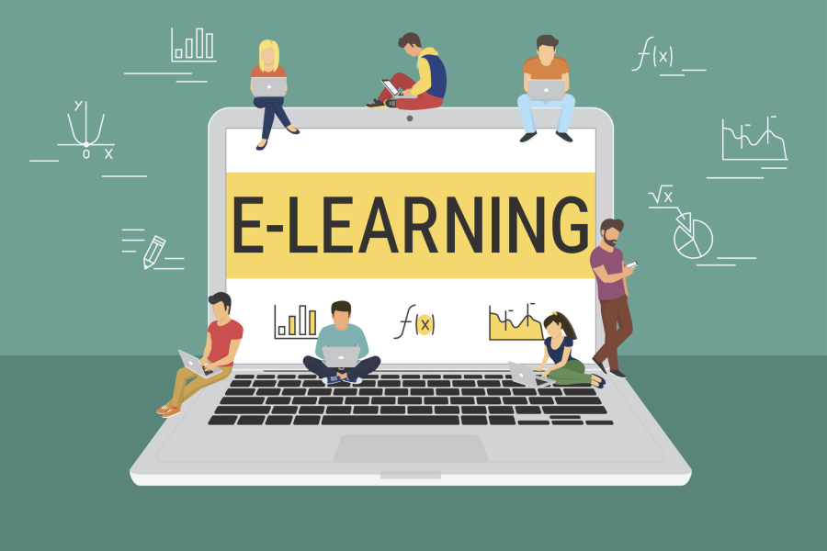
E-learning
Done by: Jessica Azrai
Done by : Jessica Azrai

Slide 2
Introducing E-learning
E-learning also known as “ digital learning or online learning”, is taking a huge part in our life ; in both educational and business parts. Especially after the lockdown, all the schools around the globe turned their learning system to digital learning , so we conclude that reliance has mostly become on E-learning.

Slide 3
What is E-learning?
E-learning is a type of learning conducted digitally via electronic media, typically involving the internet .It can be accessed via most electronic devices such as computers, laptops, tablets or Smart phones, making it an easy way for students to learn wherever they are.

Slide 4
What does the “E” in the word E-learning stand for?
The “E” in E-learning stands for “Electronic”; the original term is “ electronic learning”. The word (“ electronic/online”) in this context, means with an Internet connection. The term may also refer to a network that can provide knowledge and skills to one or more individuals.

Slide 5
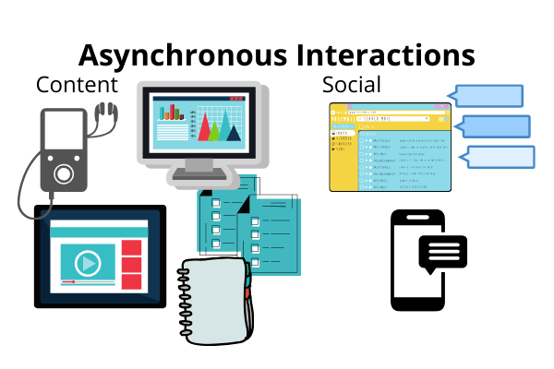
Types of E-learning
Asynchronous Online Learning:
- Asynchronous online learning includes groups of students that study independently at different times and locations without real-time communication taking place. Asynchronous e-learning methods are often considered to give students more flexibility.
Fixed E-Learning:
- Fixed e-learning is a fancy name for something you are likely already familiar with. “Fixed” in this context means that the content used during the learning process does not change from its original state and all the participating students receive the same information as all the others.

Slide 6
Adaptive E-Learning:
Adaptive e-learning is a new and innovative type of e-learning, making it possible to adapt and redesign learning materials for each learner. Taking several parameters such as student performance, goals and abilities into consideration, adaptive e-learning tools allow education to become more individualized and student-centered than ever before.
Individual Online Learning:
- Individual learning in this context refers to the number of students participating in achieving the learning goals rather than the student-centeredness of the material. When practicing individual learning, students study the learning materials on their own, and are expected to meet their learning goals on their own.

Slide 7
Advantages of E-learning
Reduced Cost:
One of the biggest benefits of e-learning is it’s cost effectiveness. The price reduction is the result of educational institutions saving a lot of money on transportation and accommodation of both students and teachers.
Transfer Credits & Commuting:
- By online education ,students gain the freedom to manage their time without interrupting the progress. The special thing is that working college students, can take online courses and transfer the credits to their primary educational institution. This makes life a lot easier for those who need to maintain their jobs in order to pay for their learning .Not to mention how it could come in handy during harsh weather conditions.

Slide 8
Quick Delivery:
Online lessons have a quick start and go straight to the topic, usually wrapping it up in that same learning session. This enables E-learning training’s to roll out within couple of weeks or even days. Also Students are advancing at their own speed, without the need to accommodate to others.
E-learning Offers Personalization:
- Because of the difference between students, online learning offers various learning styles to allow students to better adapt to their desired classes. Learning online makes it possible to cater to each student’s unique preferences and goals. It allows them to navigate their pace while choosing a path for themselves

Slide 9
Disadvantages of E-learning
Online Learning Requires Additional Training for Instructors:
- Online classes imply an initial learning curve and extra effort on the teacher’s behalf to create a successful online course. Instructors need to get a deep understanding of the different approaches to teaching and learning to avoid just replicating the physical class environment and miss out on all the added advantages and tools that eLearning and blended learning have to offer.
Health issues:
- Excessive screen-time can lead to all sorts of physical ailments like poor posture or headaches. But it can also be a personal issue to students who struggle with learning from or focusing on screens.

Slide 10
Online Classes Are Prone to Technical Issues:
The classic disadvantages of online learning center around technical problems. Nothing disrupts an online lesson more than audio, video, or connection issues. Many times in the past, students were required to download and/or install cumbersome apps or technology that would deliver inconsistent performances.
Online Learning Requires Self-Discipline:
- If a student does not feel they are getting the proper guidance, they may not have enough self-discipline to fully engage in the lessons themselves. Moving to virtual, real-time classes instead of just online courses gives a greater sense of accountability.

Slide 11
THANK YOU

