Slide 1
Assistive Technology
Sulaf Al-Ayyoub 8F

Slide 2
The Issue-
Many students face the challenge of learning with their disabilities, however new technology came in the way to serve convenience for them and help them gain their rights to education.

Slide 3
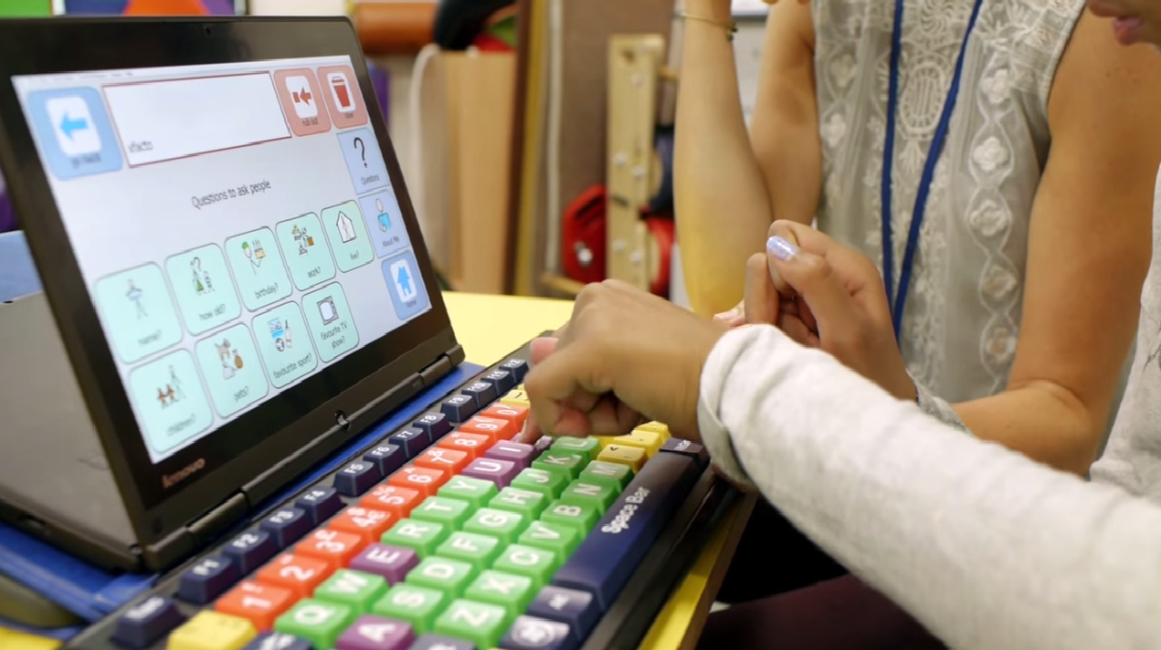
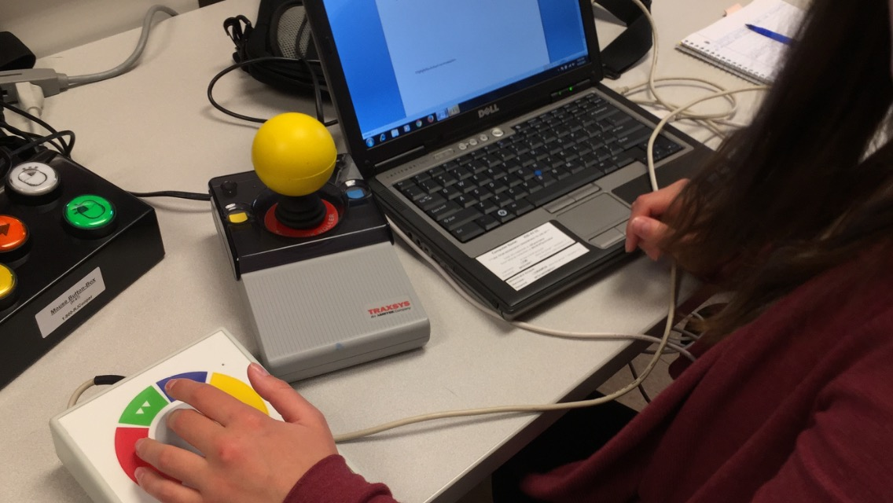
What is assistive technology?
It is a special type of technology to help the students learn and overcome their issue using the device dedicated to their disability for a better experience and more accomplishing.

Slide 4
Advantages of assistive technology-
The students have an easier access to education.
Assistive Technology can also help in matters outside of education
The students can accomplish more

Slide 5
Disadvantages-
Can be expensive
Not all people have access to it
Needs training to get used to them

Slide 6
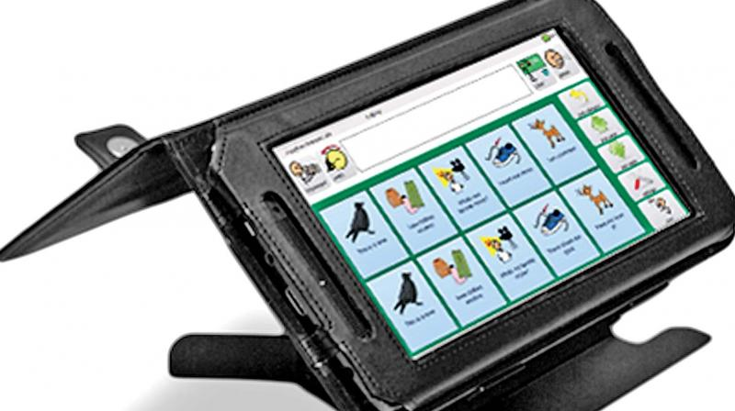
Examples of assistive technology-
Hearing aids
Voice recognition and screen readers
Reading pens
Braille keyboards
Communication device

Slide 7
Admin (2021) Pros and cons of assistive technology, Pros an Cons. Available at: https://prosancons.com/technology/pros-and-cons-of-assistive-technology/ (Accessed: February 8, 2023).
What are some types of assistive devices and how are they used? (no date) Eunice Kennedy Shriver National Institute of Child Health and Human Development. U.S. Department of Health and Human Services. Available at: https://www.nichd.nih.gov/health/topics/rehabtech/conditioninfo/device#:~:text=Some%20examples%20of%20assistive%20technologies%20are%3A%20Mobility%20aids%2C,help%20people%20hear%20or%20hear%20more%20clearly.%203 (Accessed: February 8, 2023).
What is assistive technology? (2022) Parent's Guide. Available at: https://uldforparents.com/contents/use-of-assistive-technology/what-is-assistive-technology/ (Accessed: February 8, 2023).

Slide 8
Thank you

