Slide 1
Virtual reality
Sara akkawi 8D

Slide 2
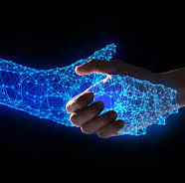
What is the defenition of virtual?
Virual means that something does not physically exsit but uses the help of a software to make it seem real.

Slide 3
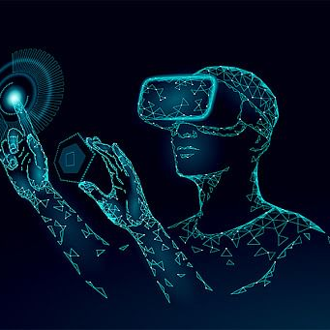
What is virual reality?
VR (virtual reality) is a computer created environment with scenes and objects that appear to be real, making the user feel they are diverted in their surroundings.

Slide 4
What are the advantages of virtual reality?
Virtual Reality generates the real world around us.
It can also transform the way of education
Virtual reality can be used in many industries such as medical, security, military, Weather forecasting, etc.

Slide 5
What are the disadvantages of virual reality?
Some people use virtual reality to play tricks on others by making this appear on their screens.
Virtual reality can also cause motion sickness for many people.
people have reported eyestrain due to the large number of visual stimuli you often experience in virtual reality.

Slide 6
Thank you!!

