Slide 1

E-Learning
Made by : Basel Ebaid 8E

Slide 2
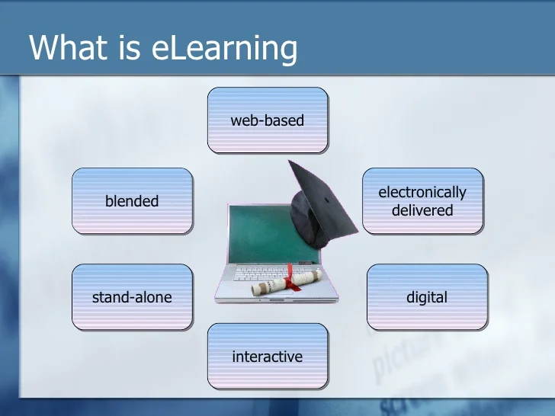
What is E-learning?
E-learning is an organized course or learning experience given electronically. An e-learning program can include a wide range of diverse components, including video, quizzes, simulations, games, activities, and other interactive features.

Slide 3
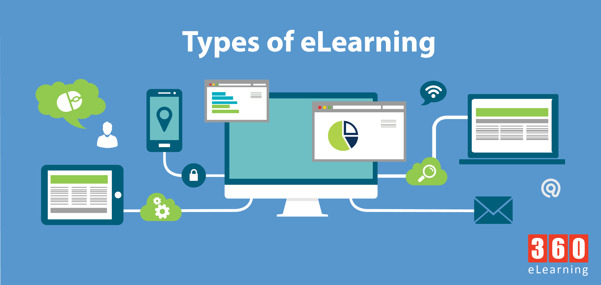
Types of E-Learning:
1. Computer Managed Learning (CML)
2. Computer Assisted Instruction (CAI)
3. Synchronous Online Learning
4. Asynchronous Online Learning
5. Fixed E-Learning
6. Adaptive E-Learning
7. Linear E-Learning
8. Interactive Online Learning
9. Individual Online Learning
10. Collaborative Online Learning

Slide 4
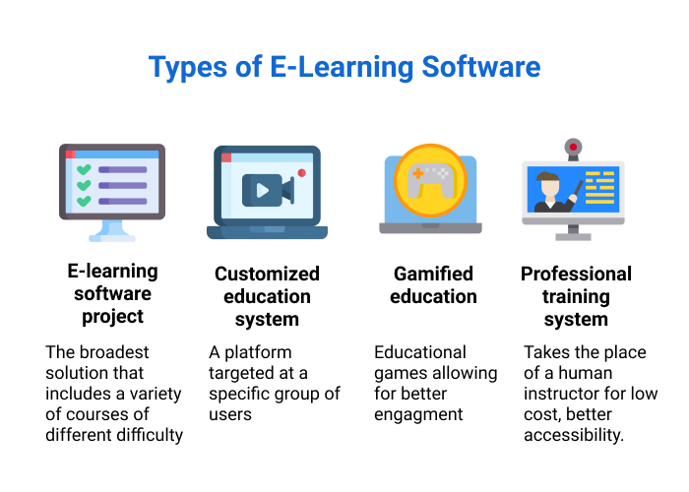

Slide 5
What Is E-Learning Used For?
E-learning for adults
Corporate E-Learning
Online Colleges

Slide 6

E-Learning for Adults:
Adult learners' struggles with continuing their education are frequently addressed via online learning. Through online learning, they are able to advance at their own rate, turn in assignments, and take exams whenever it is most convenient for them. Adult learners particularly benefit from this flexibility because they frequently have to juggle work, home obligations, and online learning.

Slide 7

Corporate E-Learning:
Business e-learning Employers utilize e-learning to increase the employees' knowledge, abilities, and general productivity while reducing the expenditures typically associated with employee training. Among the successful businesses that have previously used e-learning include Toyota, Shell, PayPal, and Lyft.

Slide 8
Online Colleges:
E-learning has the biggest potential applications for educational institutions of all. Online degree programs are already offered by a large number of approved universities, and more are expected to do so in the future. Universities are able to admit a lot more students thanks to e-learning degrees than they otherwise could because of space and staffing issues. Universities can become more global than ever before with e-learning. Educational institutions that can adapt to the norms of online learning will surely see greater profitability due to an increase in the number of admitted students and decreased expenses.

Slide 9
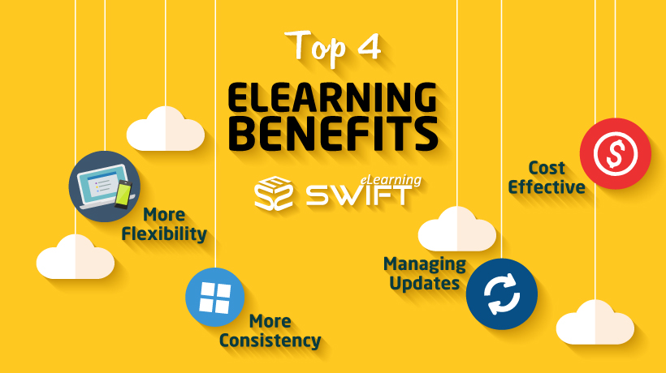
What are the benefits of E-Learning?
1.The various materials can be linked in a variety of formats.
2.It is a very effective method of online course delivery.
3.The materials can be accessed from anywhere and at any time 4.because of their comfort and flexibility.
5.Everyone can benefit from web-based learning, whether they are full- or part-time students.
6.You can train yourself whenever and wherever you want because you have access to the internet constantly.
7.It is a highly practical and adaptable choice, and most of all, you are independent in every way.

Slide 10

What Are The Drawbacks of E-Learning?
1.Most of the online assessments are limited to questions that are only objective in nature.
2.There is also the problem of the extent of security of online learning programs.
3.The authenticity of a particular student's work is also a problem as online just about anyone can do a project rather than the actual student itself.
4.The assessments that are computer marked generally have a tendency of being only knowledge-based and not necessarily practicality-based.

Slide 11
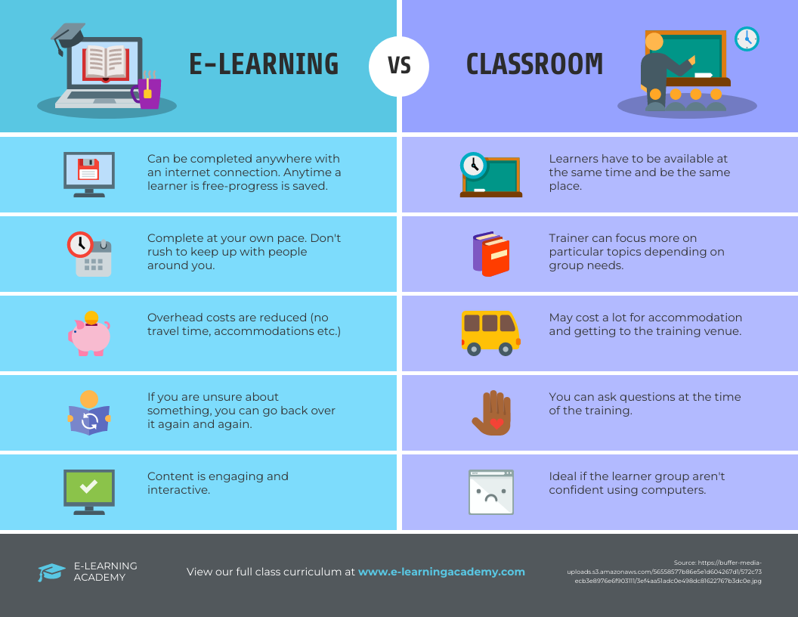

Slide 12


What is online learning going to look like in the future?
The future of online learning will continue to see exponential growth. As more educational institutions, corporations, and online learners worldwide recognize the importance of online learning, its role in education will only continue to rise. Online learning already has numerous uses in education, and its future role in education will most likely be immense.

Slide 13
Resources:
Clover, I. (2023, January 19). Advantages and disadvantages of eLearning. eLearning Industry. Retrieved February 7, 2023, from https://elearningindustry.com/advantages-and-disadvantages-of-elearning
Tamm, S. (2023, January 12). All 10 types of e-learning explained - e-student. E. Retrieved February 7, 2023, from https://e-student.org/types-of-e-learning/
Tamm, S. (2023, January 12). What is the definition of e-learning? - e-student. E. Retrieved February 7, 2023, from https://e-student.org/what-is-e-learning/
What is e-learning?: ATD: ATD. Main. (n.d.). Retrieved February 7, 2023, from https://www.td.org/talent-development-glossary-terms/what-is-e-learning

Slide 14

Thanks for listening!

