Slide 1
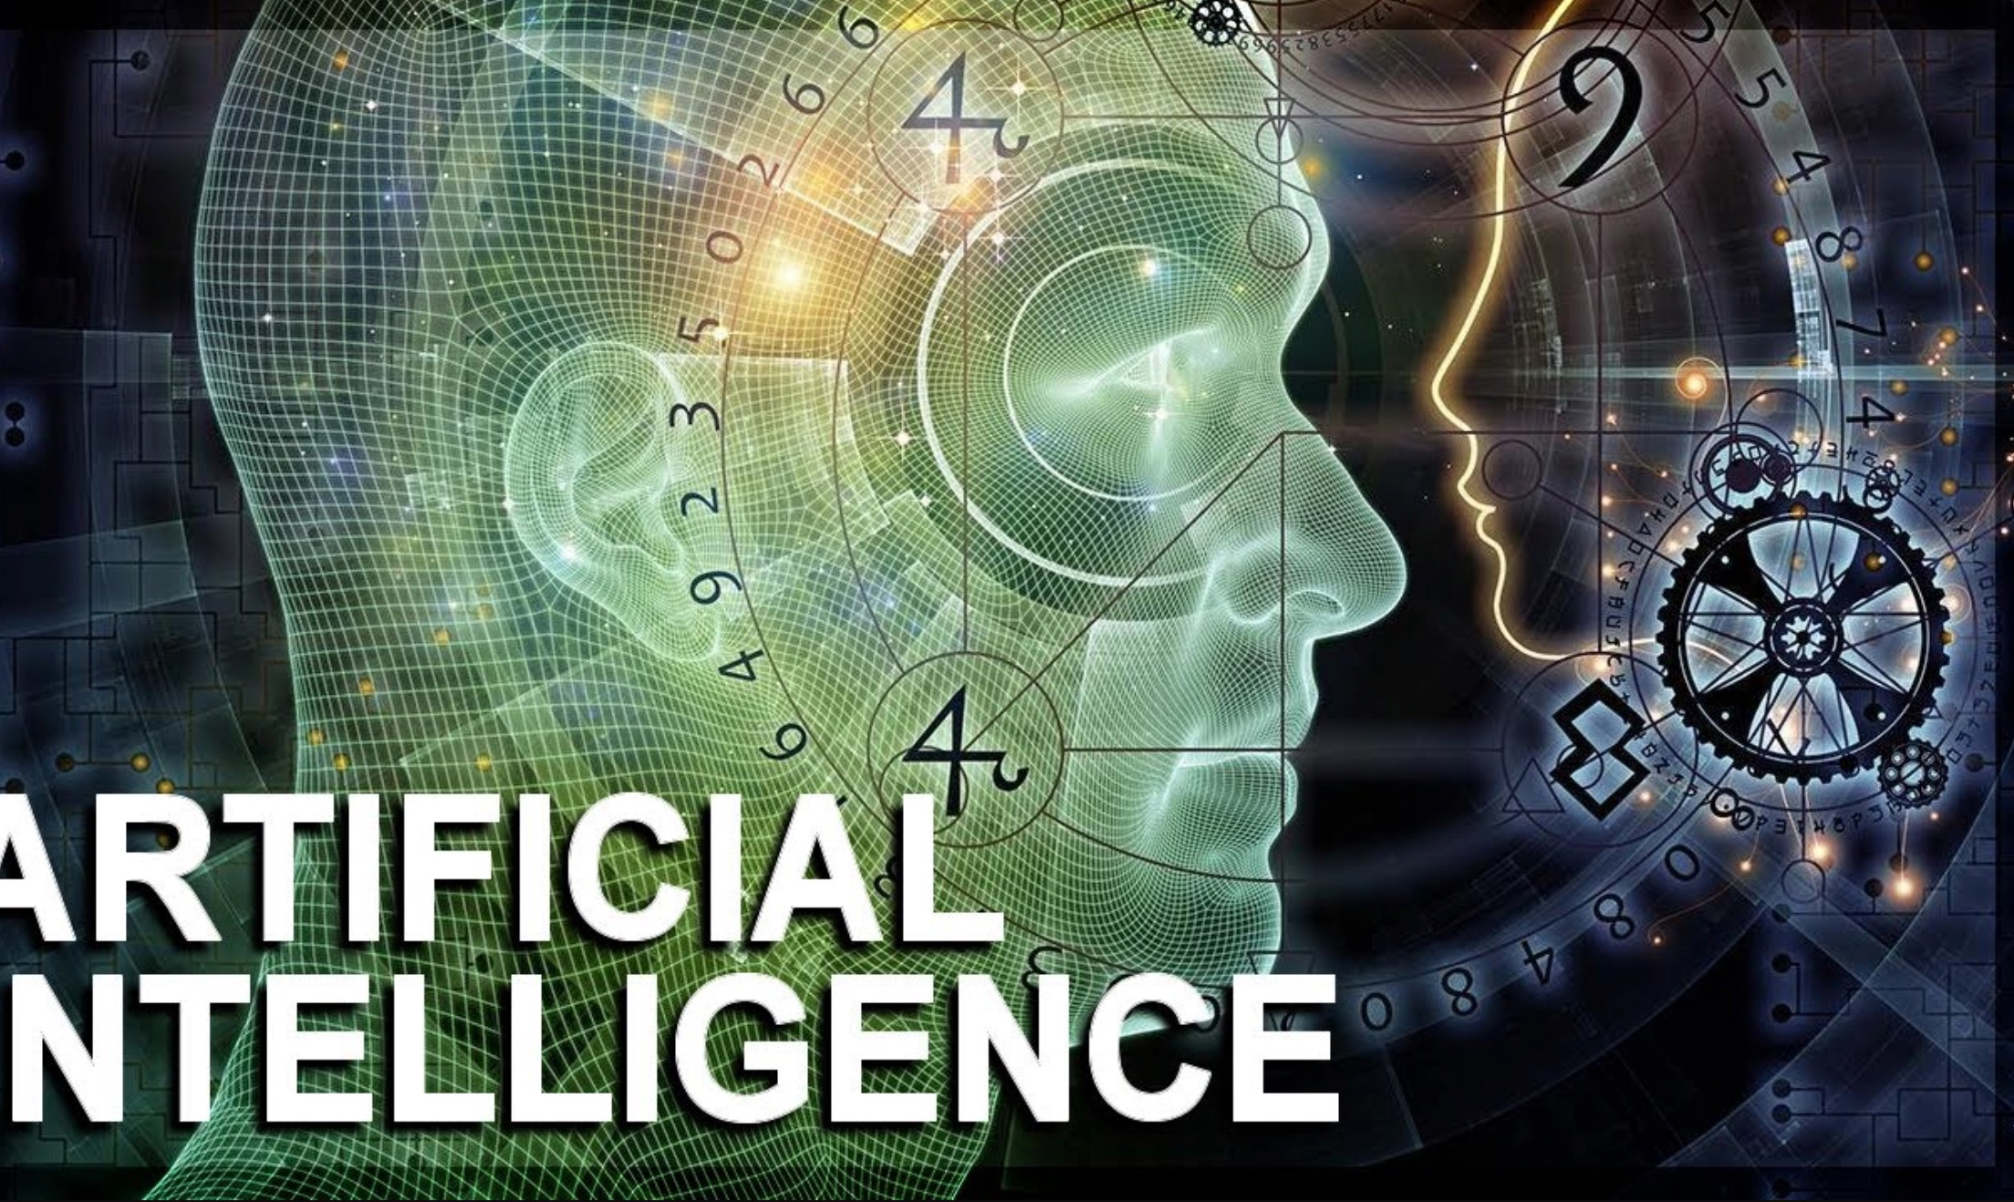
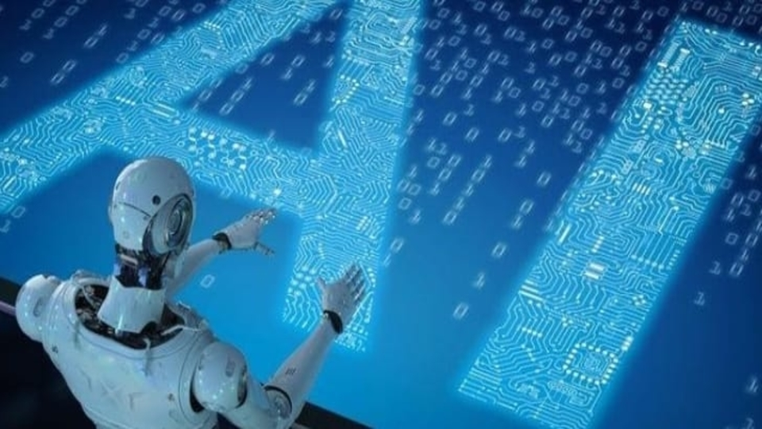
Artificial intelligence
Done by: Omar Goussous

Slide 2
Chapters
Please select a chapter to continue:
What it is
How it works
Advantages
Disadvantages
How it affects our lives
How it will change our lives in the future
Resources

Slide 3
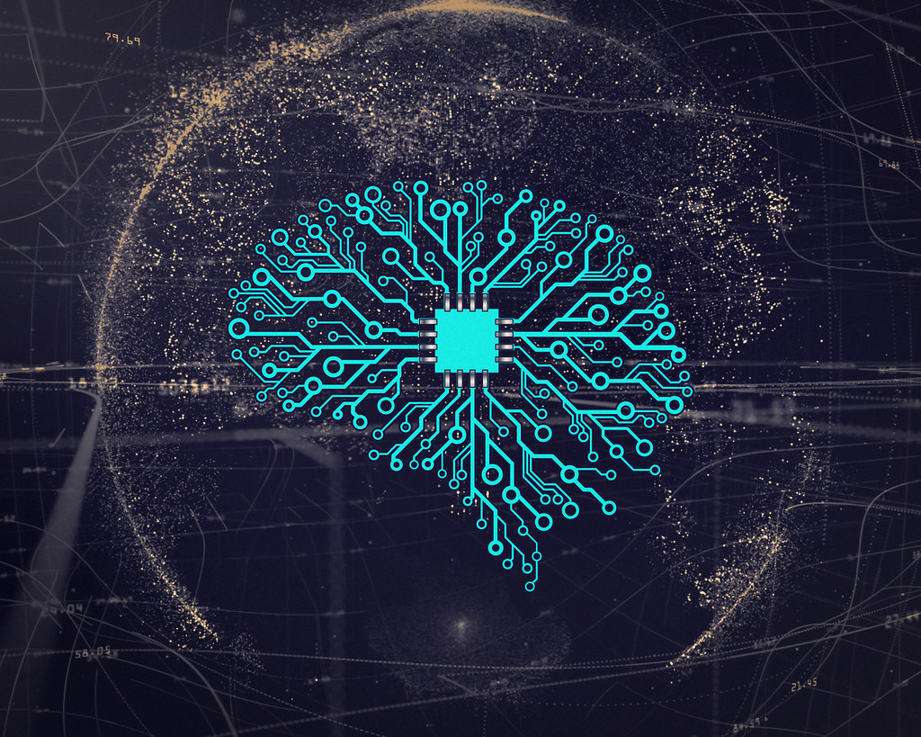
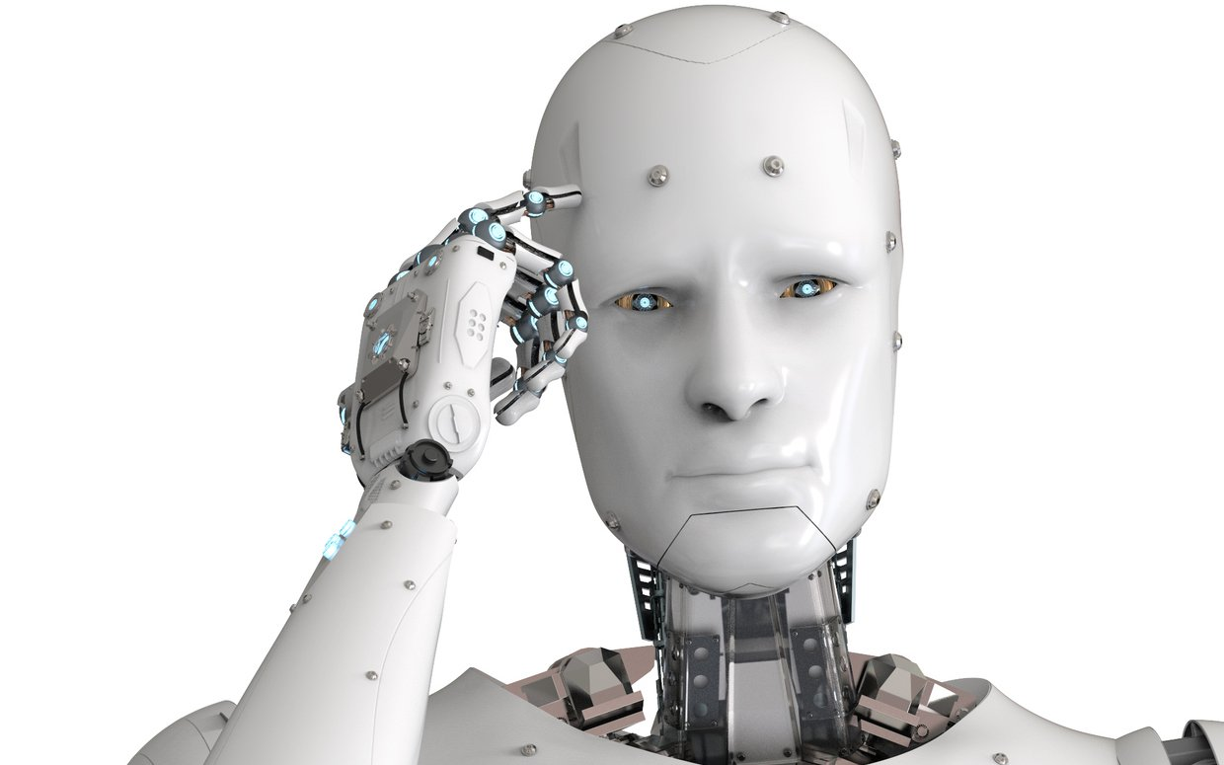
What is artificial intelligence
The simulation of human intelligence that is known as artificial intelligence functions by machines, particularly computer systems. Expert systems, natural language processing, speech recognition, and machine vision are some examples of specific AI applications.
Go Back
This Photo by Unknown Author is licensed under CC BY
This Photo by Unknown Author is licensed under CC BY

Slide 4
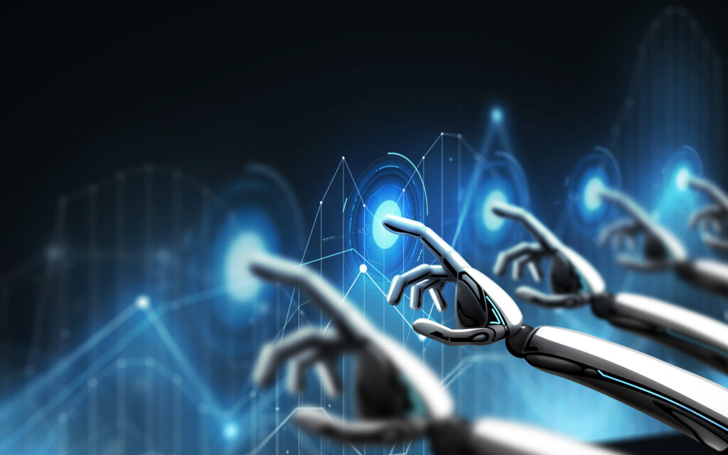
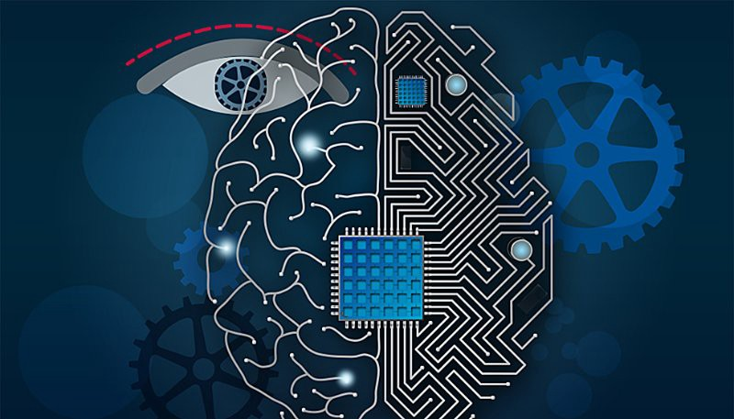
How artificial intelligence works
Large data sets are combined with intelligent, iterative processing algorithms to create AI systems that can learn from patterns and features in the data they analyze. An AI system tests and evaluates its own performance after each round of data processing, adding to its knowledge base.
Go Back
This Photo by Unknown Author is licensed under CC BY

Slide 5
Advantages of artificial intelligence
By answering a customer’s questions through chats, AI-powered digital assistants can interact with customers more easily and lighten the workload of customer service agents.
Numerous studies have shown that people only work productively for three to four hours per day on average. To balance their personal and professional lives, people also need breaks and vacation time. However, AI can operate continuously without rest. They can multitask with accuracy and think much more quickly than humans can. With the aid of AI algorithms, they can even manage difficult repetitive tasks without difficulty and boredom.
Go Back

Slide 6
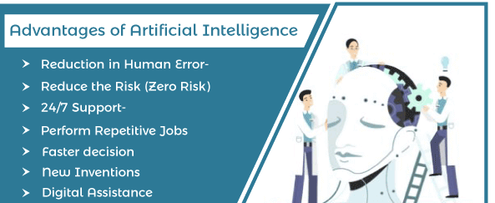
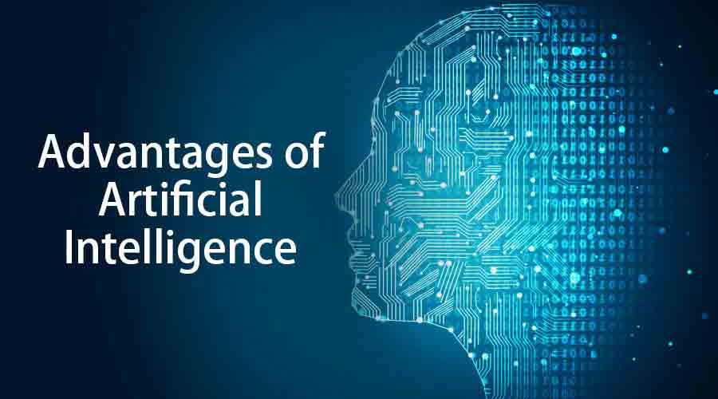
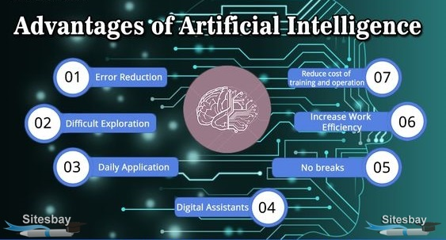
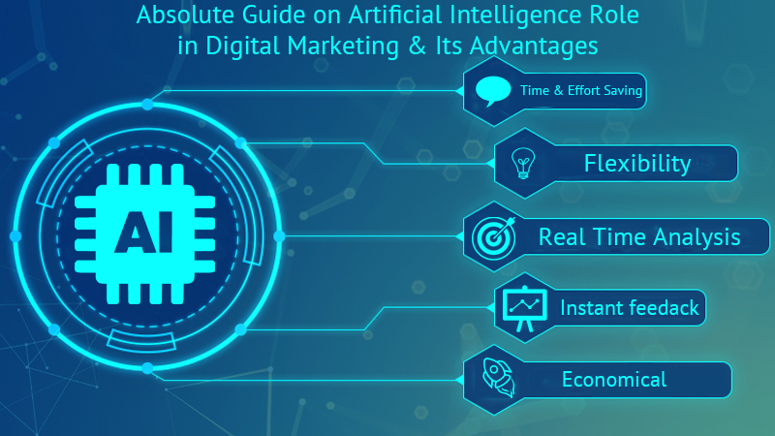

Slide 7
Disadvantages of artificial intelligence
It is an impressive achievement when a machine can mimic human intelligence however it can be very expensive and takes a lot of time and resources. AI is quite expensive because it requires the newest hardware and software to function in order to stay current and meet requirements.
The inability of AI to learn to think creatively outside the box is a significant drawback. With pre-fed data and prior experiences, AI is able to learn over time, but it is not capable of taking a novel approach. The robot Quill, which can write Forbes earnings reports, is a prime example. Only information that has already been given to the bot is contained in these reports. The fact that a bot can write an article on its own is impressive, but it lacks the human touch found in other Forbes articles.
Go Back

Slide 8
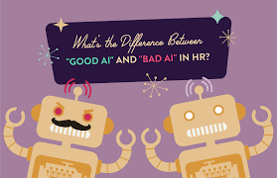
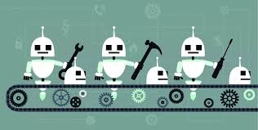
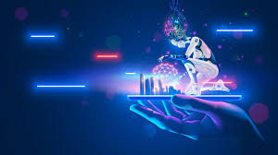
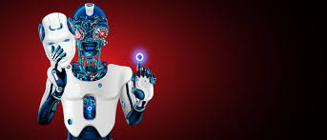

Slide 9
How artificial intelligence affects our lives
Artificial intelligence affects our lives in many ways:
1. FACIAL RECOGNITION
Through the use of smartphone facial recognition features or CCTVs installed in public spaces, facial recognition has gradually become a part of our daily lives. The AI capability in smartphones is typically used to lock and unlock access. The information is only there to save you from having to type in a password or security code; it never leaves your device. It seems pretty innocent, don't you think? Although it could be worse, it is by no means innocent. When you are sleeping, others may unlock your phone by simply displaying your face. Data on your phone may be accessed by unauthorized people if the technology is bypassed. Additionally, it might normalize face-scanning, which would make the idea of having your face scanned by others less and less unsettling.
Go Back
Second Way

Slide 10
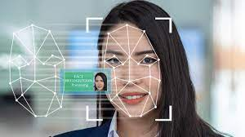
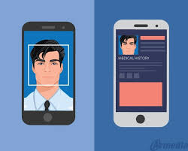
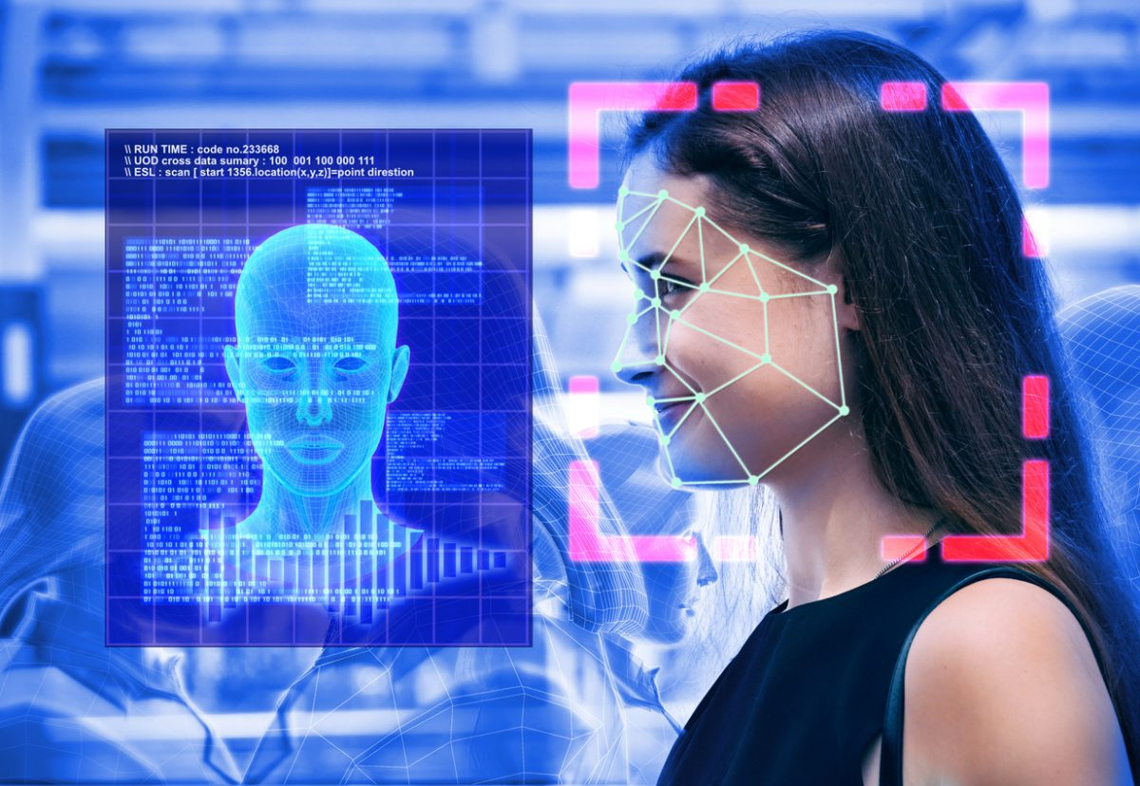
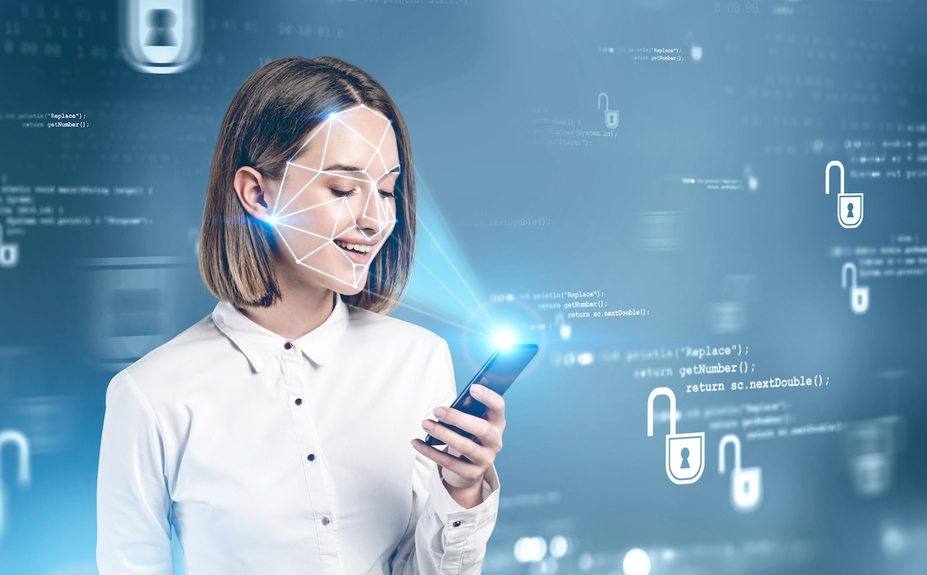

Slide 11
2. robotic chefs
Unbelievably, there are already robotic chefs available on the market. Although the technology is currently expensive, it may advance over the next few years, much like how automatic check-out machines proliferated throughout supermarkets. (By the way, did you know that the spouse of the person who invented ATMs never uses them and instead visits her neighborhood branch to get cash? Although technology may speed up processes, a lack of chance encounters with other people can have a negative impact on how well our lives are going.) Many workers in the hospitality industry may become unnecessary as a result of technology, and for those few jobs that remain, there may be issues with occupational hazards and the resulting legal ramifications.
Go Back
Third Way

Slide 12
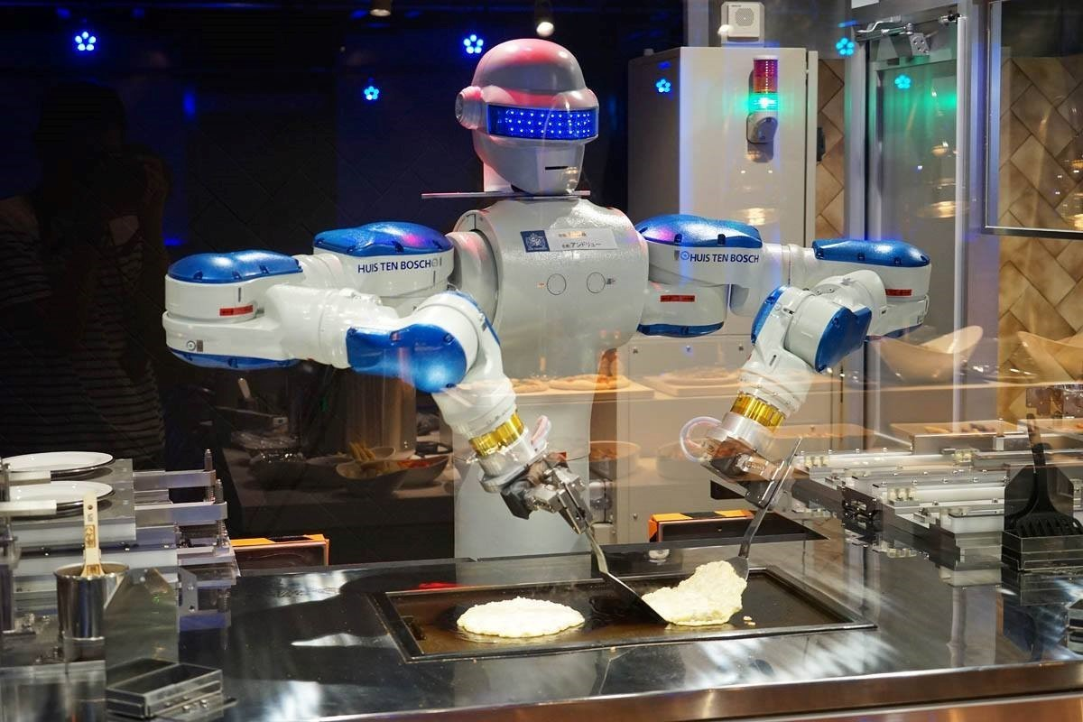
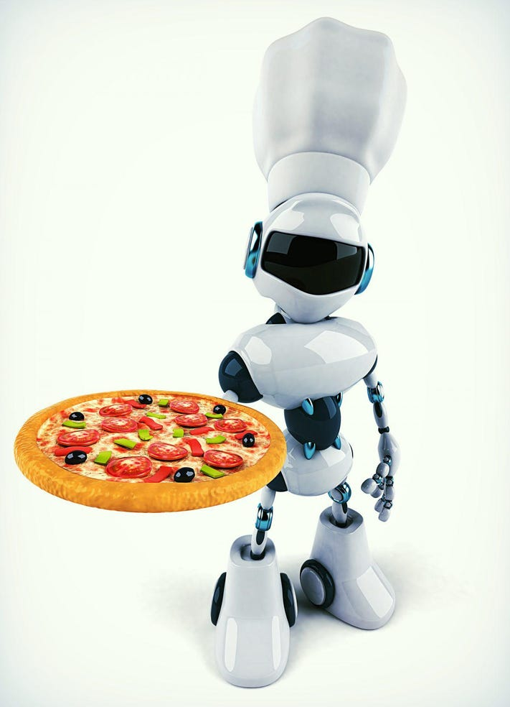
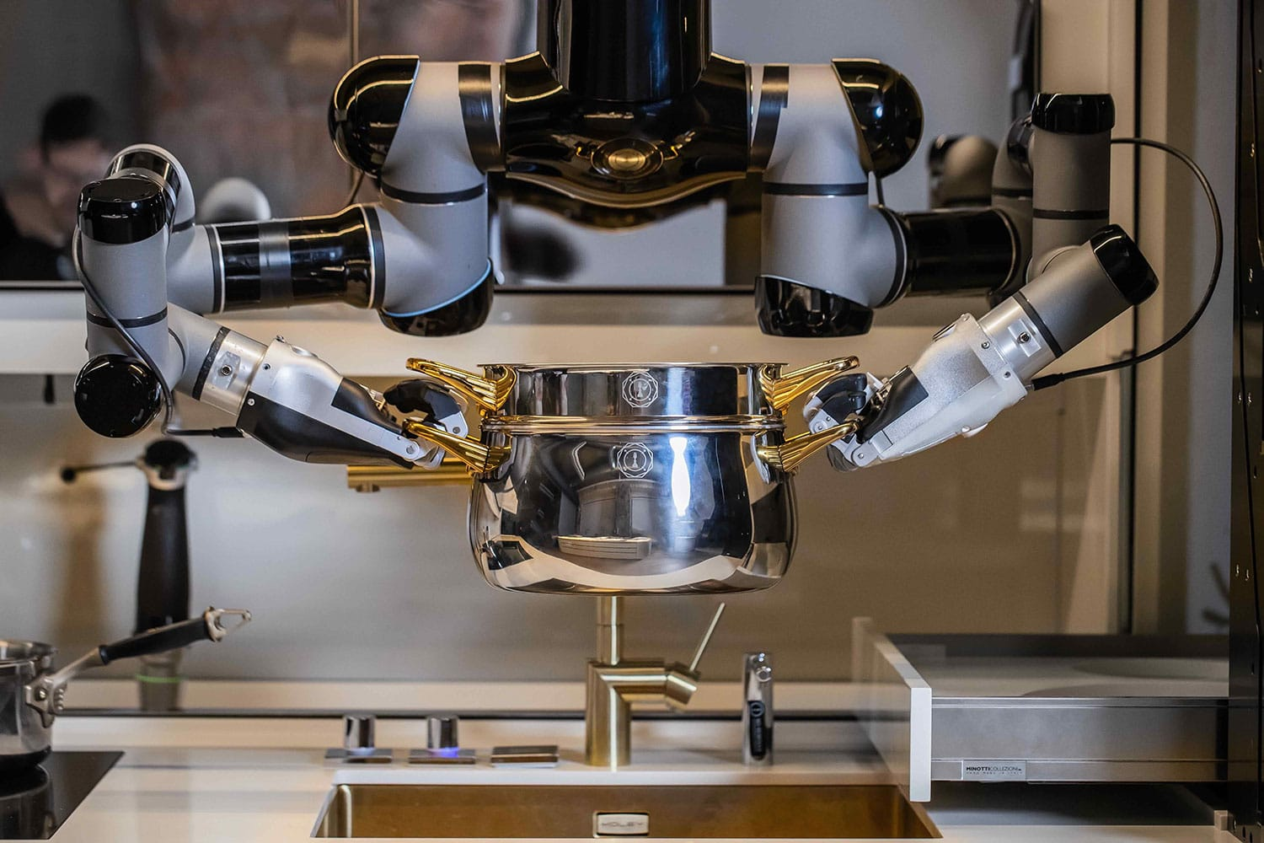
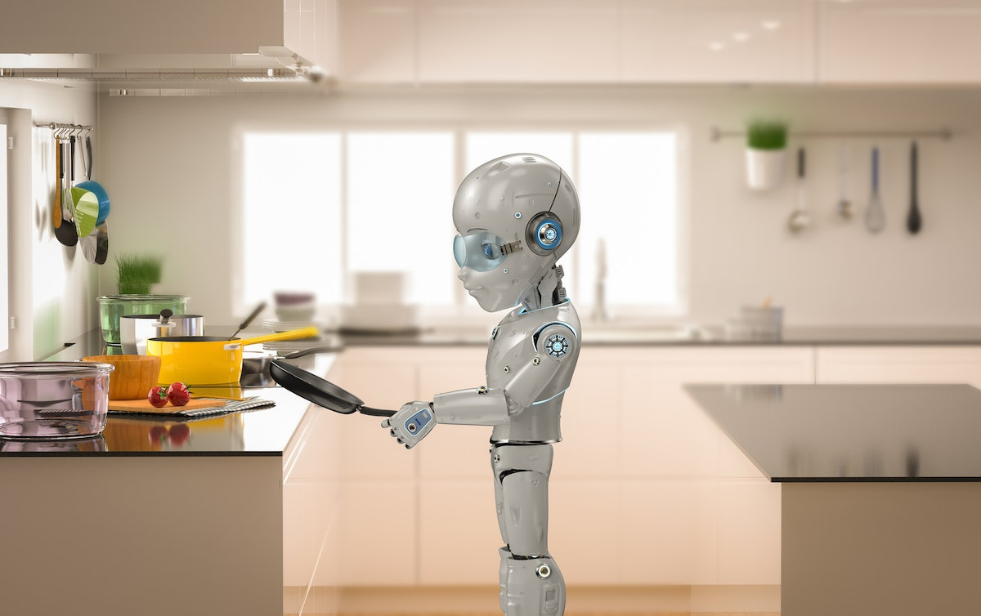

Slide 13
3. Smart houses
Homes are becoming "smart," just like phones. When we come home from work or school, our ideal temperature is waiting for us because our thermostats have learned about our preferences and daily routines. Some refrigerators generate shopping lists for you based on what's missing and suggest wines to serve with your meal. Naturally, the voice-controlled digital assistants can be linked to your smart systems and gadgets so that all you have to do is say "more light" to make more light appear. Smart homes, however, can be harmful. You cannot hack a heating system that uses a manual turn switch. Your heating system’s internet connection is capable. The only thing your old refrigerator can do is keep your food cold. Your smart refrigerator could break down.
Go Back

Slide 14
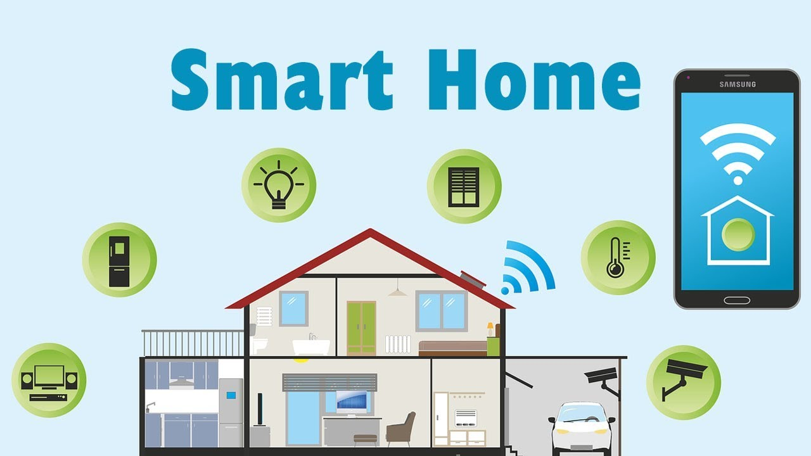
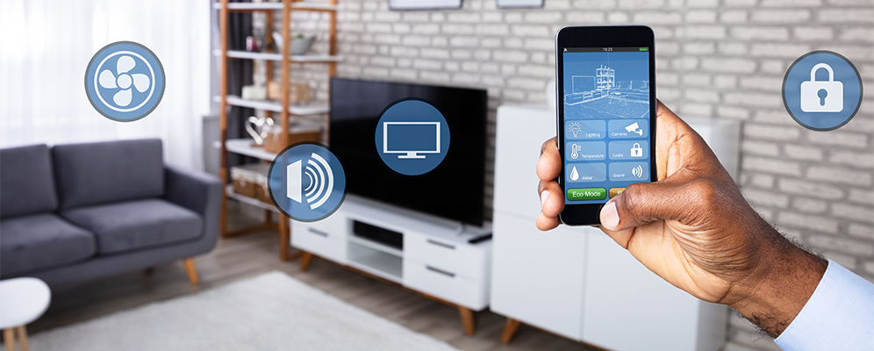
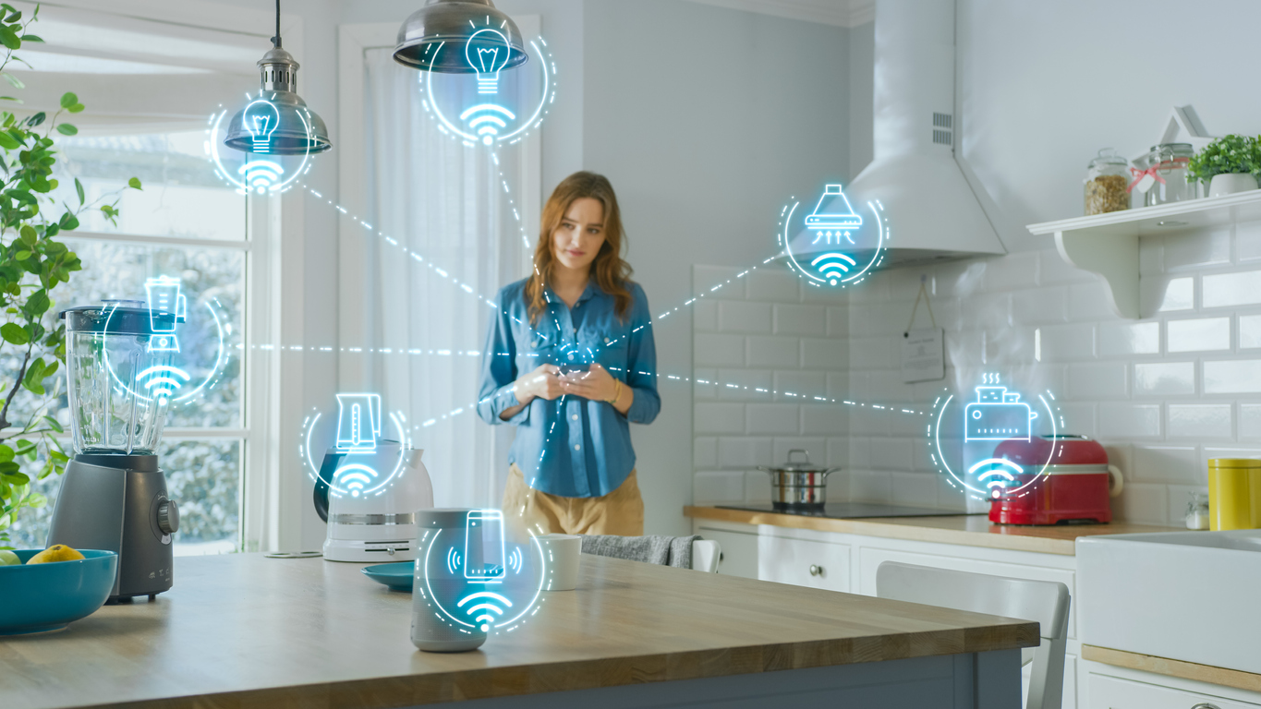
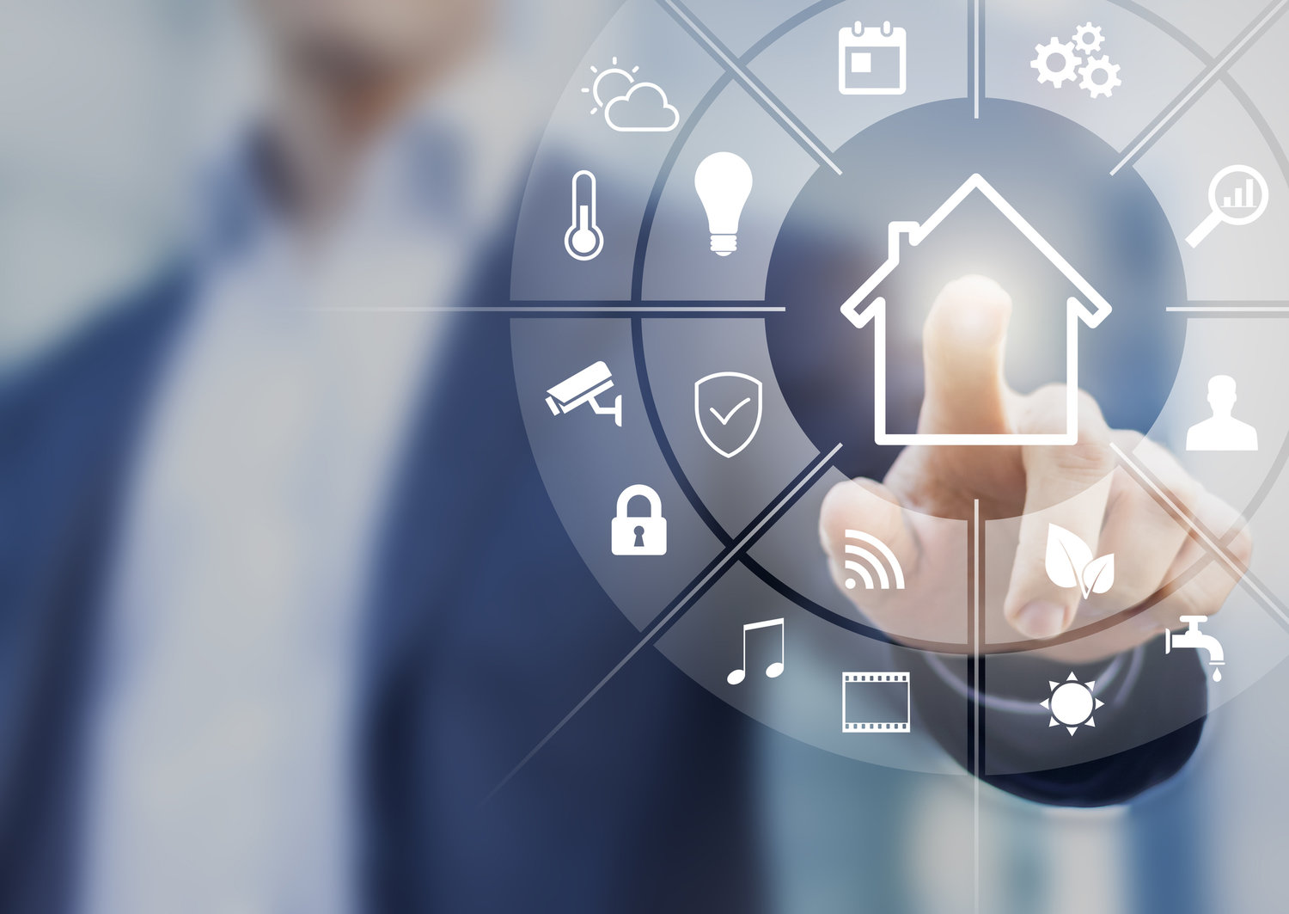

Slide 15
How artificial intelligence will change our lives in the future
There are also many ways that AI will change our lives in the future:
1. HEALTHCARE
AI will be essential in helping to prevent nearly 86% of errors in the healthcare sector. The use of AI in healthcare will help democratize the industry for the good of both patients and healthcare professionals, while also reducing costs and improving accuracy through predictive care. Artificial intelligence and predictive analytics can be used to better understand the various factors (birthplace, eating habits, local air pollution levels, etc.) that affect a person's health. Future healthcare systems powered by AI should be able to predict when a person is most likely to develop a chronic illness and suggest preemptive treatment to stop it before it gets worse.
Go Back
Second Way

Slide 16
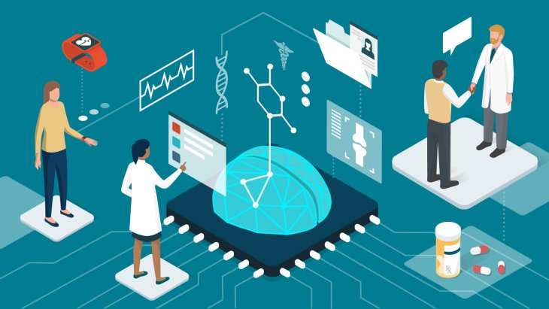
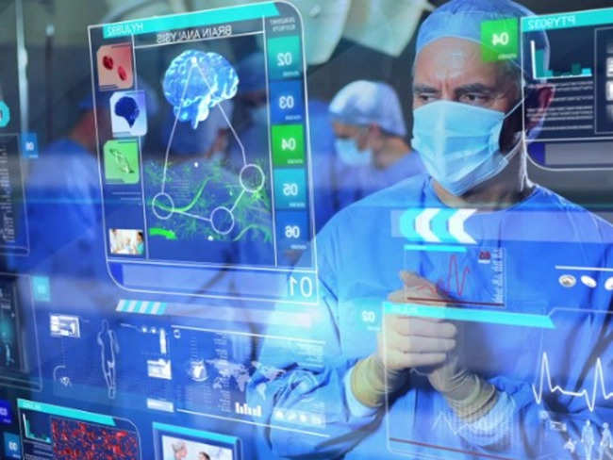
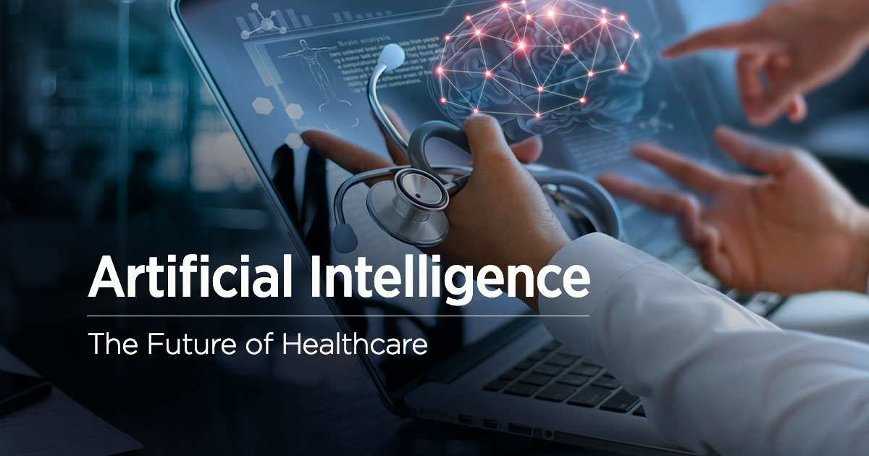
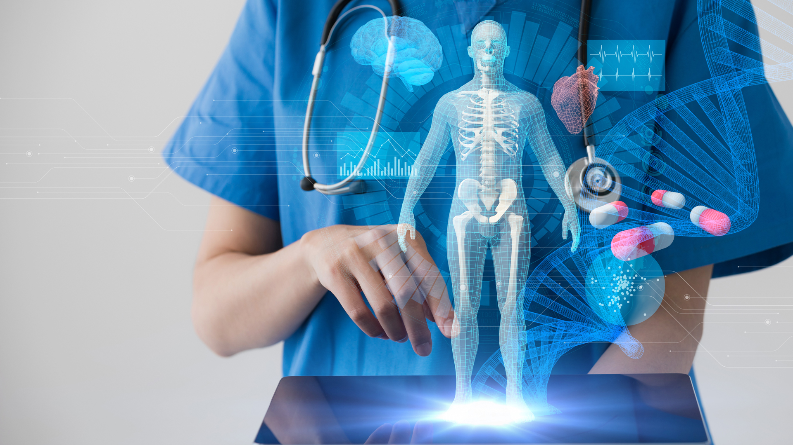

Slide 17
2. Banking
The global business value of AI in Banking is forecast to reach $300 billion by the end of 2030, according to IHS Markit's AI in Banking report. With lower costs, higher productivity, and better customer experiences, artificial intelligence is positioned to dominate sectors like business intelligence and security in the coming ten years. Robo advisors in wealth management will spread like wildfire and revolutionize the banking industry, saving both customers and wealth managers a great deal of time. The banks of the future will use AI to personalize customer experiences in addition to personalizing their services and goods.
Go Back
Third Way

Slide 18
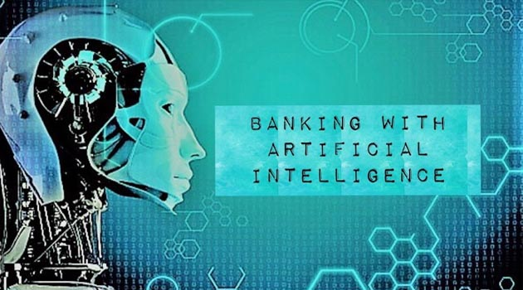
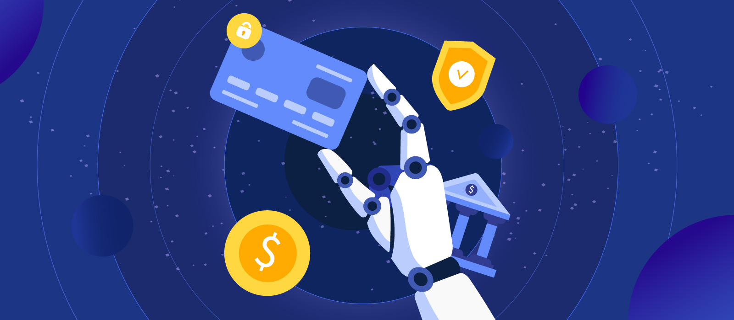
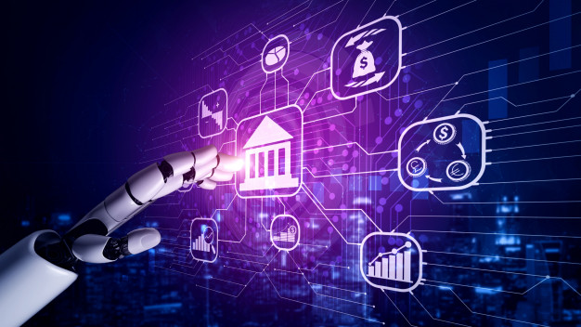
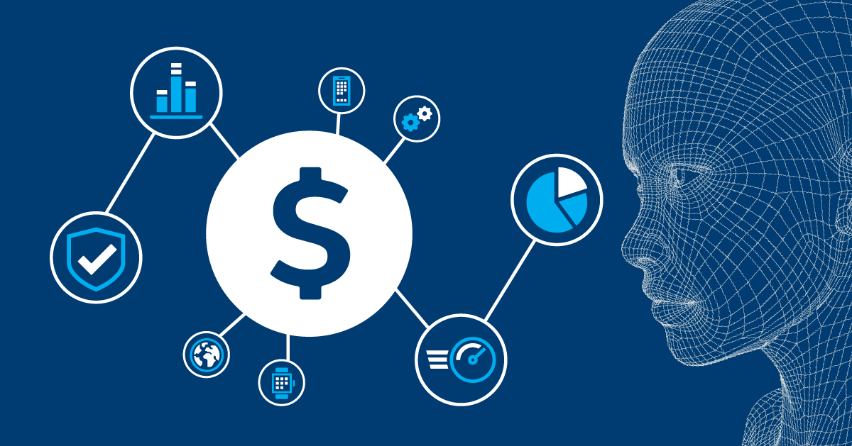

Slide 19
3. Open up millions of new job opportunities
Future fears of artificial intelligence are most frequently expressed as "Artificial Intelligence will replace us!" We can envision a more comfortable future for ourselves with artificial intelligence automating all types of work, one that will create new jobs rather than eliminate existing ones. A World Economic Forum report on the Future of Jobs predicts that by 2022, artificial intelligence will generate 58 million new jobs. By 2030, there is a very good chance that AI will perform better than humans on the majority of mental tasks, but that does not mean that jobs will be eliminated.
Go Back

Slide 20
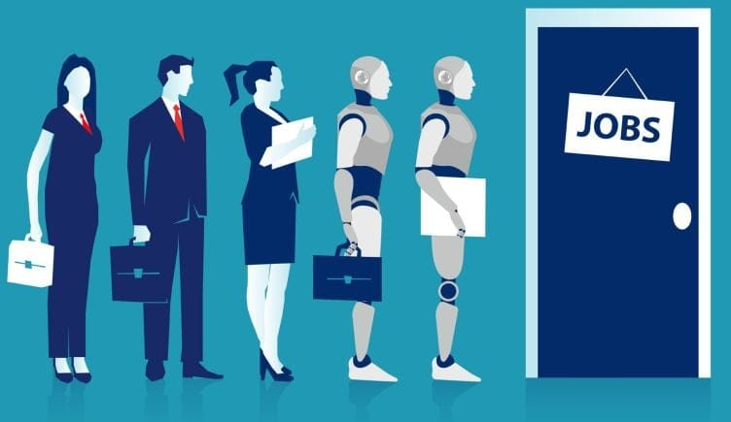
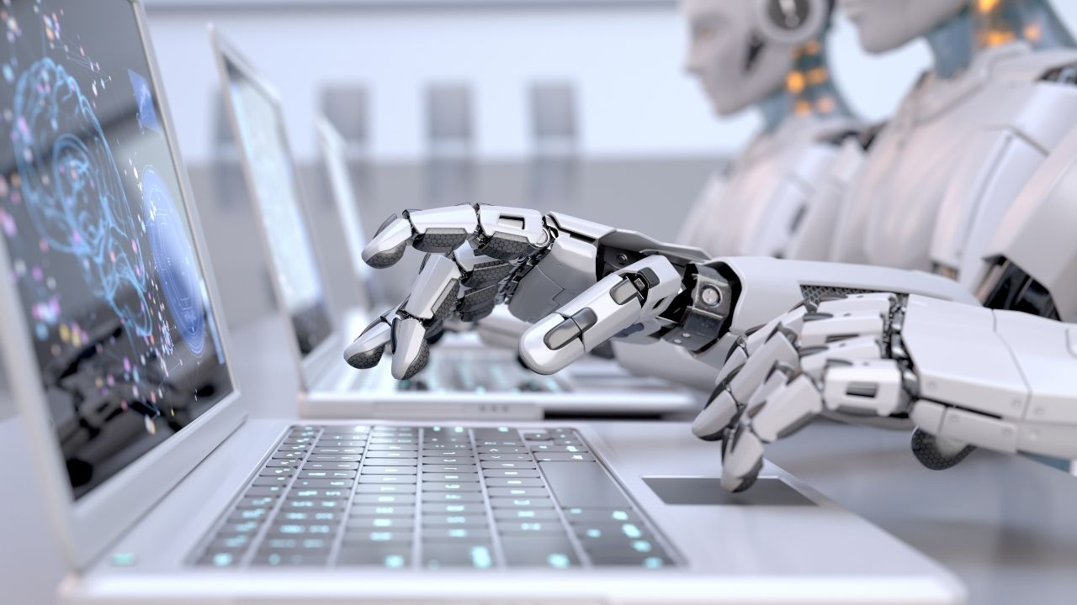
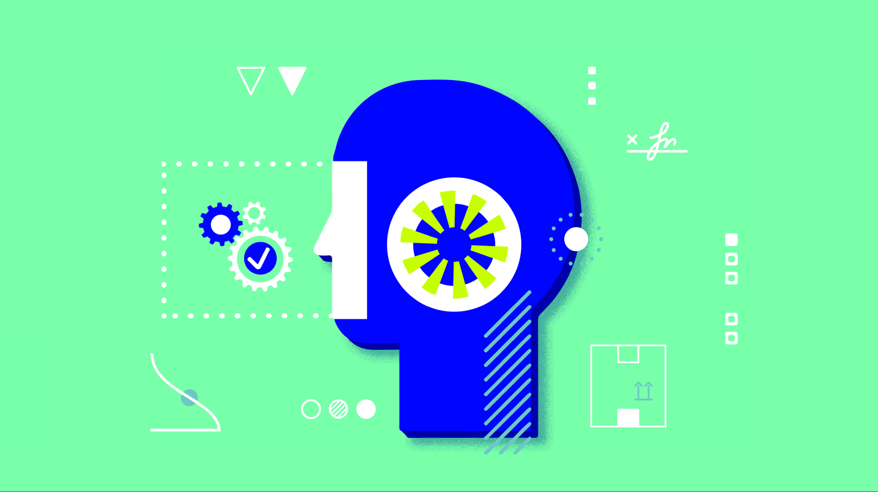

Slide 21
Resources
https://www.techtarget.com/searchenterpriseai/definition/AI-Artificial-Intelligence
https://csuglobal.edu/blog/how-does-ai-actually-work#:~:text=AI%20systems%20work%20by%20combining,performance%20and%20develops%20additional%20expertise
https://www.simplilearn.com/advantages-and-disadvantages-of-artificial-intelligence-article
https://www.liberties.eu/en/stories/impact-of-artificial-intelligence-in-everyday-life/44222
https://www.springboard.com/blog/data-science/artificial-intelligence-future/
Go Back

