Slide 1
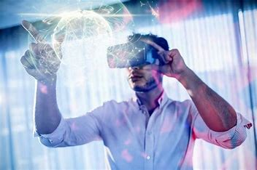
Virtual reality
By: Fahed

Slide 2
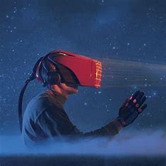
What is virtual reality?
It is computer-generated simulation of a three-dimensional image or environment that can be interacted with in a seemingly real or physical way by a person using special electronic equipment, such as a helmet with a screen inside or gloves fitted with sensors.

Slide 3
What are some of the advantages of virtual reality?
More Than Real: offers high quality visualizations that give the user a feeling of being in a different world while playing games, or watching the scenery, etc.
Safe Practice: Another of the countless other benefits of virtual reality technology is using it for training purposes and practice due to its ability to simulate potentially dangerous real-world operations like surgery, combat, flight.
Increased Learning Possibilities: Using VR technology, doctors can understand any medicine’s new qualities and determine its side-effects, giving them a clear idea of the outcome.

Slide 4
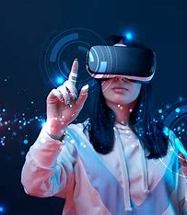
Are there any disadvantages to virtual reality?
Well, yes, there are a few, some of which are:
The Cost: Regardless of the fun and amazing experience provided by the virtual reality technology, not everyone is capable of affording the same tech as it does not come cheap.
Unreal: One can always train to either perform surgery or fly a plane, using virtual reality to an extent. But training in the virtual world and real-world are entirely different things. They might not be able to give their best when exposed to the real world because any action they take will have real consequences.

Slide 5
What is the future of virtual reality?
Hopefully, the future of virtual reality Will Change How We See the World and How We Learn. It Will Become More Physical and Sensory Oriented but unfortunately it will take some time for the industry to become mainstream

Slide 6
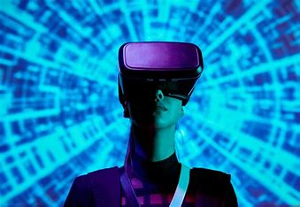
Conclusion
Finally, after understanding all the advantages and disadvantages of virtual reality, one ought to understand the meaning of the virtual world and its characteristics. Briefly, one can say that virtual reality can be astounding and educational, and it can also aid in reducing the build-up stress by granting them the joy of visiting another world virtually.

Slide 7
links
10 Advantages And Disadvantages Of Virtual Reality (honestproscons.com)
What is the Future of Virtual Reality? - The Tech Edvocate

Slide 8
Thank you for reading

