Slide 1
.
BY: TALA DABABNEH
Notes:
To use this title animation slide with a new image simply 1) move the top semi-transparent shape to the side, 2) delete placeholder image, 3) click on the picture icon to add a new picture, 4) Move semi-transparent shape back to original position, 5) Update text on slide.

Slide 2
WHAT IS E- LEARNING?
“e” stands for electronic
E-learning is a method used to help people (such as students) to learn virtually online. It helps students in many ways, it is also a space for students to study, in addition it is sometimes used as a workplace for training people. Another way this method is used is also for teachers to give extra help by setting up an online class with a student at home. On top of that information can be printed on a paper or presented on the whiteboard in class, all learning is done on a computer.

Slide 3
TYPES OF E- LEARNING
Text and images
Is a mix of information in a simple text and an image, it is like a book you use but used virtually.
An advantage of text and images is that it’s easy to makes content and is also cheap. It is also easier for teachers to use this method.
There are many ways you can learn in E- learning. When you use different types of media such as videos and messages, this is multimedia.
Games and simulation
series of instructional designs that use elements from simulation and gaming. A simulation acts and is bases of a real life situation, for example surgeons use this method and test surgeons before doing it on a real patient which is a safer way so nothing goes wrong.
Presentations and audio
Teachers use this method to explain a lesson shown in a presentation. In a presentation there is information on multiple slides, and audio file is sometimes used to explain the lesson in each slide.

Slide 4
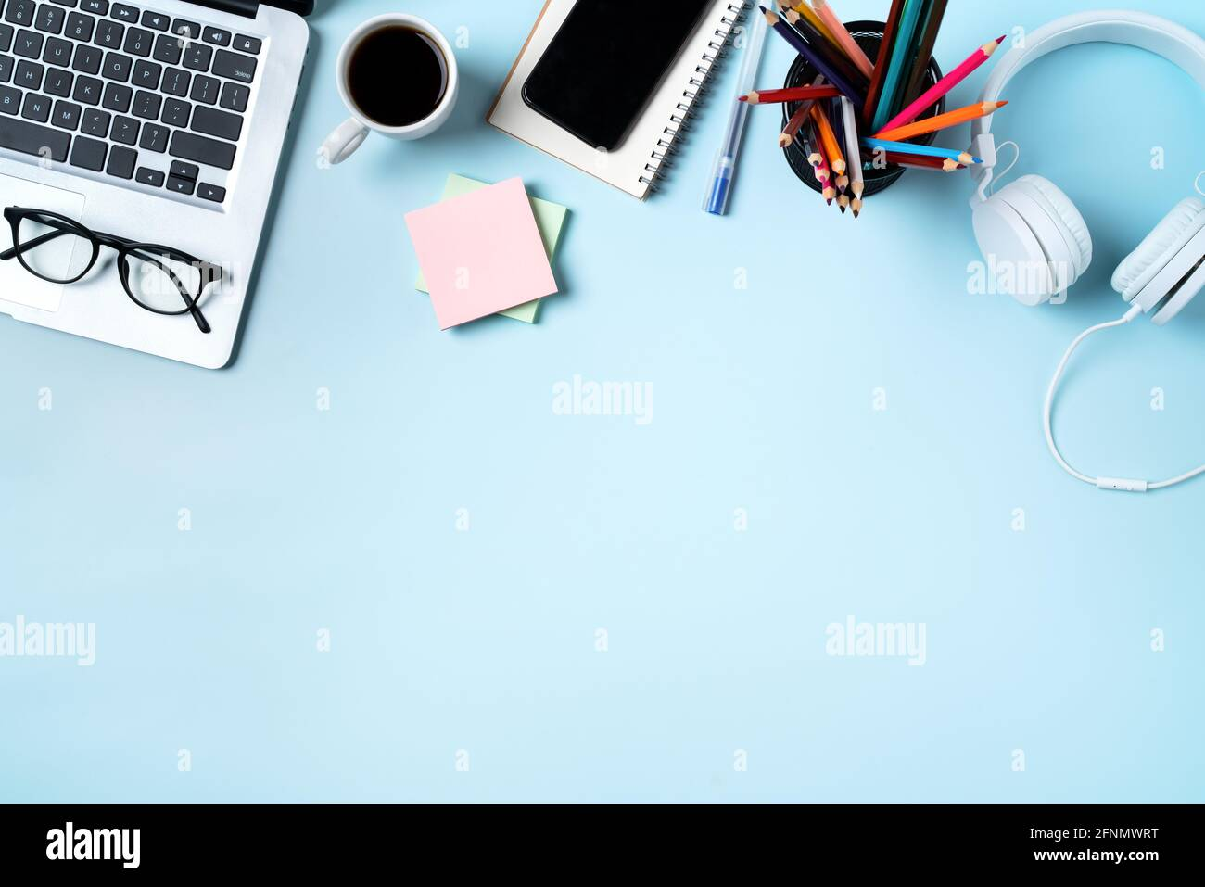
BENEFITS
Benefits of E- learning for students, college students and employers
Reducing learning time
E- learning is the best way to save and manage time for studying and working
Accessible 24/7
E-learning can be used anytime any day and whenever you want it also helps that are Learners are faced with an information overload, and a limited amount of time.
Stress free environment
helps to minimize the social discomfort and pressure many shy or previously victimized students feel.

Slide 5
Q1
Who uses E-learning?
Employers, students, college students and teachers

Slide 6
Q2
Why do we use E-learning
we use it because it speeds up the process for learners who go at a quicker pace, saving time and resources for the ultimate in efficiency.

Slide 7
Q3
Name one benefit of E-learning
Accessible anytime, peaceful environment, reduces and manages time,sociable ect.

Slide 8
THANK YOU
Neal Creative | click & Learn more

