Slide 1
Virtual Reality in Museums
By Thomas

Slide 2
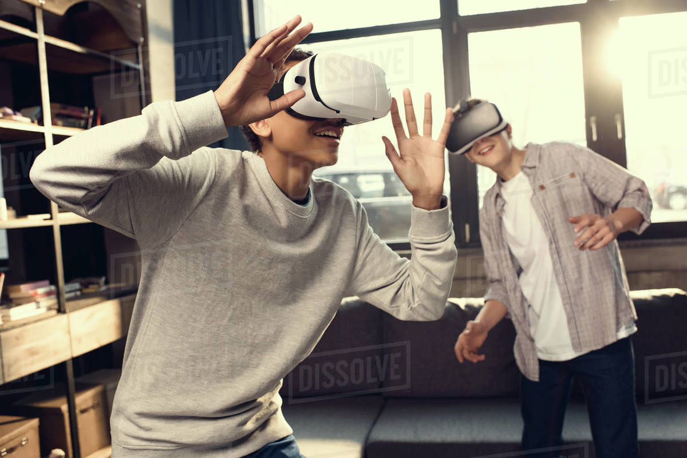
Who is the target audience for VR?
According to a study carried out by us last November, the age groups that come the most in VR gaming rooms are 12 - 15 years old and 30 - 40 years old. 50% of them are women and 50% are men.

Slide 3
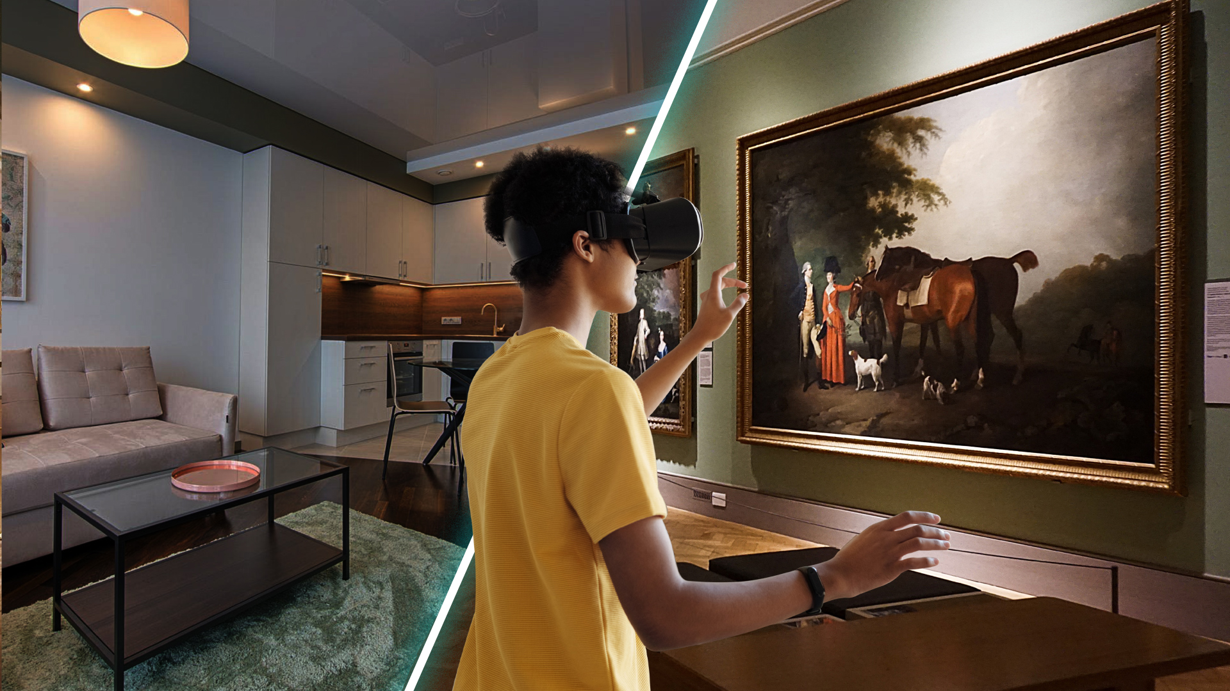
What does VR mean for museums?
Museums aim to bring collections to life and VR is an excellent tool for this. It offers a different experience for visitors. Many museums around the globe are already embracing its potential.

Slide 4
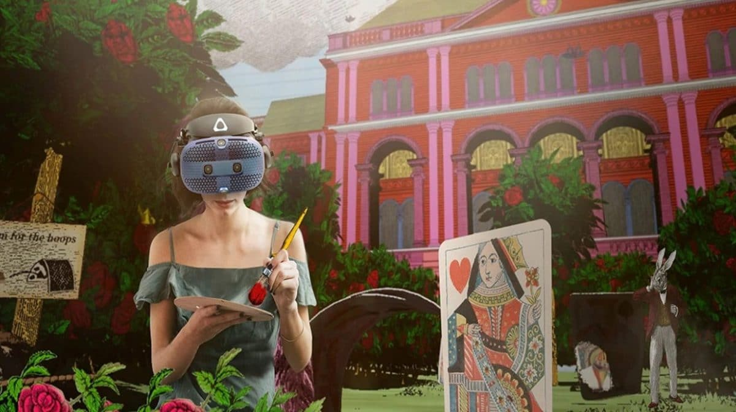
What is VR used for?
Visitors can use VR to journey to the depths of the ocean, the far edges of outer space or even inside the human body. This technology allows people to be completely involved in an interactive adventure.

Slide 5
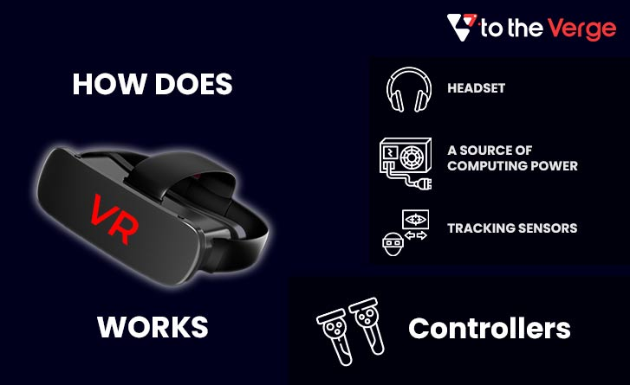
How does Virtual Reality work?
Virtual Reality (VR) is a computer-generated environment with scenes and objects that appear to be real, making the user feel they are immersed in their surroundings. This environment is perceived through a device known as a Virtual Reality headset or helmet.

Slide 6
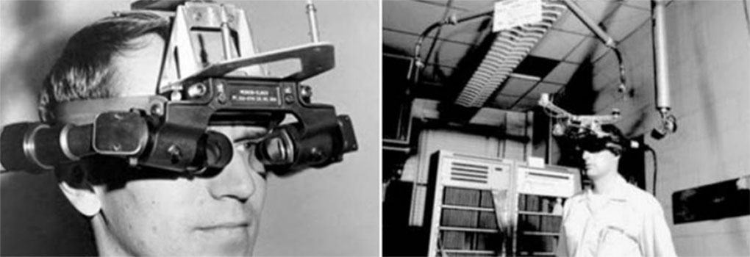
Who Invented VR?
In 1968 Ivan Sutherland and his student Bob Sproull created the first VR / AR head mounted display that was connected to a computer and not a camera. It was a large and scary looking contraption that was too heavy for any user to comfortably wear and was suspended from the ceiling.

Slide 7
RESCOURCES:
https://onix-systems.com/blog/virtual-museum-experiences-taking-the-cultural-mission-to-a-new-level
https://www.museumnext.com/article/how-museums-are-using-virtual-reality/
https://www.vrs.org.uk/virtual-reality/history.html#:~:text=In%201968%20Ivan%20Sutherland%20and,ceiling%20(hence%20its%20name).

