Slide 1
ARTIFICIAL INTELLIGENCE
Done by: Fawzi Zabaneh

Slide 2
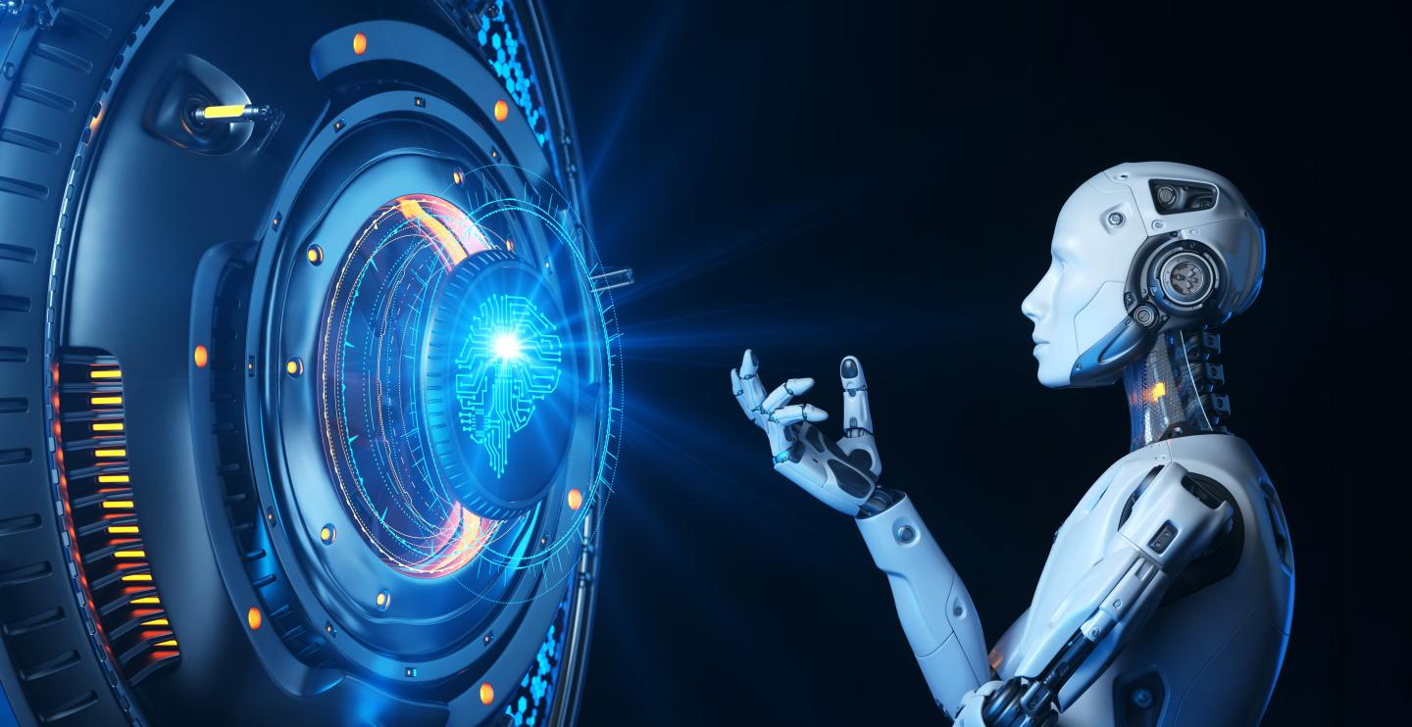
WHAT IS ARTIFICIAL INTELLIGENCE (AI) ?
Artificial intelligence is the simulation of human intelligence processes by machines, especially computer systems. Specific applications of AI include expert systems, natural language processing, speech recognition and computer vision .

Slide 3
HOW DOES ARTIFICIAL INTELLIGENCE WORK ?
Artificial intelligence (AI) makes it possible for machines to learn from experience, adjust to new inputs and perform human-like tasks. Most AI examples that you hear about today – from chess-playing computers to self-driving cars – rely heavily on deep learning and natural language processing. Using these technologies, computers can be trained to accomplish specific tasks by processing large amounts of data and recognizing patterns in the data.

Slide 4
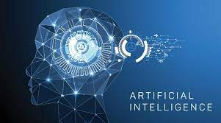
WHAT ARE THE ADVANTAGES ARTIFICIAL INTELLIGENCE
1. Reduction in Human Error.
2. Zero Risks.
3. 24x7 Availability.
4. Digital Assistance.
5. New Inventions.
6. Unbiased Decisions. (depending on the training data)
7. Perform Repetitive Jobs.
8. Daily Applications.

Slide 5
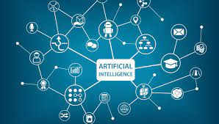
WHAT ARE THE DISADVANTAGES OF ARTIFICIAL INTELLIGENCE
1.High Costs.
2. No creativity
3. Unemployment
4. Make Humans Lazy
5. No Ethics
6. Emotionless
7. No Improvement

Slide 6
WHAT ARE THE APPLICATIONS OF ARTIFICIAL INTELLIGENCE
1.Personalized Shopping.
2.AI-Powered Assistants.
3.Fraud Prevention. ...
4.Administrative Tasks Automated to Aid Educators.
5.Voice Assistants.
6.Creating Smart Content.
7.Personalized Learning.
8.Autonomous Vehicles.

Slide 7
https://www.techtarget.com/searchenterpriseai/definition/AI-Artificial-Intelligence https://www.sas.com/en_in/insights/analytics/what-is-artificial-intelligence.html https://www.simplilearn.com/advantages-and-disadvantages-of-artificial-intelligence-article#GoTop

