Slide 1
Virtual reality (VR)
By: Lara Taani
8H

Slide 2
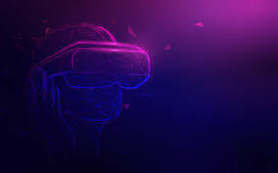
What is virtual reality
Virtual Reality (VR) is a computer-generated environment with scenes and objects that appear to be real, making the user feel they are immersed in their surroundings. This environment is perceived through a device known as a Virtual Reality headset or helmet, unlike traditional interfaces, VR places the user inside the virtual environment to give an immersive experience.

Slide 3
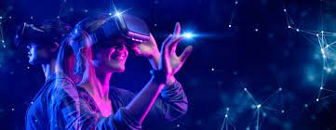
How it works
VR headsets have embedded stereoscopic lenses positioned between a built-in LED screen and eyes, distorting the image so it looks 3-D and real.
The headset passes two images through these lenses, one for each eye, similar to our vision.

Slide 4
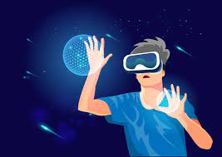
How is it used
Virtual reality is most commonly used in entertainment applications such as video games, 3D cinema, amusement park rides including dark rides and social virtual worlds.
Virtual reality is also used in a lot of other things such as education, traveling medication and much more.

Slide 5
Uses of Virtual Reality

Slide 6
3 primary categories of virtual reality simulations
fully-immersive simulations
non-immersive
semi-immersive

Slide 7
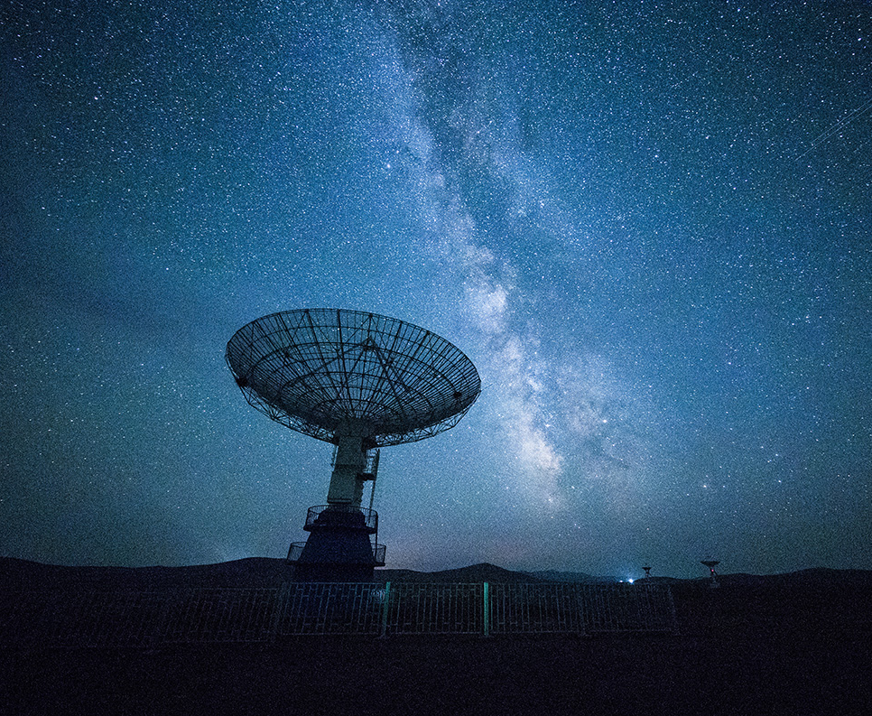
Top 4 best VR of 2023
HP Reverb G2
Valve Index
Sony PlayStation VR
Meta Quest 2

Slide 8
Thank You!

