Slide 1
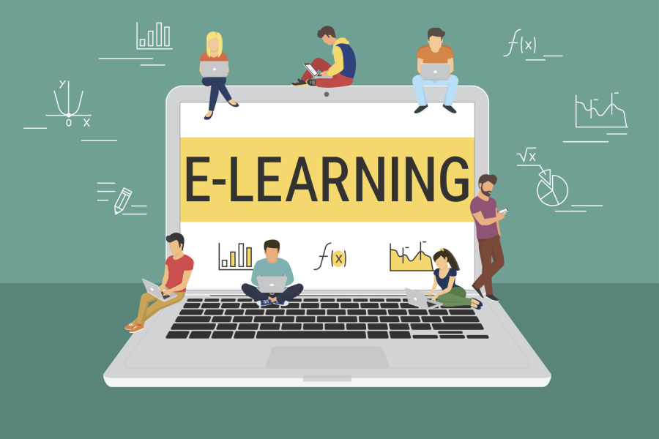
eLearning
Oun al zawaideh
8B

Slide 2
eLearning is the delivery of learning and training through digital resources. Although eLearning is based on formalized learning, it is provided through electronic devices such as computers, tablets and even cellular phones that are connected to the internet.

Slide 3
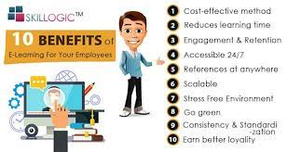
The Most Important Benefits Of eLearning
Online Learning Accommodates Everyone's Needs, The online method of learning is best suited for everyone.
Lectures Can Be Taken Any Number Of Times.
Quick Delivery Of Lessons.
Speed.

Slide 4
Disadvantages of eLearning
Online Learning May Create a Sense of Isolation, Everyone learns in their own manner.
Online Learning Requires Self-Discipline.
Online Learning means more screen-time.

Slide 5
sources
https://elmlearning.com/blog/10-reasons-elearning-works/
https://www.learnupon.com/blog/what-is-elearning/#:~:text=eLearning%2C%20or%20electronic%20learning%2C%20is,are%20connected%20to%20the%20internet.
https://corp.kaltura.com/blog/advantages-disadvantages-online-classes/

