Slide 1
E-learning
Computer assignment

Slide 2
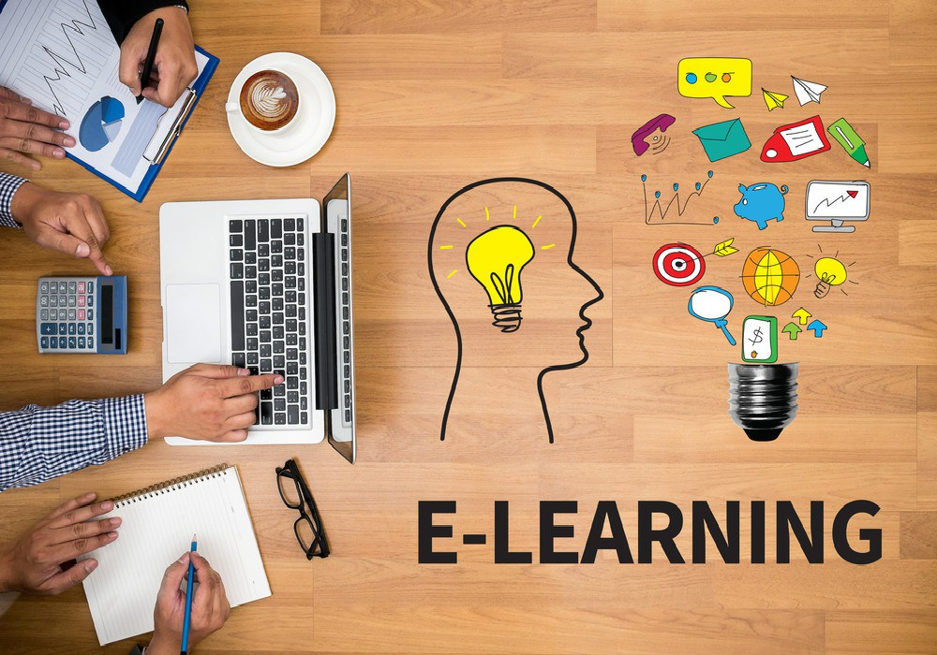
What is E-learning
E-learning is: learning done by studying at home using computers and courses provided on the internet

Slide 3
Why is E-learning important
Learning is an important part of personal development, and one of the most rewarding aspects of learning is that it helps you understand the world around you. By gaining knowledge and new skills, you can see the world in a different light and gain a deeper understanding of how things work

Slide 4
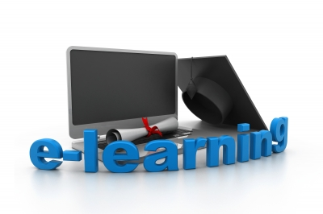
E-Learning Makes You More Employable
Learning Makes You More Employable
Learning Helps You Achieve Your Goals
Learning Helps You Earn More Money
Learning Keeps Your Mind Sharp

Slide 5
E-learning
Reading books or articles on unfamiliar topics can challenge you mentally while expanding your knowledge of many subjects.
Playing board games with friends or family provides an enjoyable social way to keep your mind busy and have fun simultaneously.
Listening to lectures or podcasts on various topics sharpens your mind and expands your understanding of complex concepts explained through audio-visual materials.

