Slide 1
Artificial Intelligence
By Adeeb Alamat 8F

Slide 2
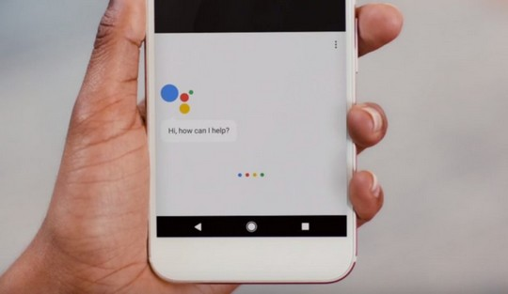
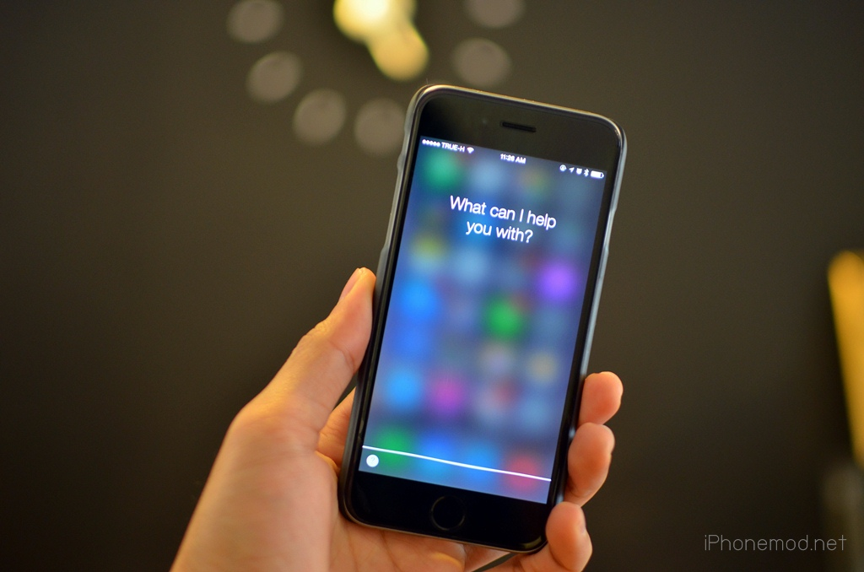
What is a.i ? (Artificial intelligence)
Artificial intelligence is the simulation of human intelligence processes by machines
An example of A.I is a Smart Assistant like (Google and Siri)
This Photo by Unknown Author is licensed under CC BY-SA-NC
This Photo by Unknown Author is licensed under CC BY-NC

Slide 3
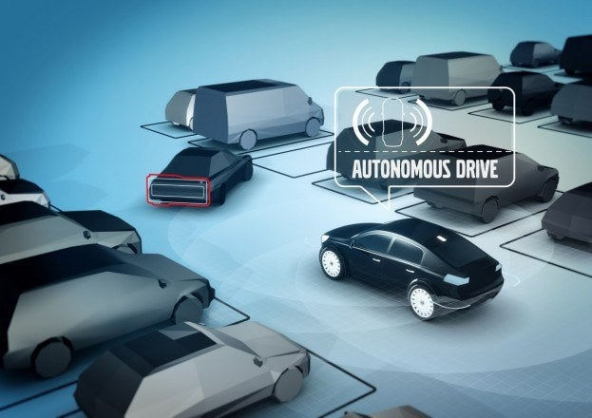
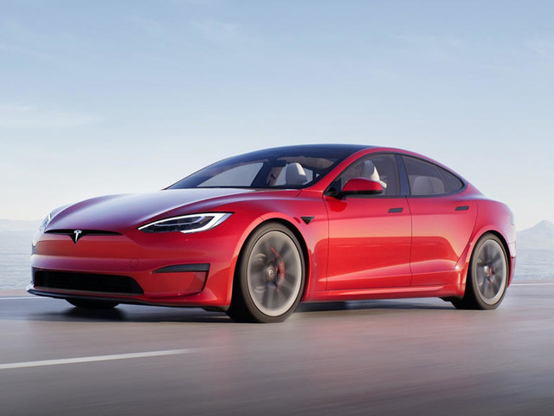
Other examples of ai
There are lots of kinds of ai and each have their own benefit.
A more recent one is Self-Parking Cars.
Tesla is a very famous example of Self-Driving cars.
Automatic self park
This Photo by Unknown Author is licensed under CC BY
This Photo by Unknown Author is licensed under CC BY-NC

Slide 4
What are the advantages of a.i?
advantages | disadvantages
Reduction in human error | expensive
Digital assistance | If we rely on it too heavily unemployment rates will spike up
It can perform repetitive jobs | No ethics

