Slide 1
e-learning
Yasmeen Alyousef

Slide 2
What is e-learning?
E-learning (electronic learning) delivery of training through digital resources, it is provided through electronic devices such as computers, tablets and even cellular phones that are connected to the internet.

Slide 3
What is the difference between e-learning and online learning?
E-learning and online learning are kind of the same thing, but not the same at the same time , e-learning allows the students to interact with their teacher only via the internet. They cannot learn or communicate with the tutor in any form even if they are on the same platform, but Online learning, on the other hand, allows live and interactive learning through video chat and messages

Slide 4
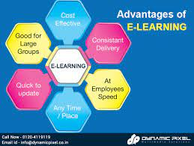
What are the advantages of e-learning?
You are able to link the various resources in several varying formats.
It is a very efficient way of delivering courses online.
Due to its convenience and flexibility, the resources are available from anywhere and at any time.
Everyone, who are part time students or are working full time, can take advantage of web-based learning.

Slide 5
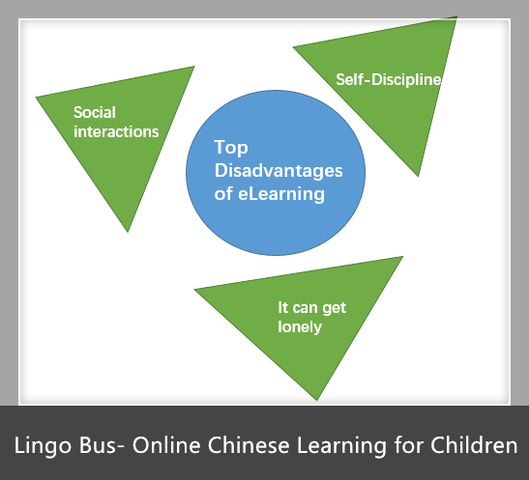
What are the disadvantages of e-learning?
Keep in mind that there are not many disadvantages of eLearning, the main one being that you get knowledge only on a theoretical basis and when it comes to putting to use whatever you have learnt, it may be a little different.
But here are 2 disadvantages that I got:
Most of the online assessments are limited to questions that are only objective in nature.
The authenticity of a particular student's work is also a problem as online just about anyone can do a project rather than the actual student itself.

Slide 6
What are the benefits of e-learning?
The most important benefits of e-learning are:
Flexibility
More engaging classes
Opportunity to grow skills
And going global
Last but not least E-learning can also makes the bond between students and teachers tighter.

Slide 7
sources
Slide 3: https://www.evelynlearning.com/digital-learning-e-learning-online-learning-whats-the-difference/
Slide 4: https://elearningindustry.com/advantages-and-disadvantages-of-elearning#:~:text=It%20is%20a%20very%20efficient,advantage%20of%20web%2Dbased%20learning.
Slide 5: https://elearningindustry.com/advantages-and-disadvantages-of-elearning#:~:text=It%20is%20a%20very%20efficient,advantage%20of%20web%2Dbased%20learning
Slide 6:https://uteach.io/articles/benefits-of-e-learning#:~:text=The%20most%20important%20benefits%20are,have%20extra%20classes%20with%20them.

