Slide 1
E-Learning
By : Zaina rabadi

Slide 2
What is E-Learning ?
E-Learning is a learning tool that is used for long distance education and is the delivery of training and learning through digital resources.
E-Learning is one way for teaching students who have problems of distance from their house to the school.
The “E” in the word E-Learning stands for electronic such as phones and computers

Slide 3
Who uses E-Learning ?
It is usually used for teaching people.
It may be used by teachers to give students extra help.
The students can use the E-Learning at home
to do extra homework and studies from school.

Slide 4
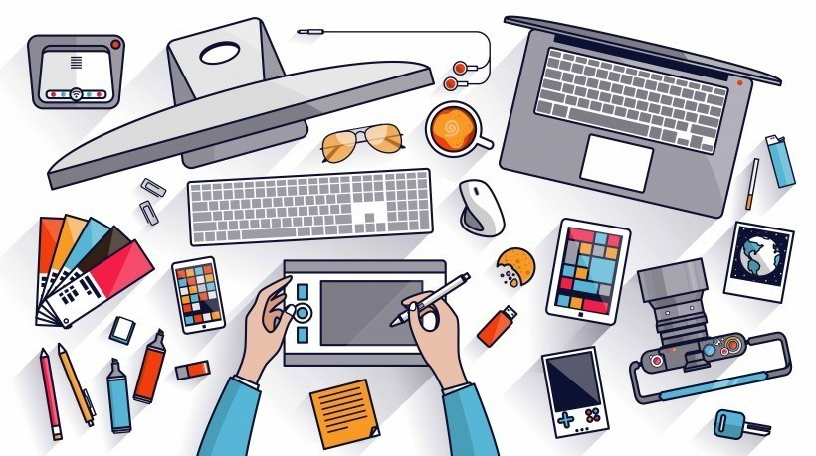

Slide 5
Why do we have to “E-Learning” ?
Speeds up the process for learners who go at a faster pace.
To reduce papers (paperless) .
Global.
Possibly being adaptive.
E-Learning

Slide 6
E-Learning Illustration
There are two types of E-Learning:
Computer based learning.
Distance learning (“online based learning”) there are two types:
Internet based learning. Web based learning.

Slide 7
Advantages of E-Learning
You can learn where and when you want.
You can use the type of media you like.
Teachers have more time to help each student.
Quick delivery.
If people live in a remote area, you can learn without having
to travel for long distances.

Slide 8
Disadvantages of E-Learning
Lacks face to face communication.
Lack of pressure for the students.
Some people prefer to learn in class instead of using electrons.
More difficult to work without a timetable.

Slide 9
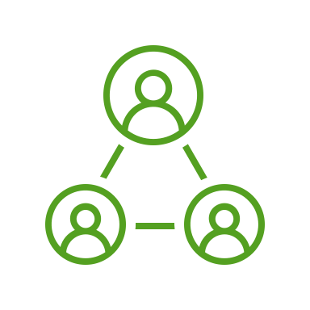
Resources
https://www.learnupon.com/blog/what-is-elearning/
https://www.sciencedirect.com/topics/social-sciences/internet-based-learning
https://www.google.com/search?q=advantages+of+elearning&oq=advantages+of+elearning&aqs=chrome..69i57j0i512l3j0i22i30l6.5068j0j15&sourceid=chrome&ie=UTF-8
https://e-student.org/disadvantages-of-e-learning/#:~:text=E%2DLearning%20lacks%20face%2Dto%2Dface%20communication,-The%20lack%20of&text=A%20lack%20of%20face%2Dto,abandon%20their%20studies%20more%20easily

