Slide 1
How AI helps us with science
Done by: Saif Jumaian

Slide 2
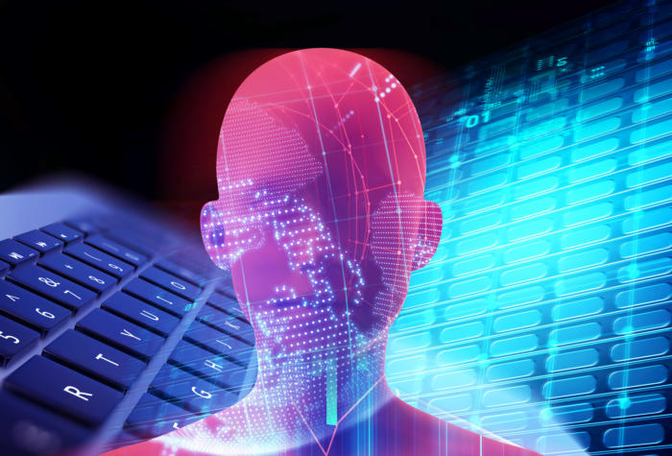
How has AI helped us in the past years
Ai has done many good things for us in the past that have helped us a lot in science, these things could vary from something small to something like an AI deciphering a language that nobody could understand to making it completely clear, that was done in MIT computer science and artificial intelligence lab.

Slide 3
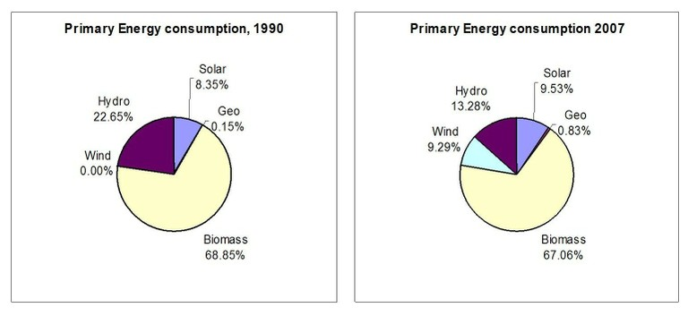
What AI has done to stop climate change scientifically
AI has done a lot to alarm scientists about climate change and natural disasters that could be caused by it over the years, it has done things such as:
Researchers using AI to visualize the future effects of floods and wildfires, improve climate decision-making, monitor forests and share data.
Build digital twins of the planet, to test out the impact of different warming-mitigation policies and detect thinning sea ice

Slide 4
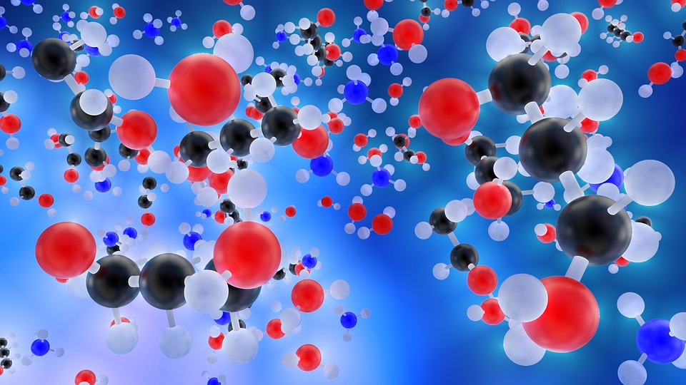
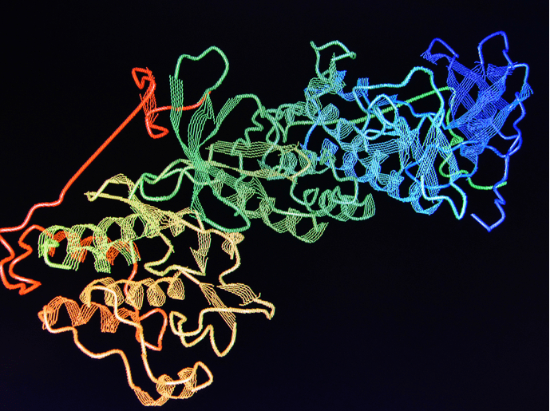
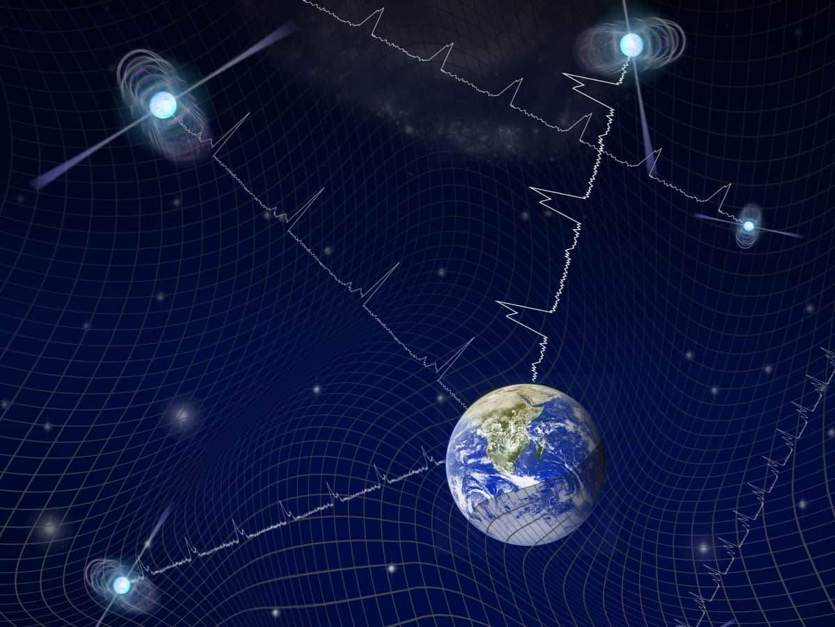
How AI helped different sciences
Ai has helped all sciences (chemistry, biology and physics) to become better, help with research and much more and it has helped them in the following ways:
Chemistry: Ai can help in the understanding in the rules of chemistry and help with making medicine for a lot of diseases.
Biology: Ai has helped simplify imagine analysis, leading to easier breakdown of protein sources and also helps with detecting disease and examining it.
Physics: Ai helps physics with detecting gravitational waves from the universe and also simplify 100000 quantum equations to only four.

Slide 5
Thank you for listening

Slide 6
sources
https://www.sciencedaily.com/
https://bitesizebio.com/
https://oecd.ai/
https://www.scientificamerican.com/
https://www.weforum.org/
https://medium.com/

