Slide 1
E-learning
Done by: Natalie zabaneh
Grade:8
Section:A

Slide 2
1)What is E-learning?
E-learning is a type of learning conducted digitally via electronic media, typically involving the internet.
It can be accessed via most electronic devices including a computer, laptop, tablet or smartphone, making it a versatile and easy way for students to learn wherever they are. E-learning resources come in a variety of forms – from software programs and digital courses to interactive online platform and apps.

Slide 3
there are some common types of e-learning methods
DIGITAL MATERIALS
E-learning can be carried out via the consumption of videos, PDF documents, slideshows and word documents. Thanks to the availability of these resources, it’s incredibly easy for anybody to teach themselves a new skill at their own pace.
ONLINE COURSES
Online courses are often provided by Learning Management Systems (LMSs) and allow learning material to be delivered at a steady rate, organised into sections and chunks to make it easier for the learner.
They often come with interactive materials to allow the learner to test and apply their own knowledge.
Popular online course providers include Skillshare and Udemy.

Slide 4
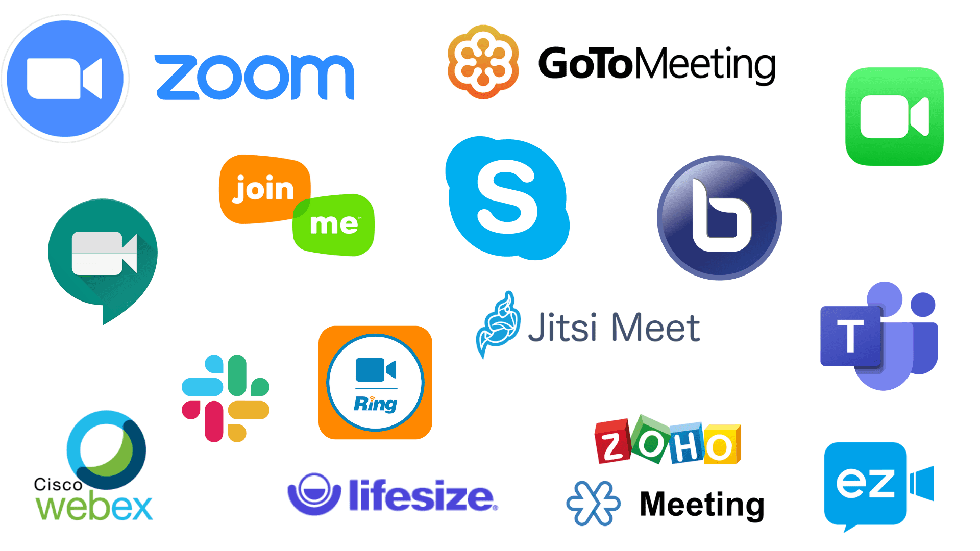
VIRTUAL TUTORING
Thanks to the internet, private tutors are no longer as expensive as they once were. Thanks to websites like My Tutor and Tutor Hub, it’s now easy to find online tutors for any subject at an affordable rate. Lessons are completed via video communication platforms like Skype and Zoom.
APPS & SOFTWARE
Apps and software are nothing new, and many people are discovering the amazing possibilities for self-taught learning through apps they can download right to their phone.
Learn a new language with Duolingo, or try your hand at a musical instrument with Yousician and Urochord.
Learning software can also be used both online and off to engage in shared learning courses (as mentioned above) or engage in your own personal learning journey.

Slide 5
Types of E-learning
Asynchronous Online Courses
Synchronous Online Courses
Hybrid Courses
Providing Continuity
Distributing Materials
Creating Content
Curating Content
Fostering Collaboration

Slide 6
The advantages of the E-learning
Accessibility
Mobility
Regularly Updated Content
Budget-Friendly
Individual Learning Styles
Self-Paced Learning
The Solution to Teacher Scarcity
Customizable Learning Environment
Extensive Use of Analytics
Environmentally Friendly

Slide 7
Accessibility
One of the key advantages that come up when there are no geographical limits involved is accessibility. Moving to another nation to study is simply not an option for some students.
E-learning removes all barriers, allowing people from all over the world to finish the courses or training that they want.
Those who are unable to attend a classroom due to physical or psychological reasons might continue their education through online courses.
Mobility
For many people, balancing education with work or other hobbies can be difficult. The mobility involved in higher education learning techniques impacted by technology is one of the aspects that has attracted so much attention.
E-learning allows students to study from any location and at any time, completely meeting their demands. Today’s students demand a personalized, mobile approach to education, which this option delivers.

Slide 8
Regularly Updated Content
Traditional learning is often an impediment in today’s fast-paced world, due to outmoded learning resources. In rapidly changing situations, digital learning allows study materials to be updated quickly and in real-time, keeping content fresh and relevant.
Students can be confident that the knowledge they get in an online class is up to date and relevant to the current atmosphere, but textbooks in traditional settings may still contain outdated irrelevant content.
Budget-Friendly
Learning institutions that use eLearning can expect to save 50 percent to 70 percent on overall training expenditures due to simplified logistics and lower travel costs, among other factors.
The term “cost-effectiveness” in eLearning refers not just to educational institutions, but also to students. It helps cut all expenses connected with transportation, textbooks, and childcare.

Slide 9
Individual Learning Styles
As each learner has a unique learning style, finding a one-size-fits-all approach in education is nearly impossible.
Luckily, Individual learners’ characteristics are taken into account in eLearning, allowing students to practice their own unique learning approaches.
In other words, students are not always compelled to pass all of the courses in a curriculum that they do not wish to take, and they can choose specific areas that they are interested in.
Self-Paced Learning
Students who study online can set their own schedules rather than sacrificing personal time to meet the attendance requirements of lecturers and traditional universities.
Self-paced learning has been shown in studies to boost student happiness and minimize stress, resulting in better learning outcomes for all parties involved. Efficiency, effectiveness, convenience, scalability, and reusability are just a few of the benefits of self-paced learning.

Slide 10
The Solution to Teacher Scarcity
The problem of teacher shortages will likely be tough to address, but the benefits of eLearning in mitigating teacher shortages may be undervalued.
Let’s construct a comparison to help clarify: E-learning courses created by one or two certified and experienced teachers can be delivered to thousands, if not millions, of students, whereas regular universities have an average of 16.5 students per staff person.
Customizable Learning Environments
Employees working in locations lacking photos, plants, souvenirs, and other “distractions” were shown to be 15% less productive than those working in environments containing said “distractions.”
This is also true in the educational setting: Students who do not have a positive learning environment will experience negative consequences in their academic performance and mental health.
Students have complete control over their learning environment in eLearning. They can maximize their learning potential by choosing or making their personalized learning environment.

Slide 11
Extensive Use of Analytics
Data is the new oil, and eLearning makes far more effective use of student data than any previous kind of education in history.
Educational institutions can improve their training materials and improve learning outcomes in a variety of ways using student data obtained through eLearning analytics. For example, it can help lower dropout rates and further improve knowledge retention in students.
Environmentally friendly
For those still wondering why e learning is important it’s worth mentioning that it helps to safeguard the environment to a large extent. Given it’s a paperless method of learning, there is no need to cut down trees or waste other resources such as electricity.
According to a study on eLearning courses, distance-based learning programs used 90 percent less power and produced 85 percent fewer CO2 emissions than typical campus-based study programs.

Slide 12
Technology’s Bright Future in Higher Education
While digital learning tools cannot totally replace traditional learning at this time, they have proven indispensable for the modern student.
Is e-learning good for education? E-Learning allows for scalability, which aids in the delivery of instruction. Through E-Learning, all students can receive the same type of syllabus, study materials, and training.
What is the purpose of e-learning? The goal of e-learning is to enable people to learn for personal gain or to get a professional degree without having to physically visit a university or academic institution.

Slide 13
The disadvantages of E-learning
Online student feedback is limited
E-Learning can cause social Isolation
E-Learning requires strong self-motivation and time management skills
Lack of communicational skill development in online students
Cheating prevention during online assessments is complicated
Online instructors tend to focus on theory rather than practice
E-Learning lacks face-to-face communication
E-Learning is limited to certain disciplines
Online learning is inaccessible to the computer illiterate population
Lack of accreditation & quality assurance in online education

Slide 14
Why is eLearning important today?
Online learning helps students to create and communicate new ideas. You get the chance to uplift your skills and gain knowledge apart from school education. One of the prime importance of e-learning is that it helps students and teachers develop advanced skills.

