Slide 1
Art, Creativity, and the Potential of Artificial Intelligence
Loay Kawar 8H

Slide 2
Artificial Intelligence is a method of making a computer, a computer-controlled robot, or a software think intelligently like the human mind. AI is accomplished by studying the patterns of the human brain and by analyzing the cognitive process. The outcome of these studies develops intelligent software and systems.

Slide 3
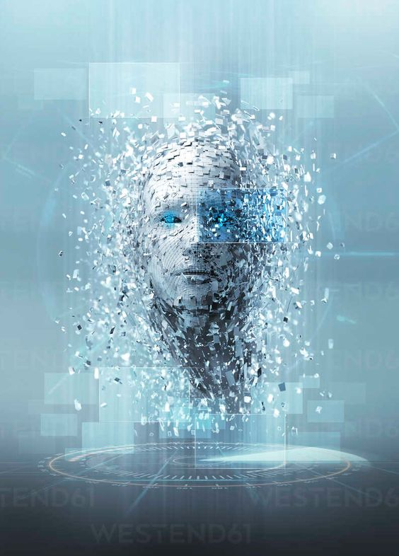
Is artificial intelligence is good or not?
One of the biggest advantages of Artificial Intelligence is that it can significantly reduce errors and increase accuracy and precision. The decisions taken by AI in every step is decided by information previously gathered and a certain set of algorithms.
(AI) it will simply respond with results that are derived completely by its learning. The good or badness of AI will depend on how well we train the AI, and perhaps most importantly how well we test the artificial intelligence.

Slide 4
what does AI do? The advantages range from streamlining, saving time, eliminating biases, and automating repetitive tasks, just to name a few.
1-Reduction in Human Error. ...
2-Zero Risks. ...
3-24x7 Availability. ...
4-Digital Assistance. ...
5-New Inventions. ...
6-Unbiased Decisions. ...
7-Perform Repetitive Jobs. ...
Etc..

Slide 5
The disadvantages
1-High Costs.
2-No creativity. A big disadvantage of AI is that it cannot learn to think outside the box. ...
3-More Unemployment. ...
5-Make Humans Lazy. ...
6-No Ethics. ...
7-Emotionless. ...
.

Slide 6
artificial intelligence conclusion
AI holds the key to unlocking a magnificent future where, driven by data and computers that understand our world, we will all make more informed decisions. These computers of the future will understand not just how to turn on the switches but why the switches need to be turned on.
thank you for reading

