Slide 1
Made by saif fashho

Slide 2
Introduction for what is simulation
Many people use simulations in there real life ,but do they know what is simulation ?

Slide 3
What is simulation?
A simulation is a model that mimics the operation of an existing or proposed system, providing evidence for decision-making by being able to test different scenarios or process changes.

Slide 4
Can simulations answer questions with no answer ?
Yes simulations can answer questions with no answers like:
What is the best design for a new telecommunication network ?

Slide 5
advantages of simulations
Can be safer and cheaper than the real world.
Able to test a product or system works before building it.
Can use it to find unexpected problems.
Can repeat the experiment more than once

Slide 6
disadvantages of simulations
Mistakes may be made in the programming or rules of the simulation or model.
People’s reactions to the model or simulation might not be realistic or reliable.

Slide 7
Examples of simulations
Dangerous experiments
In our school dangerous equipment's are not allowed for example potassium because it is highly reactive with oxygen we can use simulations to see this experiment with no injuries
ttps://phet.colorado.edu/sims/html/ph-scale/latest/ph-scale_en.html

Slide 8
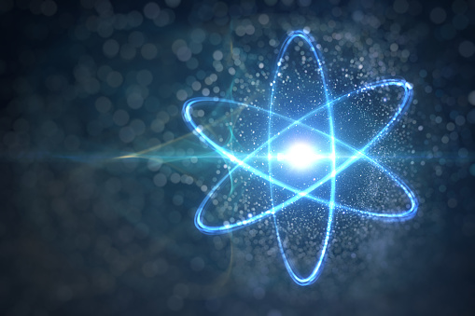
Another example of simulations
For example in physics we take about electrons, we cant see electrons using our naked eye so we use simulation .
https://phet.colorado.edu/sims/html/balloons-and-static-electricity/latest/balloons-and-static-electricity_en.html

Slide 9
YouTube video link
https://www.youtube.com/watch?v=UAO0FlelxF4

Slide 10
Citation
https://phet.colorado.edu/sims/html/balloons-and-static-electricity/latest/balloons-and-static-electricity_en.html
https://phet.colorado.edu/sims/html/ph-scale/latest/ph-scale_en.html
https://www.bbc.co.uk/bitesize/guides/zyqfr82/revision/3

Slide 11
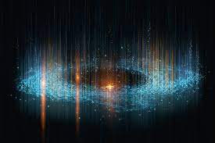
Thank you

