Slide 1
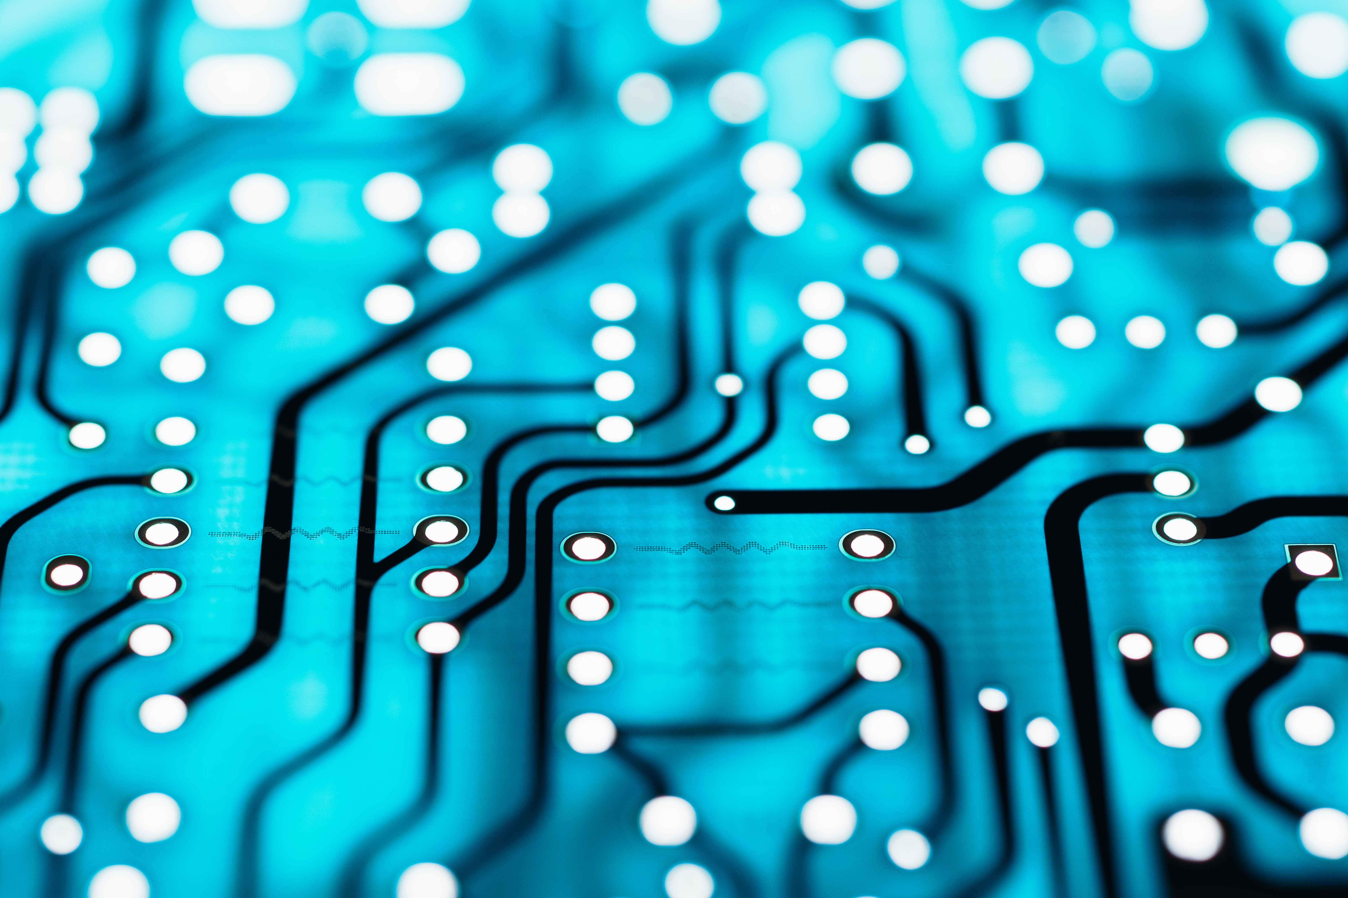
Artificial intelligence
By : Jad halaseh

Slide 2
What is artificial intelegnce
Artificial intelligence is the simulation of human intelligence processes by machines, especially computer systems. Specific applications of AI include expert systems, natural language processing, speech recognition and machine vision.

Slide 3
What a.i can do
Artificial intelligence (AI) makes it possible for machines to learn from experience, adjust to new inputs and perform human-like tasks. Most AI examples that you hear about today – from chess-playing computers to self-driving cars – rely heavily on deep learning and natural language processing.

Slide 4
Advantages of a.i
Reduction in Human Error.
Zero Risks.
24x7 Availability.
Digital Assistance.
New Inventions.
Unbiased Decisions.
Perform Repetitive Jobs.
Daily Applications.

Slide 5
The disadvantages of a.i
High Costs. The ability to create a machine that can simulate human intelligence is no small feat.
No creativity. A big disadvantage of AI is that it cannot learn to think outside the box.
Unemployment.
Make Humans Lazy.
No Ethics.
No Improvement.

