Slide 1
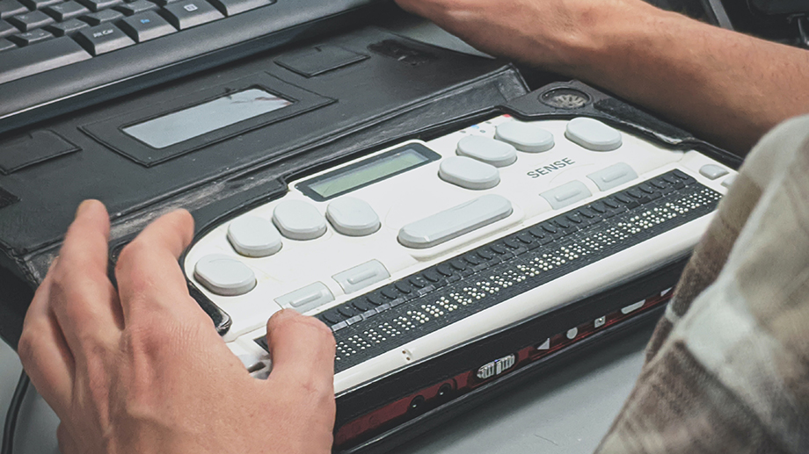
Assistive technology
By:Eliana Barghouth

Slide 2
Definition of Assistive technology
Assistive technology (AT) is any item, piece of equipment, software program, or product system that is used to increase, maintain, or improve the functional capabilities of persons with disabilities.

Slide 3
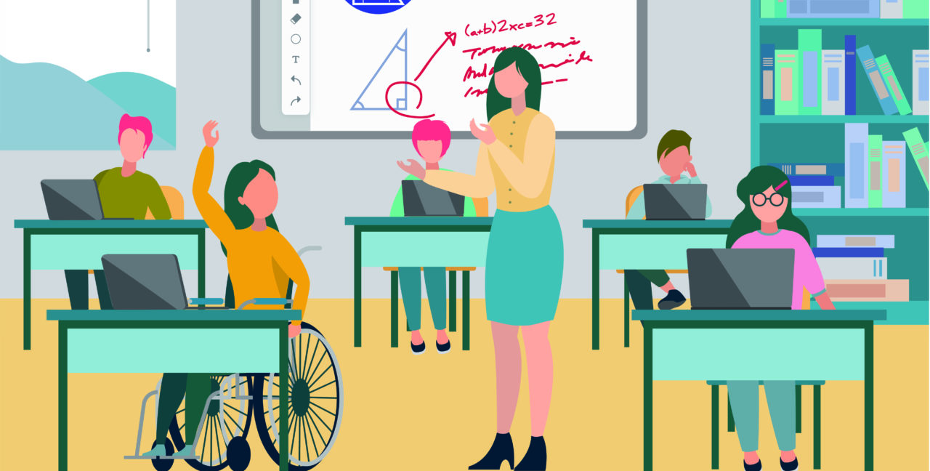
Benefits of assistive technology
Assistive technology helps students with reading, writing, communication, visual, hearing, and mobility challenges to improve their functioning in the classroom. Also increase their independence.
In banking many systems that support people with disabilities are integrated to facilitate those people with special needs to visit banks and do Fianacial transaction.

Slide 4
Examples of assistive technology

Slide 5
Braille
Braille is a system of raised dots that can be read with the fingers by people who are blind or who have low vision.

Slide 6
Speech generator
Speech-generating devices are hand-held electronic devices that play words or phrases when the user touches a switch or presses buttons or keys.

Slide 7
citation
1.What is AT?
https://www.atia.org/home/at-resources/what-is-at/
2.Rethinking Assistive Technology
Sullivan
https://www.edutopia.org/article/rethinking-assistive-technology/#:~:text=Similarly%2C%20assistive%20technology%20allows%20students,their%20functioning%20in%20the%20classroom
3.What Is Braille?
https://www.afb.org/blindness-and-low-vision/braille/what-braille
4.Speech-generating devices
https://raisingchildren.net.au/autism/therapies-guide/speech-generating-devices#:~:text=Speech%2Dgenerating%20devices%20are%20hand,devices%20used%20only%20for%20communication.

