Slide 1
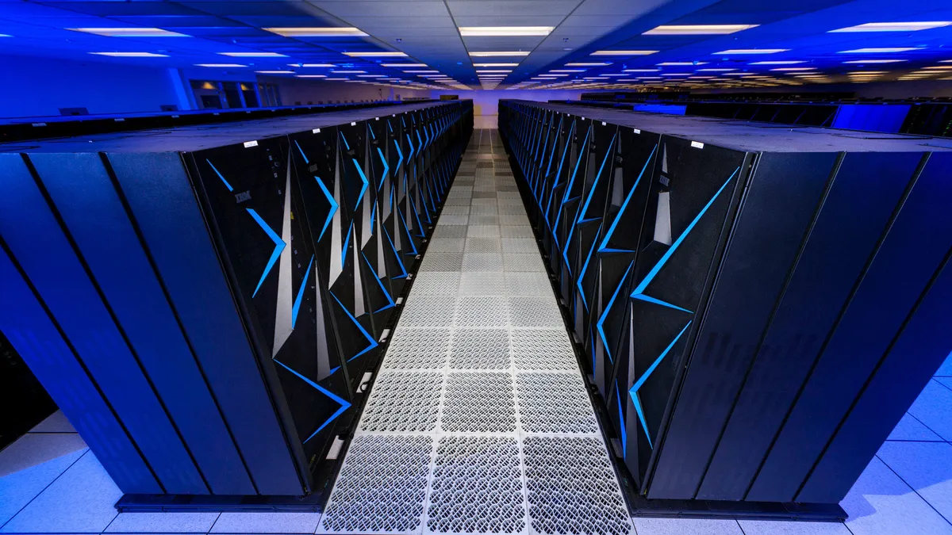
supercomputer
By Jordan Abu Joudeh

Slide 2
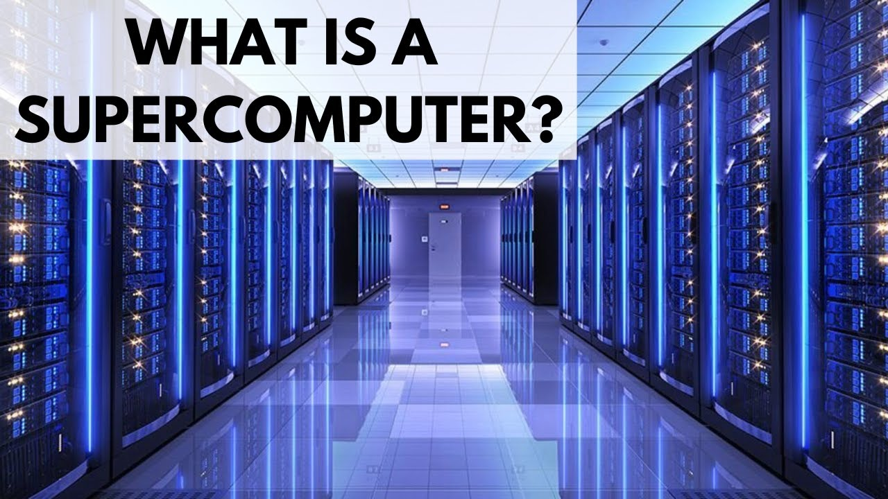
What is a supercomputer?
A supercomputer is a computer with a high level of performance compared to a general purpose computer.

Slide 3
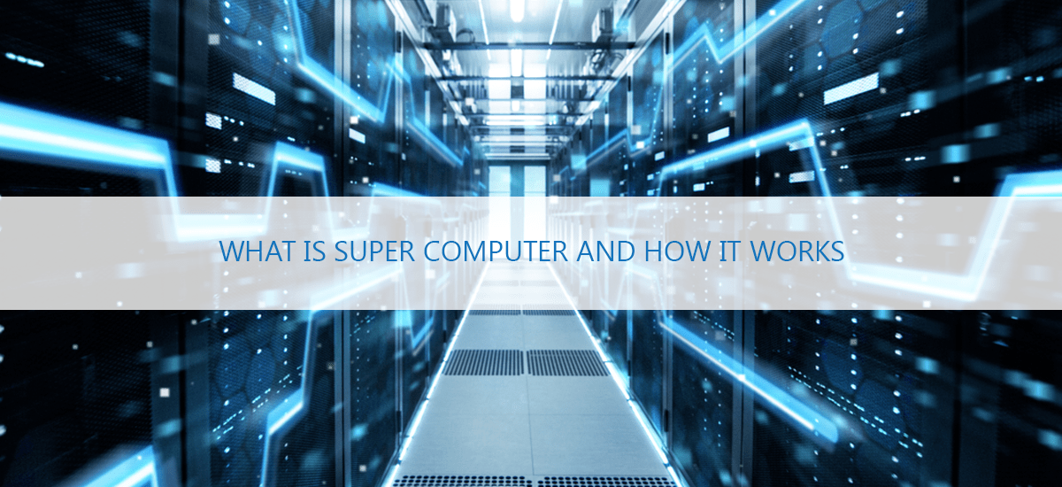
How does it work?
Unlike traditional computers, supercomputers use more than one central processing unit (CPU). These CPUs are grouped into compute nodes, comprising a processor or a group of processors—symmetric multiprocessing (SMP)—and a memory block. At scale, a supercomputer can contain tens of thousands of nodes.

Slide 4
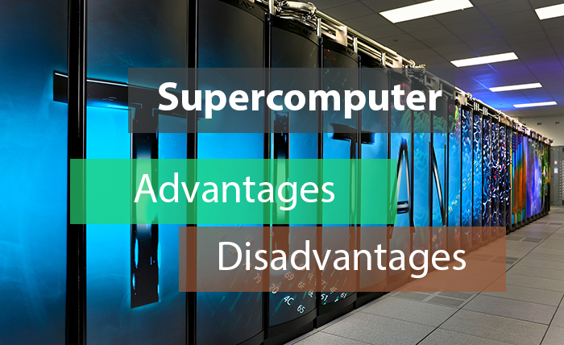
What are the advantages and disadvantages of a supercomputer?
Advantages
Disadvantages
Can decrypt any password:
High processing time:
Environment safety:
Cost efficiency:
Used for filming:
A lot of electricity is used:
A lot of areas are required:
Trained staff needed:
heat up quickly
very expensive to build

