Slide 1
E-learning
Haya Bataineh 8d

Slide 2
What is e-learning?
E-learning is a structured course or learning experience delivered electronically.
There are many different elements that can make up an e-learning program, such as live or pre-recorded lecture content, video, quizzes, simulations, games, activities, and other interactive elements.

Slide 3
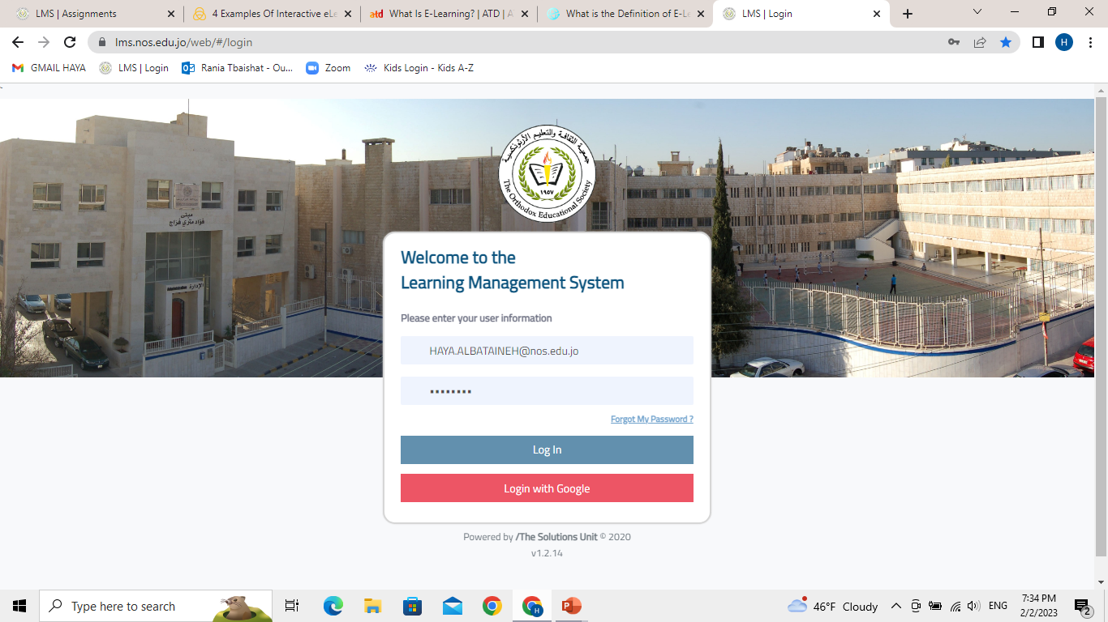
E-learning
The ‘e’ in e-learning stands for electronic.
E-learning is like classroom learning, but it takes place over a local area network or the internet.
E-learning courses are typically managed and administered via a learning management system (LMS).

Slide 4
What are the advantages of e-learning?
Less expensive
Can be taken anywhere and anytime
Tracking capabilities
Allows global collaboration

Slide 5
What are the disadvantages of e-learning?
Online Learning May Create a Sense of Isolation.
Online Learning Requires Self-Discipline.
Online Classes Are Prone to Technical Issues.
Online Learning means more screen-time

Slide 6
Sources
https://www.td.org/talent-development-glossary-terms/what-is-e-learning
https://www.prosperityforamerica.org/disadvantages-of-online-learning/

Slide 7
Thank you

