Slide 1
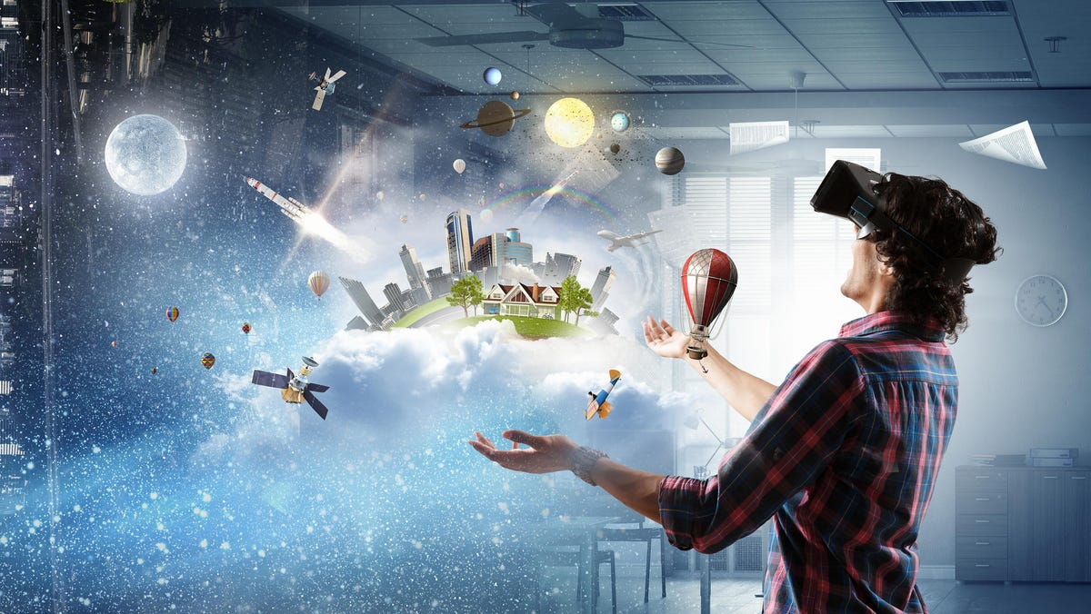
Virtual reality
By: Carla Seleme
8CS-D

Slide 2
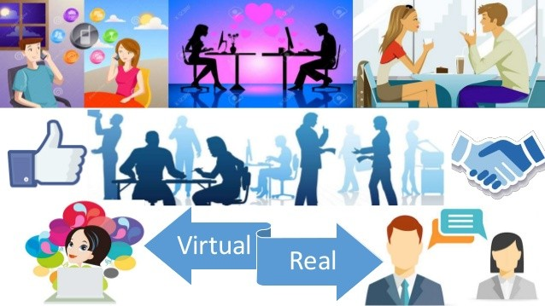
First you have to know what does virtual means..
What does virtual really mean?
It is a digitally replicated version of something real, whether it's a machine, a switch, memory or even reality.

Slide 3
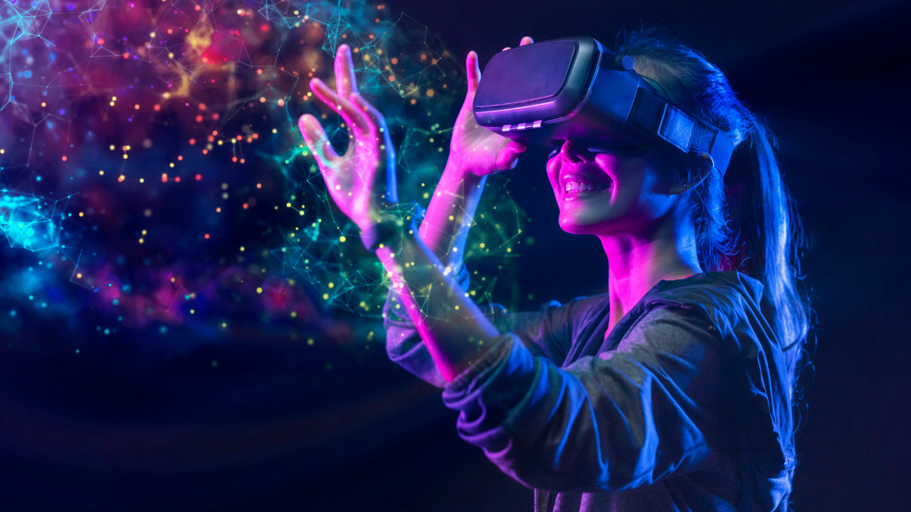
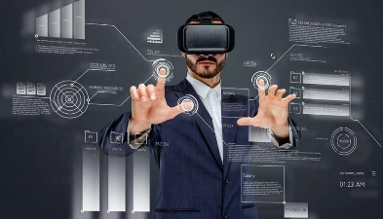
Now what is virtual reality??
Virtual reality is a simulated experience that employs pose tracking and 3D near-eye displays to give the user an immersive feel of a virtual world.
Applications of virtual reality include:
Entertainment: the creation of a virtual environment presented to our senses in such a way that we experience it as if we were
really there.
Education: helps education by creating immersive lessons that are
engaging, memorable and impactful for students
Business: enables sales teams to immerse their clients in
environments where they can interact with a product.

Slide 4
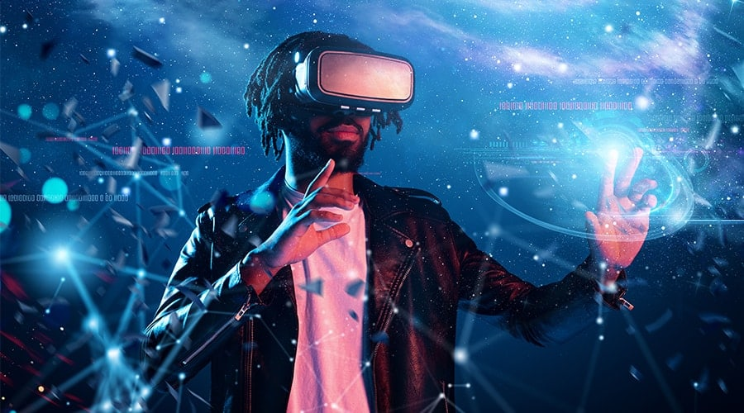
Advantages and Disadvantages of virtual reality:
Advantages:
Disadvantages:
Virtual reality helps in exploring places without actually being there
The education system has been improved
It creates a realistic world
Help in providing training
Deteriorates Human Connections.
Lack Of Flexibility.
Functionality Issues
Addiction To The Virtual World.

Slide 5
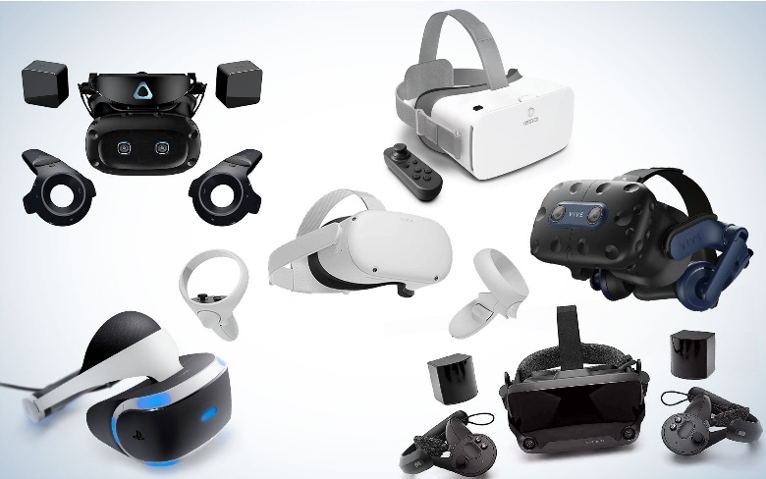
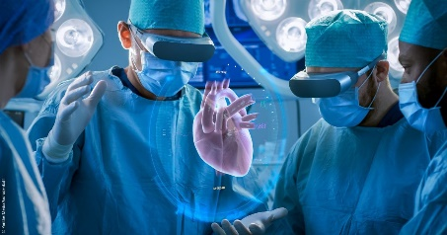
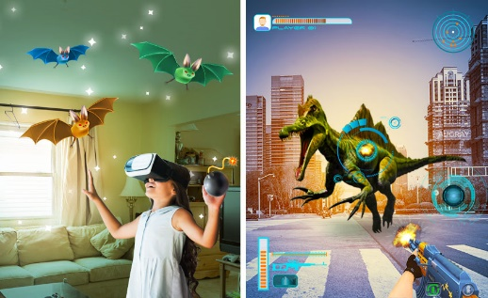
Is virtual reality a need or a want?
Now in this question it depends if it’s a need or a want, it depends how your going to use the virtual reality device:
How could it be a need?
It could be a need with our recent technology, it will help you with whatever you want to work. Lets talk about being a doctor, virtual reality helps people to see and make surgeries virtually to learn how to perfect a real surgery. That’s why they need it.
How could it be a want?
It could be a want to have fun! Many kids have asked for a VR headset to play games and feel like they are in the game itself. In my opinion it is fun but not always because a lot of death cases are caused of having heart attacks from being scared in the game so if you decide to get a VR headset for games be very careful with what you play.
Click here for better experience
Such as these

Slide 6
Nice right?☺
Click here to go back..

Slide 7
Resources I used:
https://dictionary.cambridge.org/dictionary/english/virtual (second slide)
https://www.vrs.org.uk/virtual-reality/what-is-virtual-reality.html (third slide)
https://www.vrs.org.uk/virtual-reality-applications/ (third slide)
https://www.aplustopper.com/virtual-reality-advantages-and-disadvantages/ (forth slide)
https://www.simplilearn.com/tutorials/artificial-intelligence-tutorial/what-is-virtual-reality (fifth slide)

Slide 8
I hope you enjoyed my presentation

