Slide 1
Artificial intelligence
By: Sulaf Abulatif

Slide 2
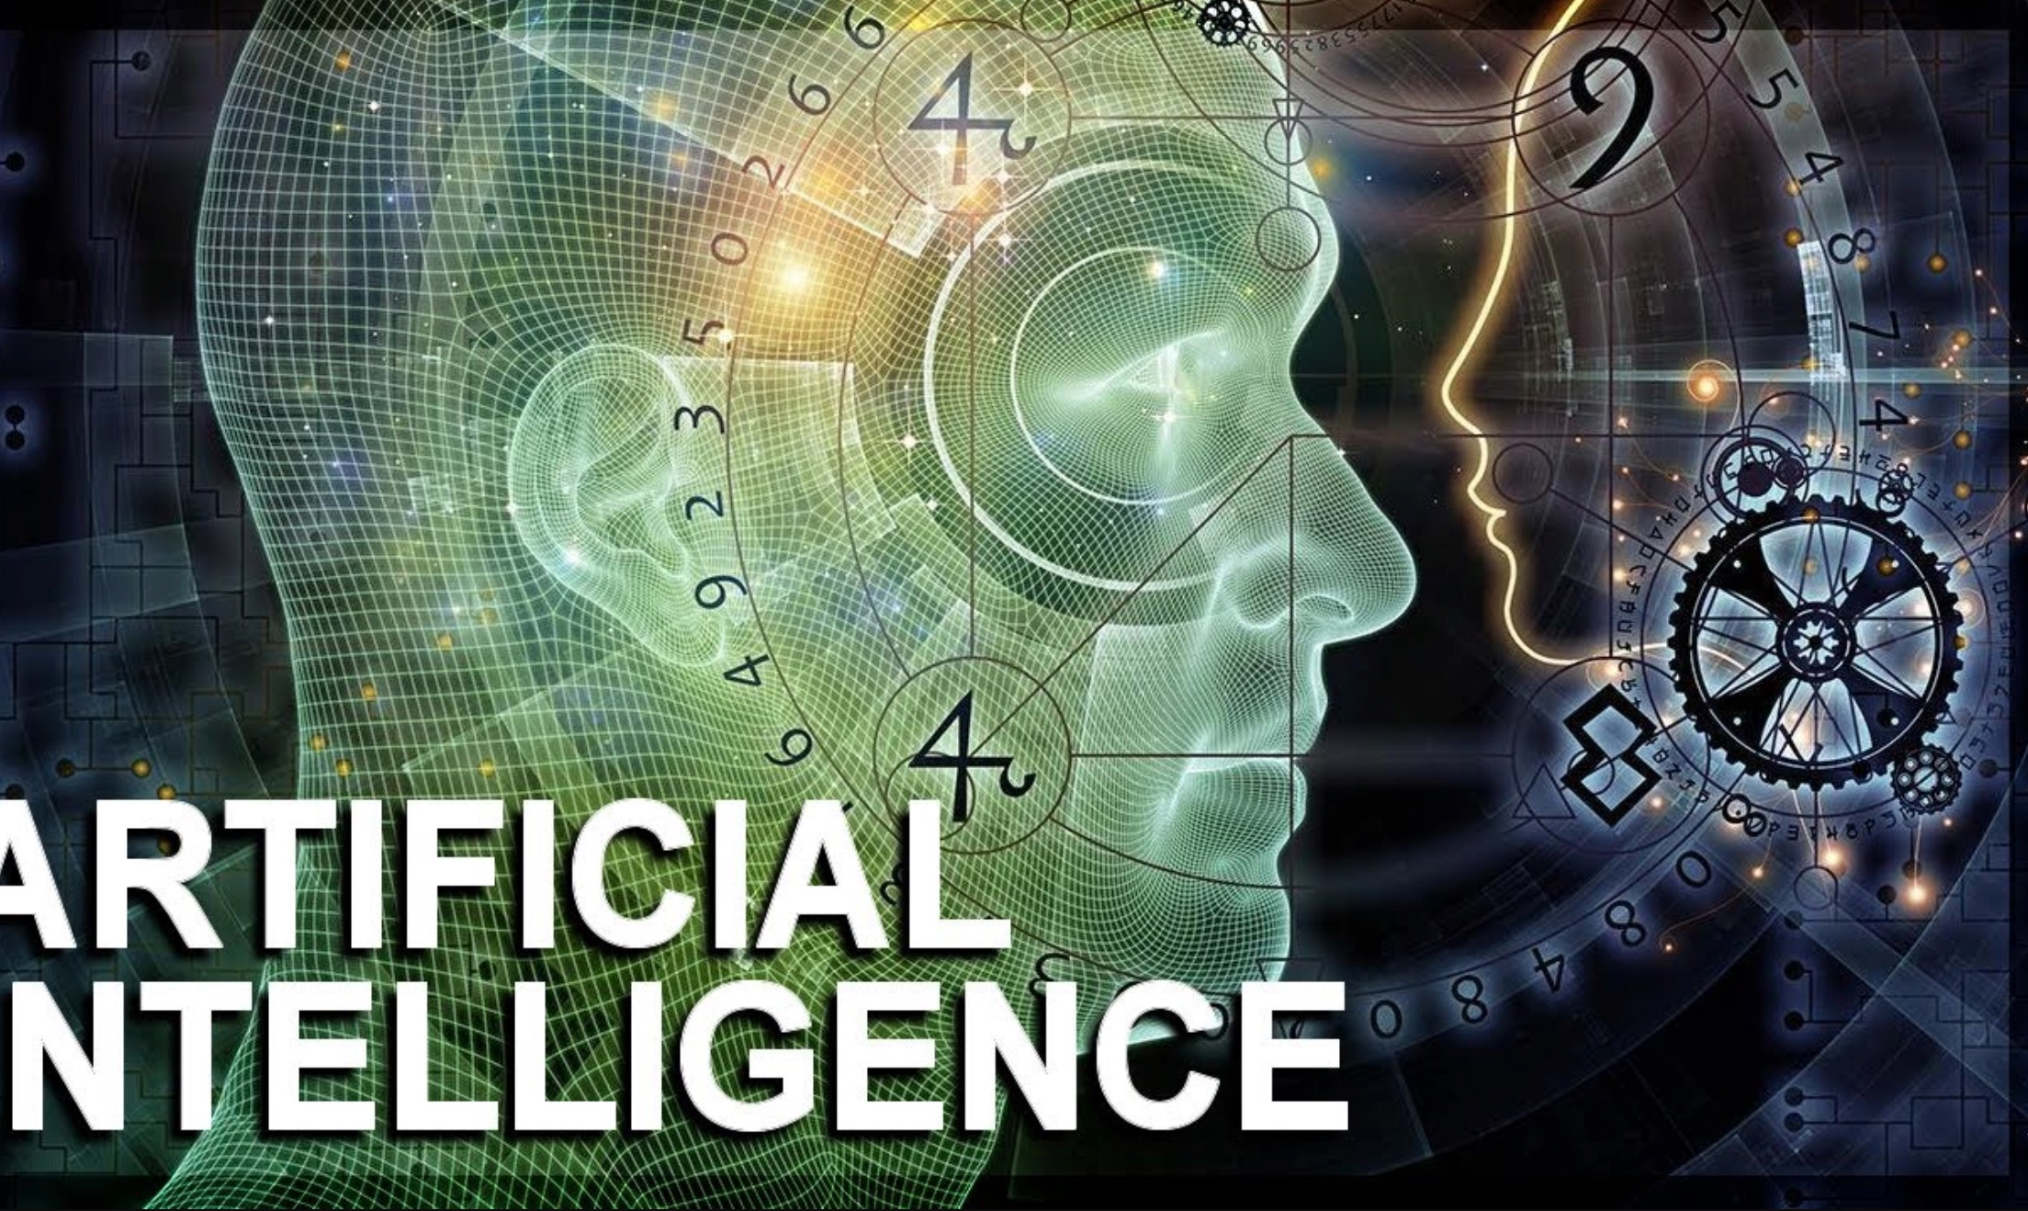
What is Artificial intelligence?
Artificial intelligence (also known as AI) is the simulation of human intelligence processes by machines, especially computer systems. Specific applications of AI include expert systems, natural language processing, speech recognition and machine vision.

Slide 3
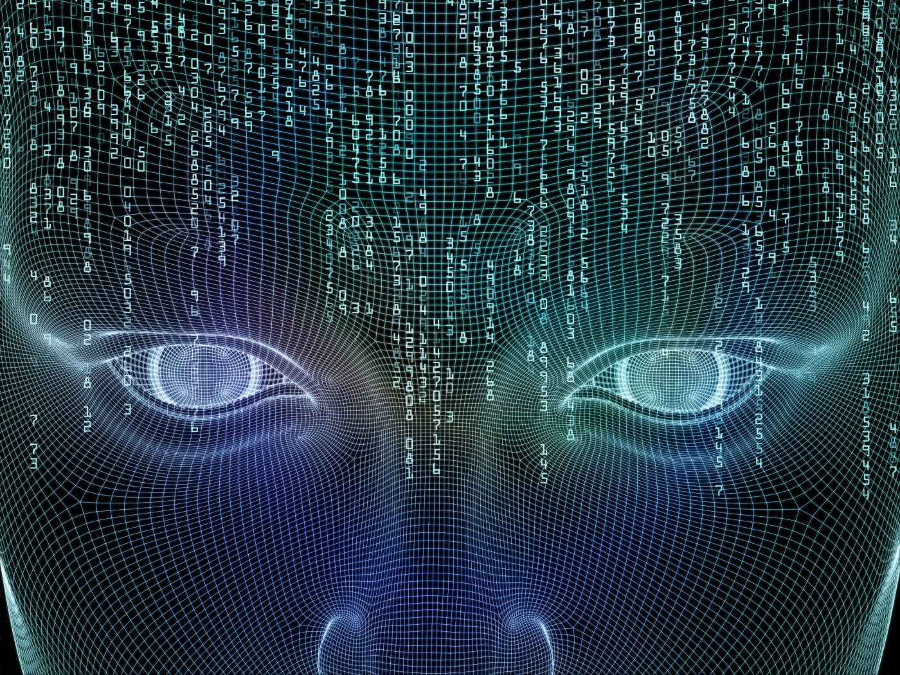
How does Artificial intelligence work?
AI requires a foundation of specialized hardware and software for writing and training machine learning algorithms. No one programming language is synonymous with AI, but a few, including Python, R and Java, are popular. In general, AI systems work by ingesting large amounts of labeled training data, analyzing the data for correlations and patterns, and using these patterns to make predictions about future states. In this way, a chatbot that is fed examples of text chats can learn to produce lifelike exchanges with people, or an image recognition tool can learn to identify and describe objects in images by reviewing millions of examples.

Slide 4
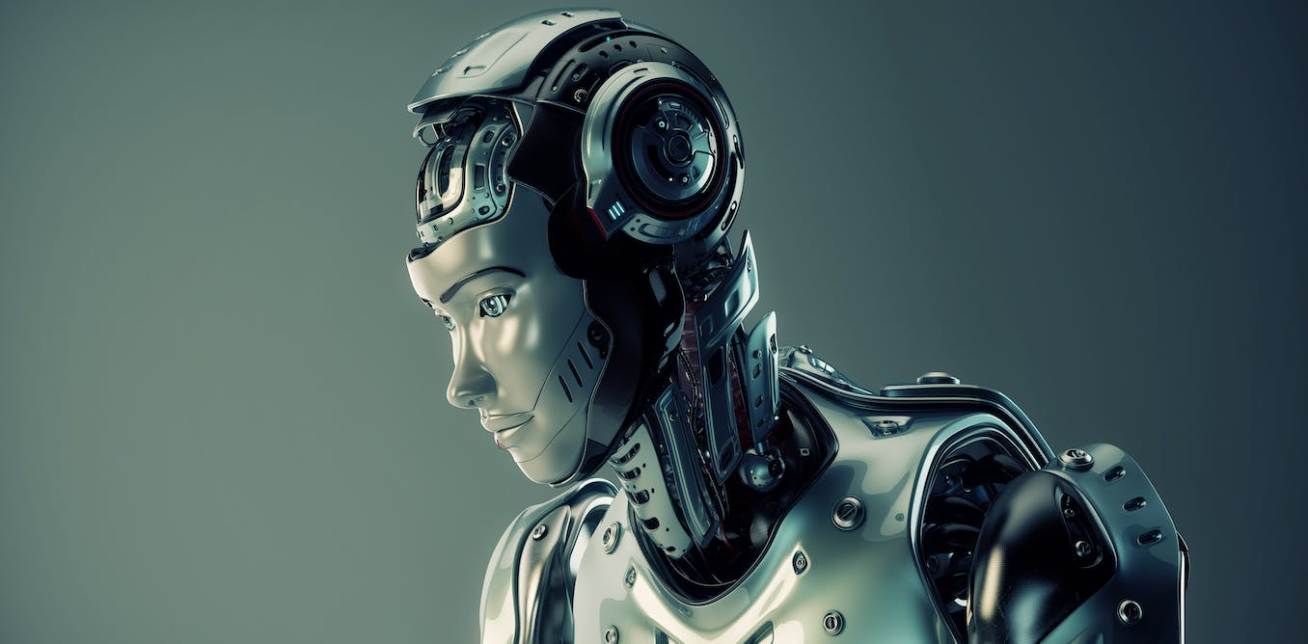
Advantages of Artificial intelligence
Reduction in Human Error.
Takes risks instead of Humans.
Available all the time.
Digital Assistance.
Faster Decisions.
New Inventions.
Daily Applications.
Increased Efficiency.
Improved Workflows.
Helping in Repetitive Jobs.

Slide 5
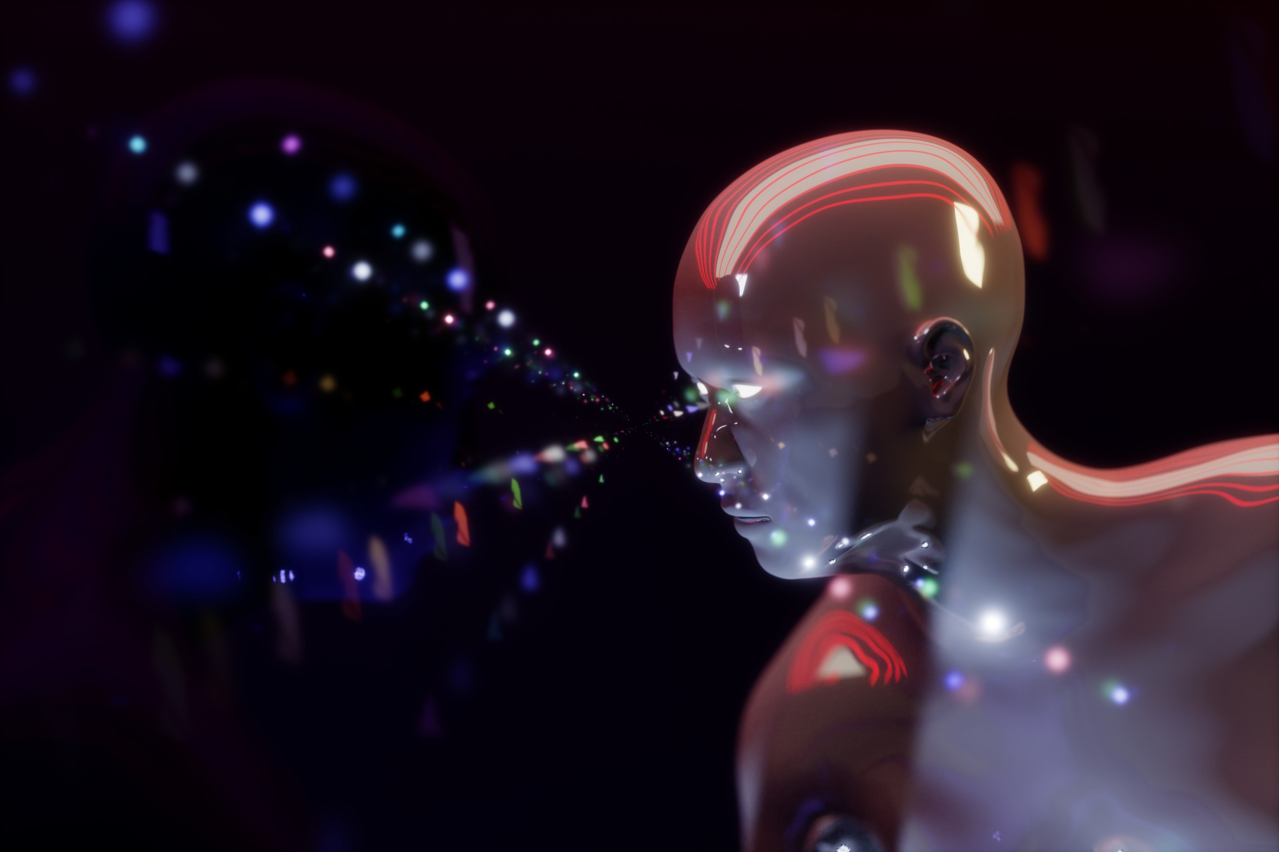
Disadvantages of Artificial intelligence
High Costs.
Unemployment.
Make Humans Lazy.
No Ethics.
Emotionless.
Security problems.
Lacking creativity.
Big Tech domination.
Lacking Out of Box Thinking.
No Improvement.

Slide 6
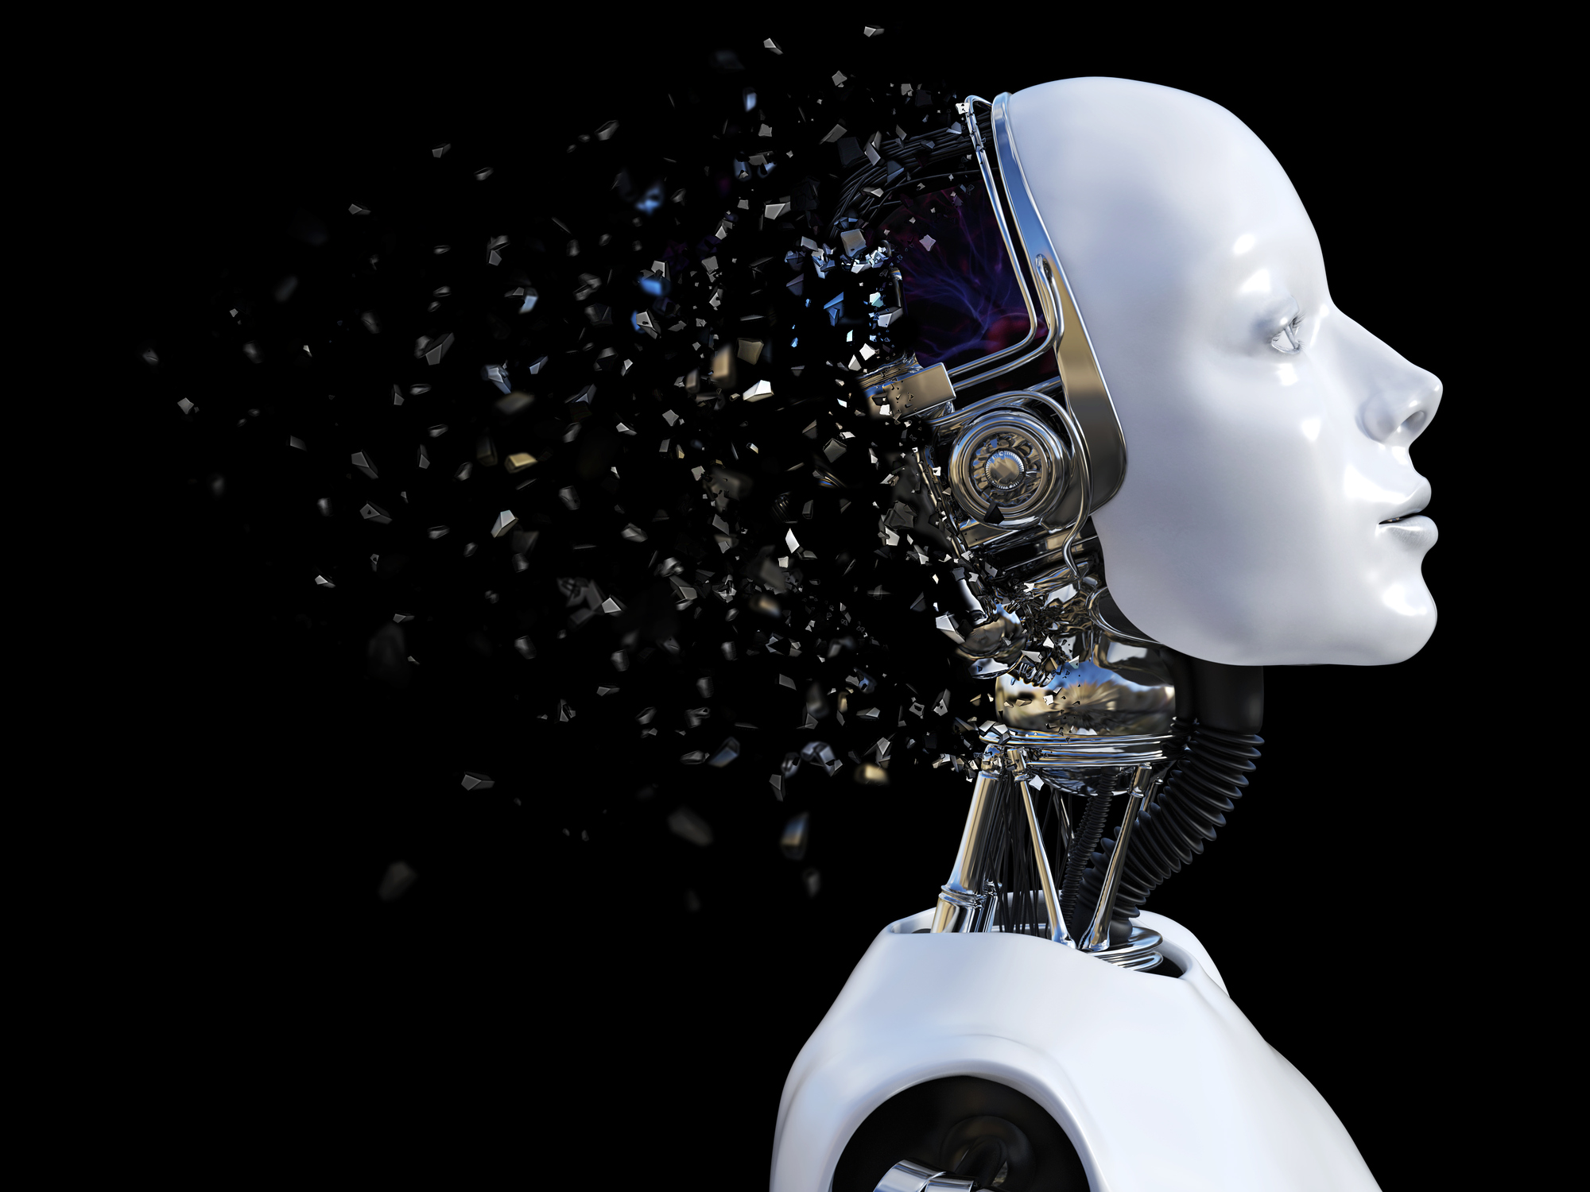
How does Artificial intelligence affect society?
Artificial intelligence can dramatically improve the efficiencies of our workplaces and can augment the work humans can do. When AI takes over repetitive or dangerous tasks, it frees up the human workforce to do work they are better equipped for—tasks that involve creativity and empathy among others. If people are doing work that is more engaging for them, it could increase happiness and job satisfaction.

Slide 7
Resources
https://www.techtarget.com/searchenterpriseai/definition/AI-Artificial-Intelligence
https://www.sas.com/en_in/insights/analytics/what-is-artificial-intelligence.html#:~:text=AI%20works%20by%20combining%20large,or%20features%20in%20the%20data.
https://bernardmarr.com/what-is-the-impact-of-artificial-intelligence-ai-on-society/#:~:text=Artificial%20intelligence%20can%20dramatically%20improve,creativity%20and%20empathy%20among%20others.
https://www.simplilearn.com/advantages-and-disadvantages-of-artificial-intelligence-article
https://towardsdatascience.com/advantages-and-disadvantages-of-artificial-intelligence-182a5ef6588c\
https://www.rev.com/blog/speech-to-text-technology/what-are-the-advantages-of-artificial-intelligence
https://dataconomy.com/2022/08/the-cons-of-artificial-intelligence/

