Slide 1
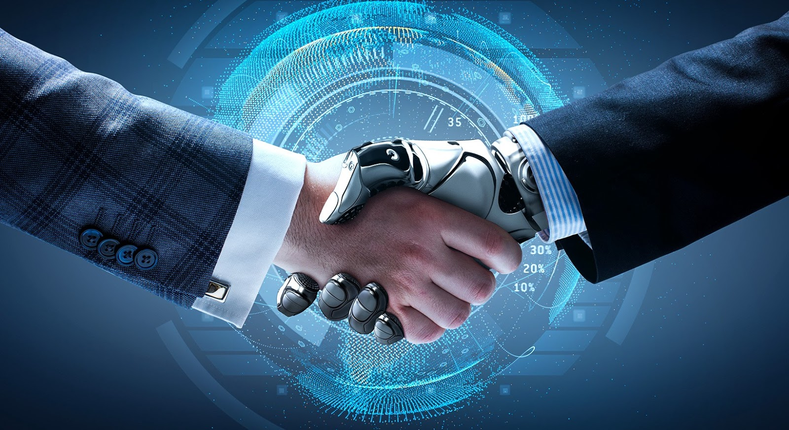
Artificial intelligence
by: perla habash

Slide 2
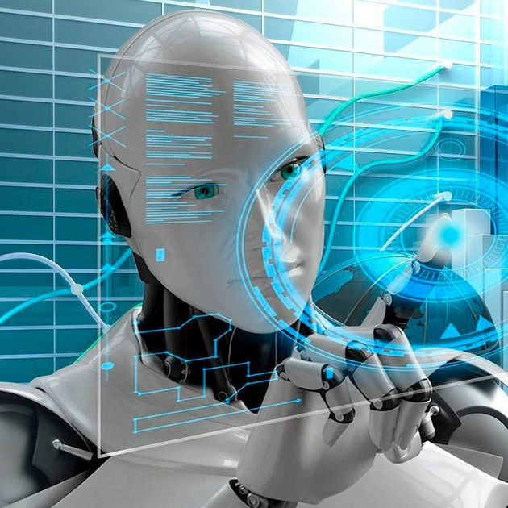
What is the artificial intelligence?
Artificial intelligence (AI) is a set of technologies that enable computers to perform a variety of advanced functions, including the ability to see, understand and translate spoken and written language, analyze data, make recommendations, and more.
AI is a broad field that encompasses many different disciplines, including computer science, data analytics and statistics, hardware and software engineering, linguistics, neuroscience, and even philosophy and psychology.

Slide 3
AI with examples
Artificial intelligence is the simulation of human intelligence processes by machines, especially computer systems. Specific applications of AI include expert systems, natural language processing, speech recognition and machine vision.

Slide 4
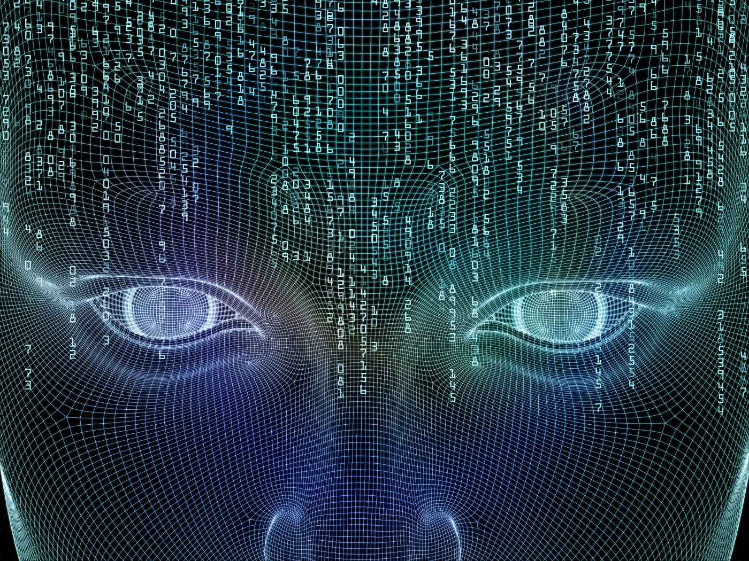
How does work?
As the hype around AI has accelerated, vendors have been scrambling to promote how their products and services use AI. Often what they refer to as AI is simply one component of AI, such as machine learning. AI requires a foundation of specialized hardware and software for writing and training machine learning algorithms. No one programming language is synonymous with AI, but a few, including Python, R and Java, are popular.

Slide 5
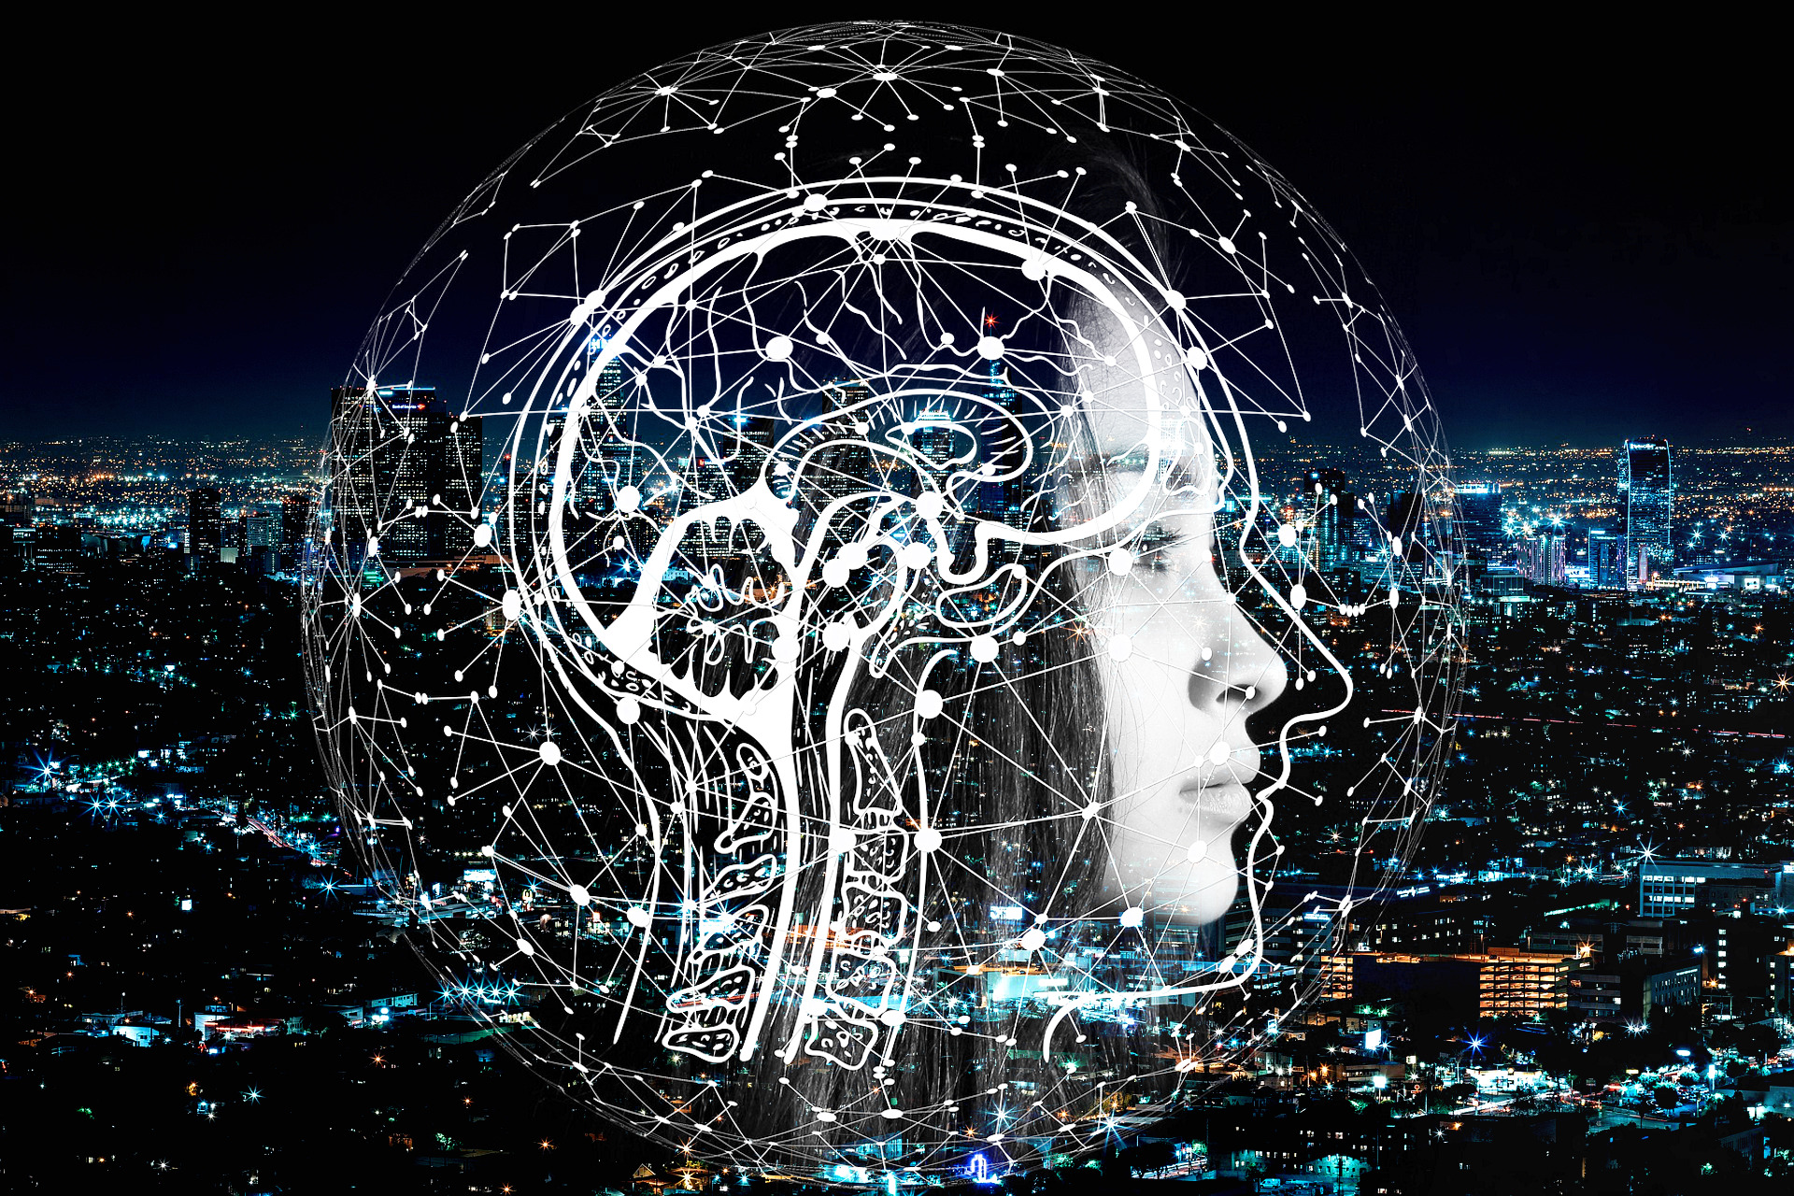
What is purpose of artificial intelligence?
Artificial intelligence (AI) makes it possible for machines to learn from experience, adjust to new inputs and perform human-like tasks

Slide 6
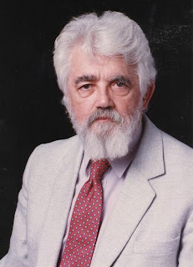
Where did the term “Artificial Intelligence” come from?
One of the greatest innovators in the field was John McCarthy, widely recognized as the father of Artificial Intelligence due to his astounding contribution in the field of Computer Science and AI.

Slide 7
When was AI first invented?
The earliest successful AI program was written in 1951 by Christopher Strachey, later director of the Programming Research Group at the University of Oxford.

Slide 8
How does AI improve life?
AI assists in every area of our lives, whether we're trying to read our emails, get driving directions, get music or movie recommendations.

Slide 9
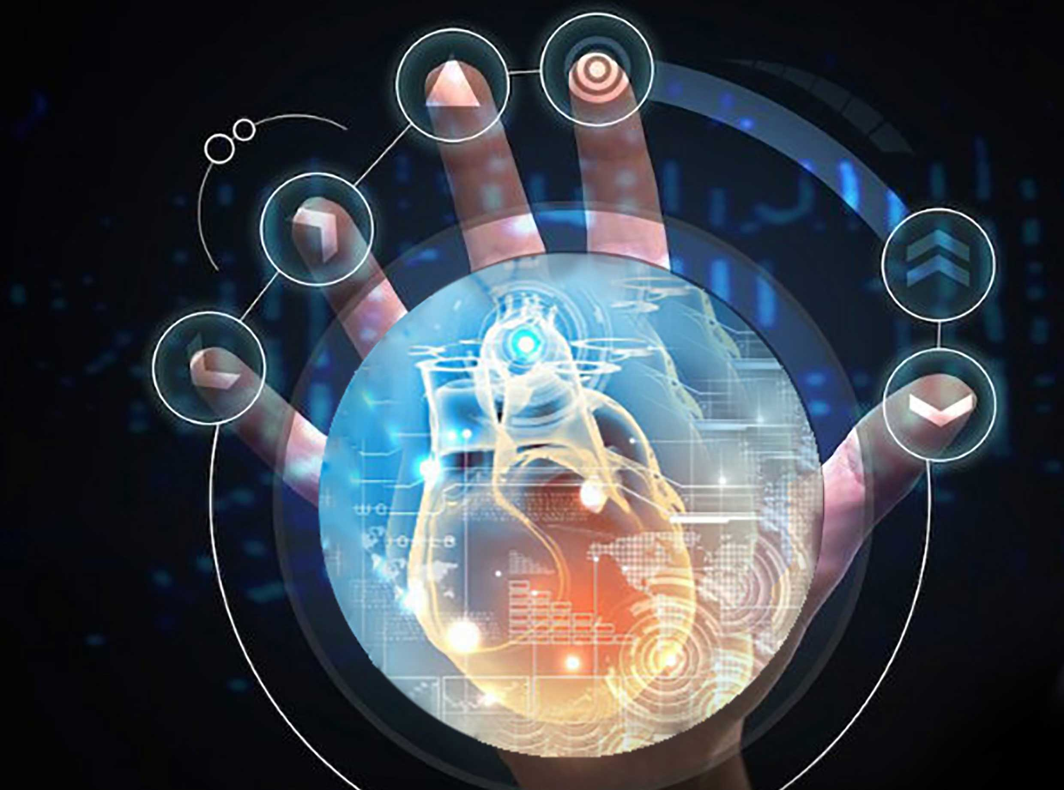
Where is AI used in daily life?
Voice assistants, image recognition for face unlock in cellphones, and ML-based financial fraud detection are examples of AI software currently being used in everyday life.

Slide 10
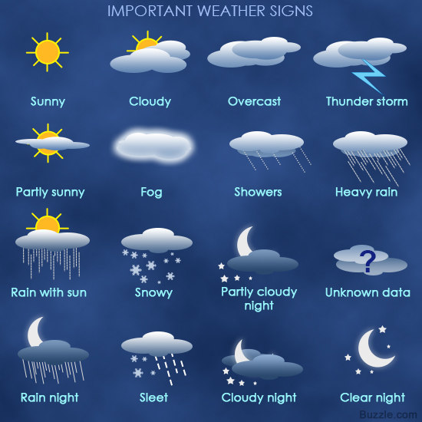
How is AI helping the world?
AI has helped companies solve complex issues such as fraud detection, medical diagnosis, weather forecasting and so on.

Slide 11
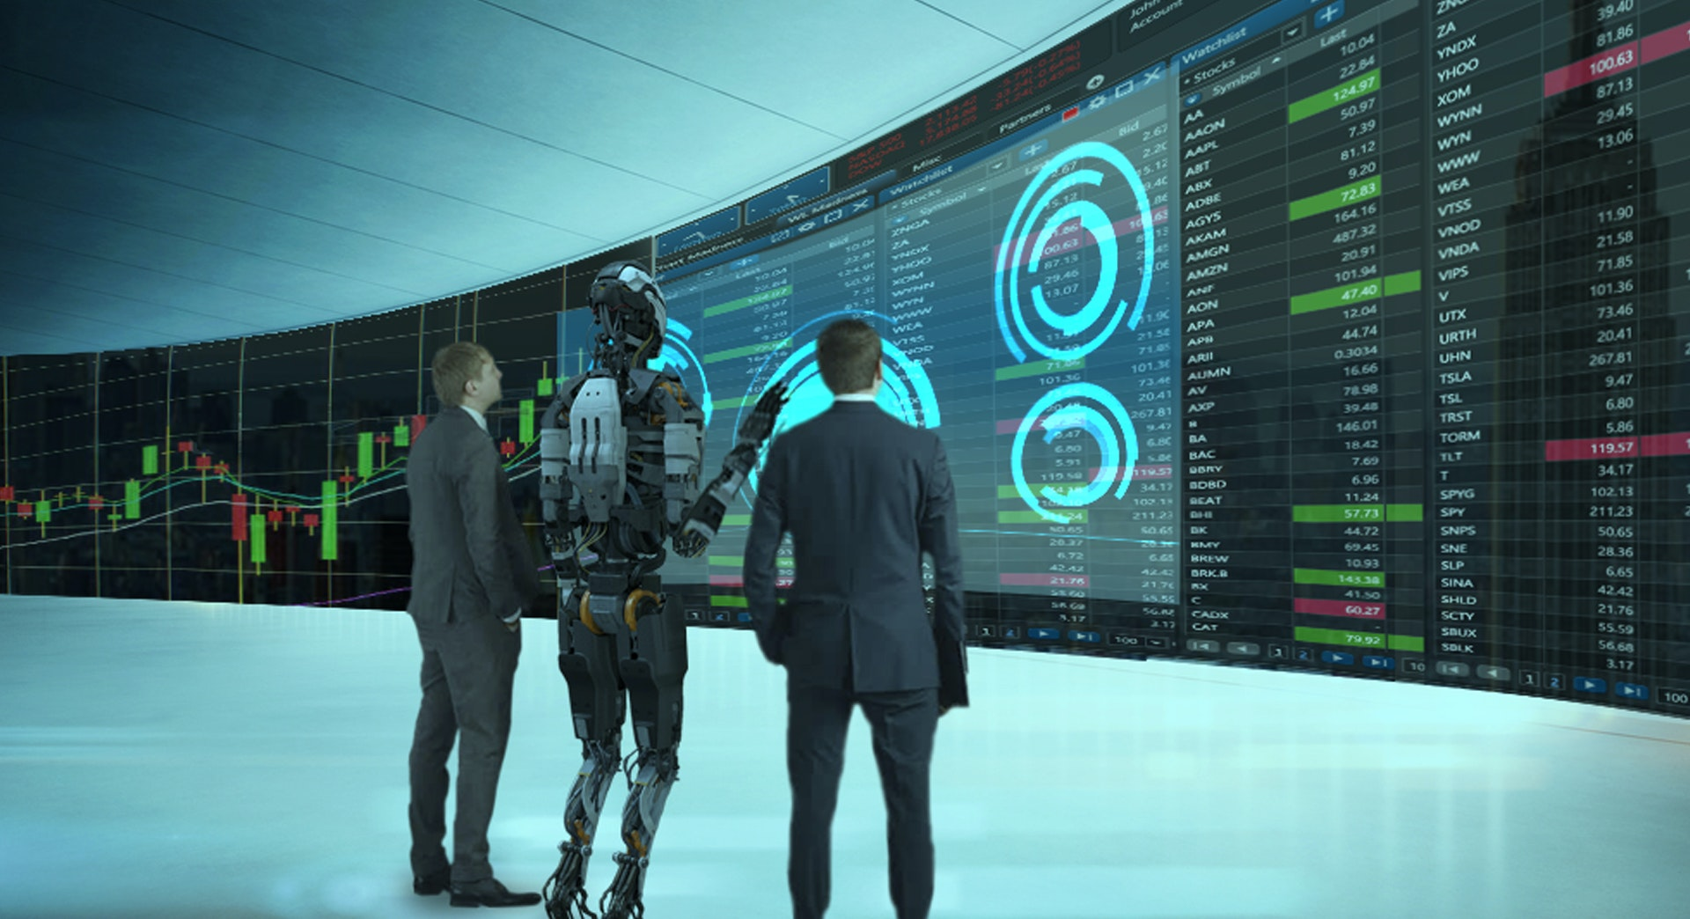
Disadvantages of AI
1. HIGH COST OF IMPLEMENTATION
2. CAN’T REPLACE HUMANS
3. DOESN’T IMPROVE WITH EXPERIENCE
4. LACKS CREATIVITY
5. RISK OF UNEMPLOYMENT

Slide 12
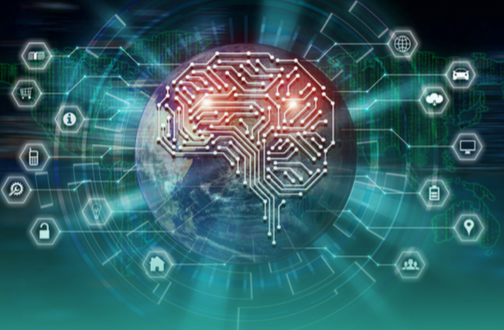
Advantages of AI
AI drives down the time taken to perform a task. It enables multi-tasking and eases the workload for existing resources.
AI enables the execution of hitherto complex tasks without significant cost outlays.
AI operates 24x7 without interruption or breaks and has no downtime
AI facilitates decision-making by making the process faster and smarter.

Slide 13
https://www.techtarget.com/searchenterpriseai/definition/AI-Artificial-Intelligence#:~:text=Artificial%20intelligence%20is%20the%20simulation,speech%20recognition%20and%20machine%20vision.
https://www.artificial-solutions.com/blog/homage-to-john-mccarthy-the-father-of-artificial-intelligence#:~:text=Where%20did%20the%20term%20%E2%80%9CArtificial,of%20Computer%20Science%20and%20AI.
https://www.edureka.co/blog/benefits-of-artificial-intelligence/#:~:text=Throughout%20the%20years%2C%20AI%20has,weather%20forecasting%20and%20so%20on.
https://proschoolonline.com/blog/what-are-the-disadvantages-of-ai
https://dataconomy.com/2022/05/artificial-intelligence-in-everyday-life/#:~:text=Voice%20assistants%2C%20image%20recognition%20for,no%20other%20devices%20is%20required.
https://towardsdatascience.com/how-artificial-intelligence-is-impacting-our-everyday-lives-eae3b63379e1
https://cloud.google.com/learn/what-is-artificial-intelligence#:~:text=Artificial%20intelligence%20(AI)%20is%20a,%2C%20make%20recommendations%2C%20and%20more.
https://www.sas.com/en_us/insights/analytics/what-is-artificial-intelligence.html#:~:text=Artificial%20intelligence%20(AI)%20makes%20it,learning%20and%20natural%20language%20processing.

