Slide 1
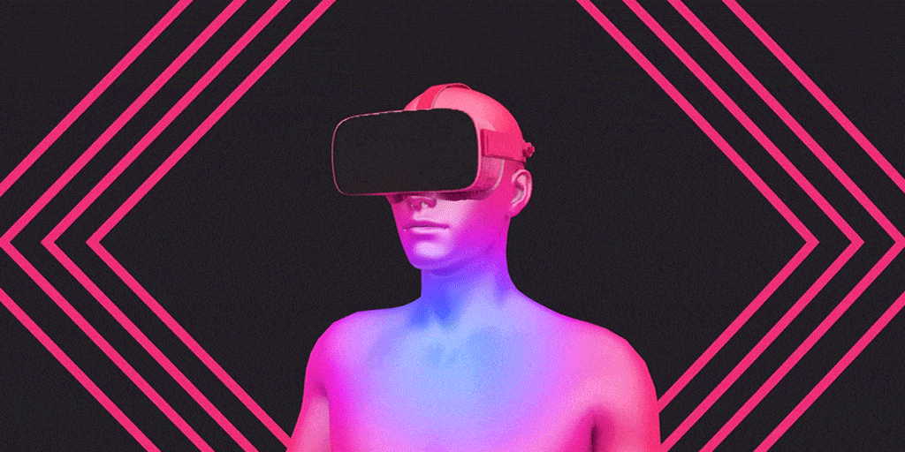
Virtual reality
By: Taleen Habash

Slide 2
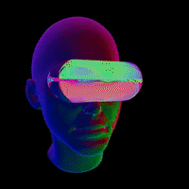
What is Virtual Reality?
Virtual Reality, or VR, is a technology that allows users to fully immerse themselves in a specially created or simulative world. For instance, 360-degree exploration of medical training and games without bounds or borders. Through the use of VR goggles or other technologies, users may engage in virtual, simulated settings.

Slide 3
Why Is Virtual Reality Needed?
Users of virtual reality may develop simulated, interactive, and purpose-specific settings.
It is intended to facilitate human contact or specifically to provide experiences.
With its completely immersive and interactive technology, VR elevates the user experience to a higher degree than other reality technologies like AR and MR.

Slide 4
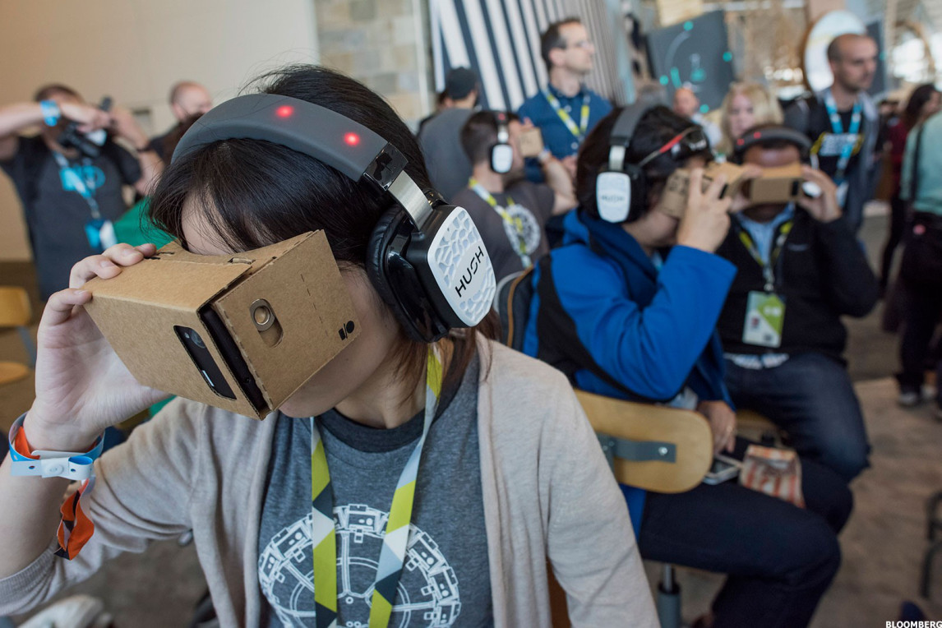
In classrooms:
Any topic may be covered with this tool, which also allows teachers a chance to connect with a range of learning methods and explore new ideas with students. For instance, children can explore a rainforest and learn about various plants and animals.
The technology also gives designers and programmers a lot of flexibility. VR may be used in the school curriculum to educate social and personal skills while removing geographical and communication limitations.
Virtual reality is a new technology that is being used in schools to enhance the teaching of a subject or topic and help students "experience" the information. Students may explore, experience, and immerse themselves in virtual worlds via VR, which goes beyond simply engaging them.
Virtual reality may be utilized in the classroom in one of two ways: either a student can explore a virtual environment using a computer, keyboard, and mouse, or they can use an input device, such a controller or a virtual reality headset.

Slide 5
Disadvantages of Virtual Reality:
1. Costly implementation Virtual reality implementation is a costly process. Only a select few people could afford the expensive technology and equipment utilized in virtual reality. Therefore, the initial installation of this kind of equipment is expensive.
2. Developing only technical abilities with no interaction: Although technical expertise is established, virtual reality experiences are based on pre-recorded environments, therefore there is no room for teacher involvement. As a result, the learner's uncertainties persist until any other knowledgeable individual shares their understanding of the subject.

Slide 6
4. Psychological harm: Individuals who grow hooked to virtual reality also have psychological effects, hence it is advised that people refrain from using virtual reality for extended periods of time.
3. Effects on the actual human body: Many people who use virtual reality have eye strain, vertigo, and nausea disorders. This is as a result of the illusion that virtual reality creates.
5. Not interested in the actual world: As individuals get dependent on virtual reality, they no longer desire to interact with it. They no longer want to interact with the real world since the virtual world has become their actual reality.

Slide 7
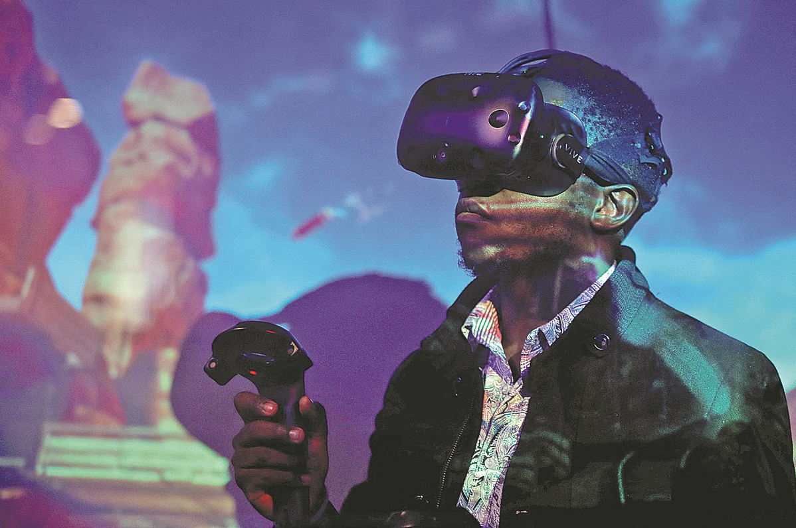
How will Virtual Reality be used in the future
Applications that go beyond entertainment, tourism, and marketing are now in high demand, and they must also be more user-friendly and economical. We are therefore likely to encounter expanded reality in hitherto unimaginable ways.
As a result of anticipated technology advancements, VR and AV will be quicker, lighter, and more cheap. Future smartphones with better cameras and processors, 5G networks, and other advancements will also enable us to take advantage of considerably more advanced immersive experiences everywhere.

Slide 8
Resources:
https://evergine.com/future-virtual-augmented-reality/#:~:text=Virtual%20and%20augmented%20reality%20devices,as%20full%2Dbody%20haptic%20suits.
https://www.aplustopper.com/virtual-reality-advantages-and-disadvantages/
https://www.vrs.org.uk/virtual-reality/what-is-virtual-reality.html
https://edu.gcfglobal.org/en/thenow/understanding-virtual-reality-and-augmented-reality/1/

Slide 9
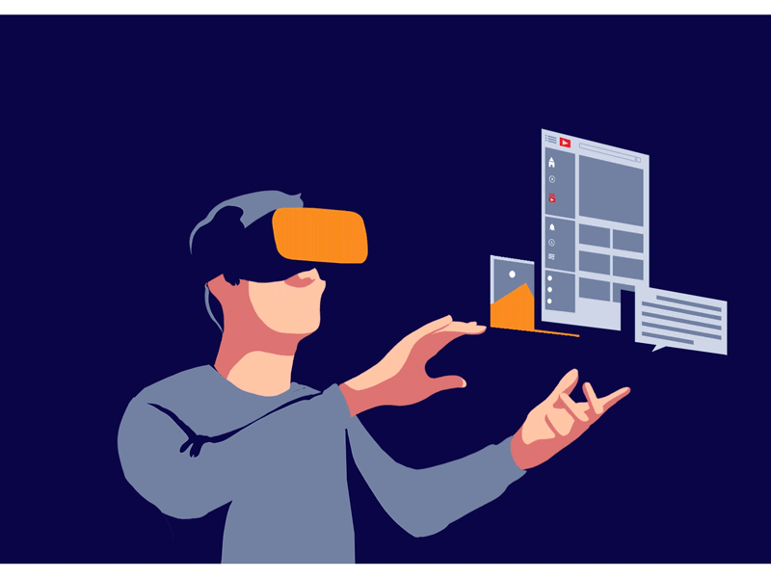
THANK YOU

