Slide 1
Simulation
Project

Slide 2
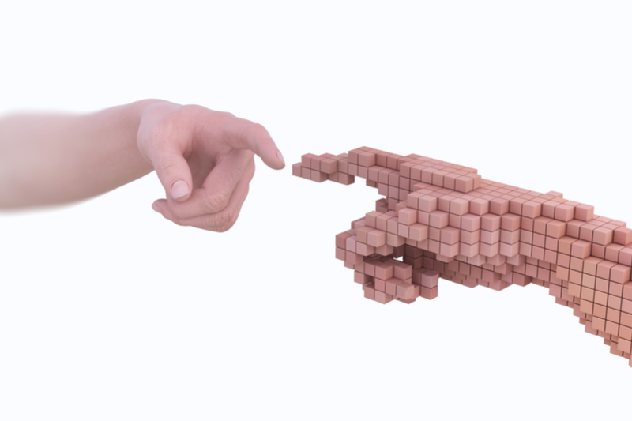
What is the meaning of simulation?
The ability to test various scenarios or process improvements makes simulation an effective tool for decision-making. Simulation is a model that replicates the operation of an existing or proposed system. For a more immersive experience, this can be combined with virtual reality technology.

Slide 3
examples of simulation
fire drills
weather forecasting
CGI graphics in entertainment
Also used in healthcare to teach skills or prepare for emergencies

Slide 4
Simulation in real life
A simulation is an ongoing recreation of how a system or process might work in the actual world. Models must be used in simulations; the model reflects the essential traits or behaviors of the chosen system or process, whilst the simulation depicts the model's development over time.

Slide 5
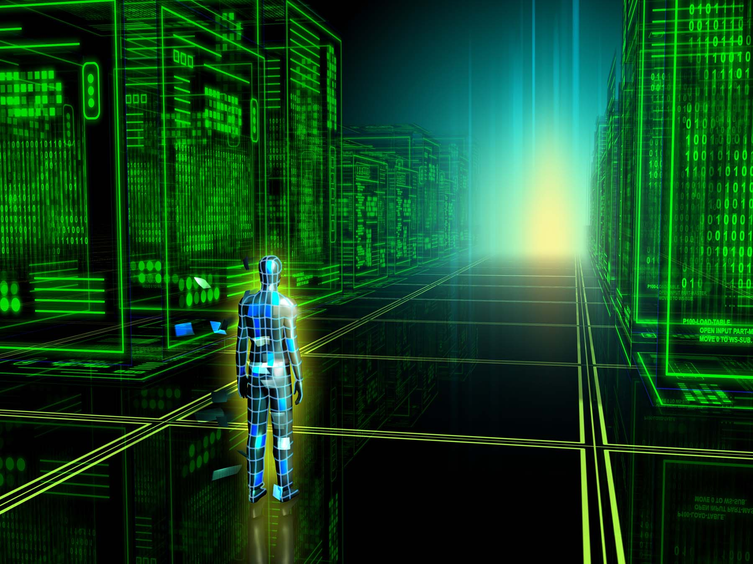
What is simulation in learning
Before treating actual patients, trainees practice a procedure or routine in a simulated learning environment (SLE). This is known as simulation learning. These environments range in realism and employ various scenarios and tools.

Slide 6
How do simulation benefit us humans?
You can investigate hypothetical situations and "what if" questions with simulation rather than by performing system-based experiments. It assists you in locating obstructions in the flow of materials, information, and goods. It aids in your understanding of the factors that affect system performance the most.

Slide 7
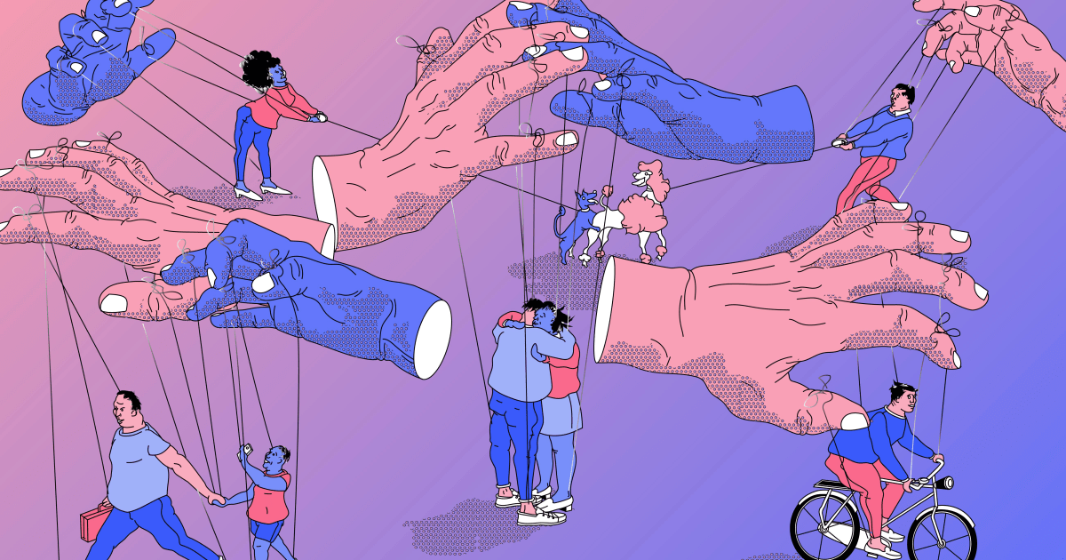
What are simulation skills?
Technical and functional expertise training

