Slide 1
Simulations In Our Lives
By: Hala Abu Baida
Grade:8
Section: (C)

Slide 2
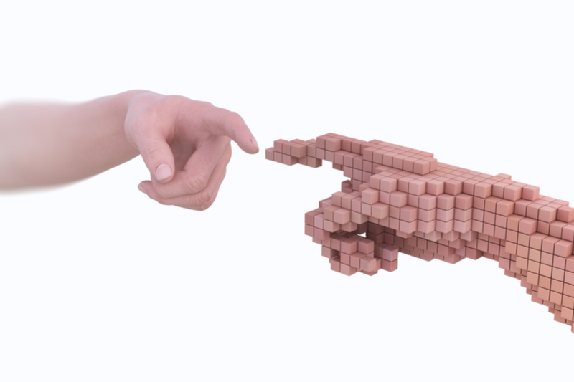
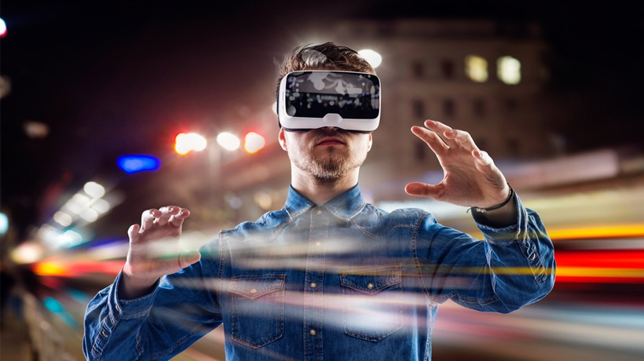
What Is A Simulation?
A simulation is a model or program that mimics an experience or event that could happen in real life
You can use a simulation assisted by virtual reality to make the experience more realistic or interactive.

Slide 3
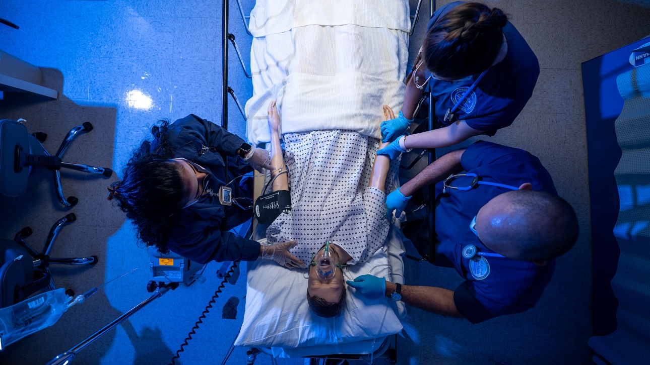
Examples of simulations used in different industries:
Healthcare:
Healthcare providers(doctors & nurses) need to be trained not to make mistakes on a patient in a critical environment, but with no risk on the patient, that is where simulations come into play. by training with simulations they most likely wont make a mistake on the patient.

Slide 4
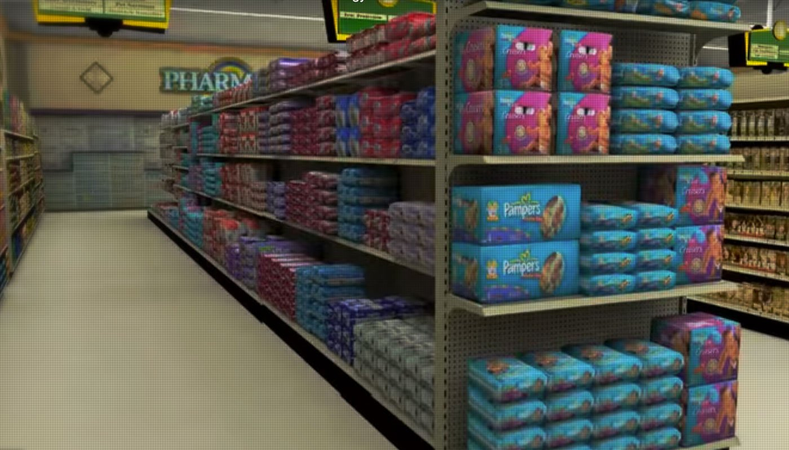
Manufacturing:
When some kind of business wants to make a new product, they depend on simulations in the planning of how the product looks or how it functions, they do that to ensure that the product works and if the design is eye-catching to the customers.
It is not like that with just products, but store layouts too, store owners plan the way their store is going to look and where all of the products will be placed through a simulation of the store

Slide 5
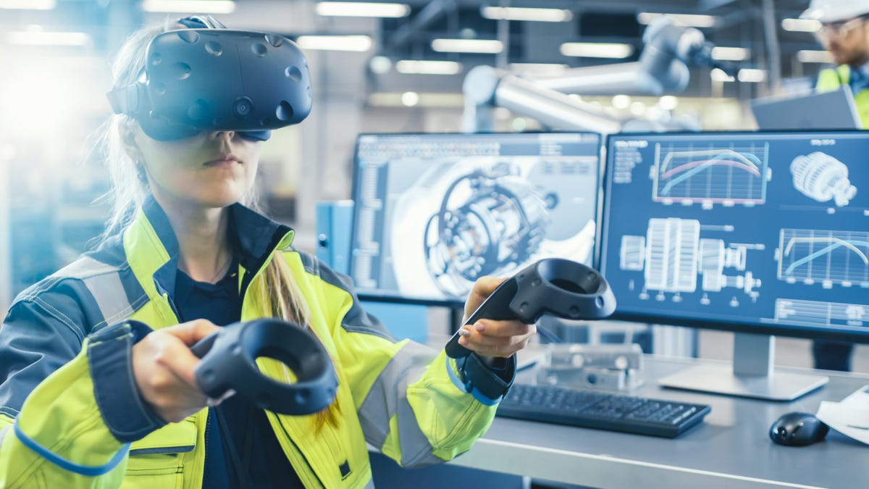
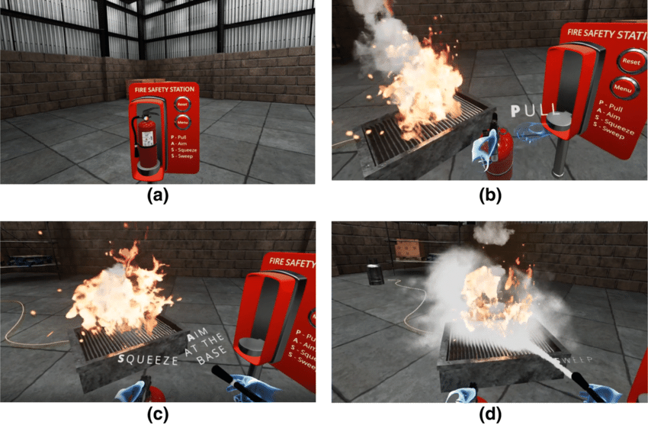
Natural Disasters:
Simulations can be used to practice drills for natural disasters or mimic the effect they have on the area they happen to, to ensure everyone's safety, they can also be used to train first responders(firefighters, paramedics or police officers).

Slide 6
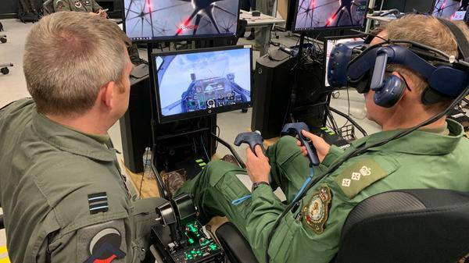
Air Transportation:
Air transportation was one of the first users of flight simulation to train pilots, because they can’t learn through mistakes, that endangers many lives.

Slide 7
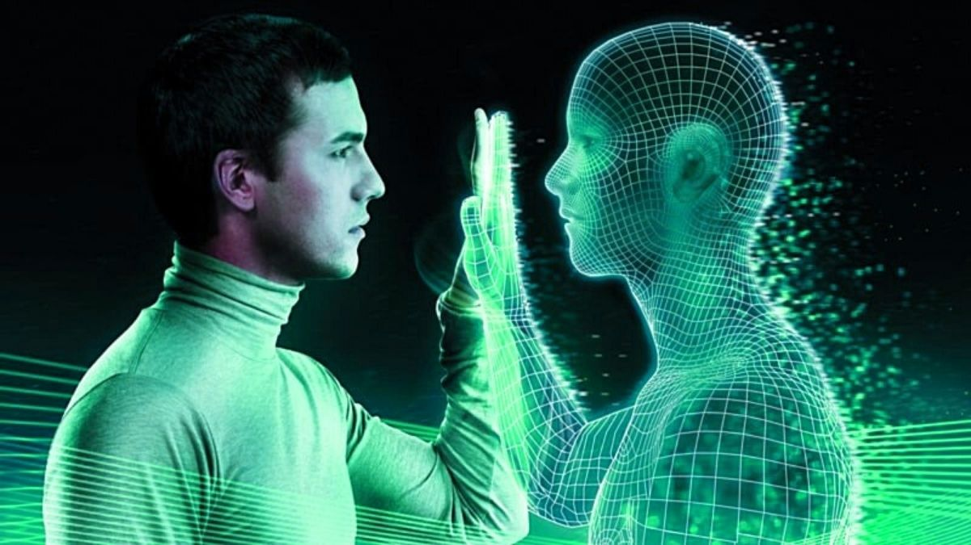
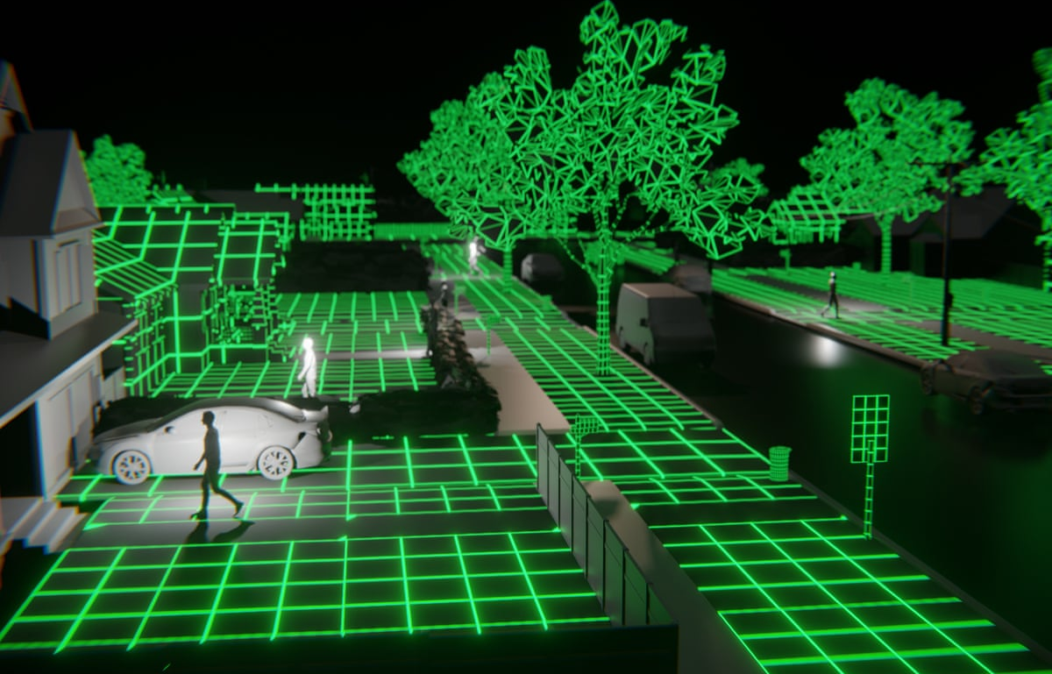
What Are The Advantages Of Simulations?
Less financial risk: equipment needed can be less expensive than the real world.
Exact repeated testing: an experiment can be repeated many times under the same exact conditions.
Examine long-term impacts: simulations can speed up processes affecting the earth such as climate change to show us its impact on our future in seconds.
Easily accessible: simulations can be done anywhere at any time.

Slide 8
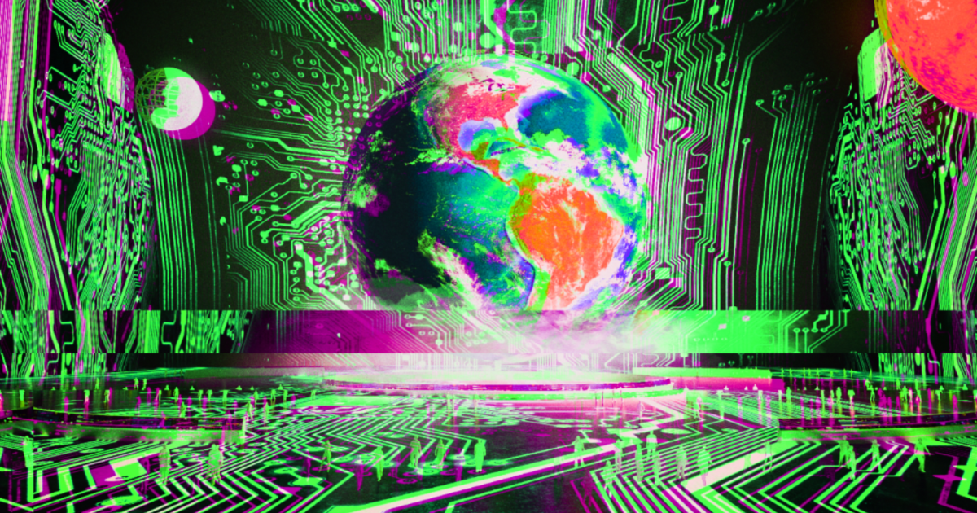
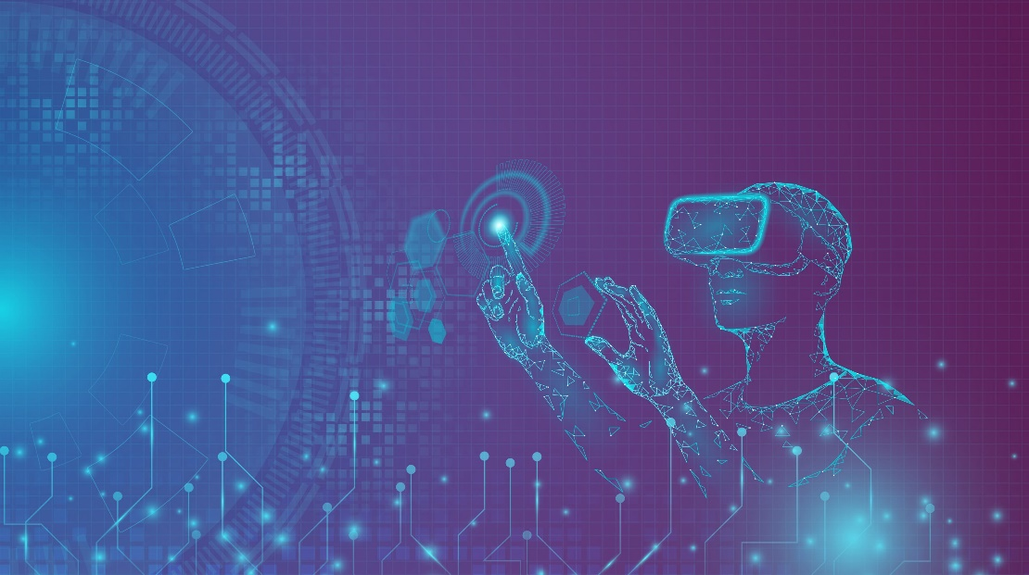
What Are The Disadvantages Of Simulations?
Programming mistakes: the programmer may make a mistake in the rules, and that can cause a malfunction in the simulation.
The cost of making and running a simulation: it may be costly to make and run the simulation many times.
The reaction of the person in the experience: the reaction of a person in the simulation may not be genuine or real.

Slide 9
A video to help you understand:
Click here
(click “browse YouTube” when the page with the browsers is shown)

Slide 10
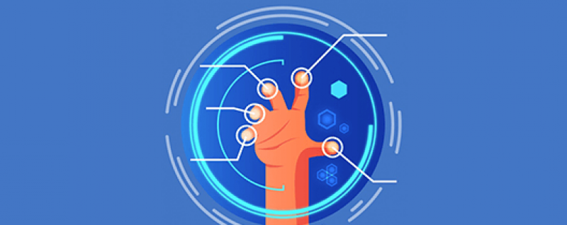
Conclusion:
In conclusion, simulations are very entertaining and useful for many things, but they may have some issues. That is why we should use and appreciate simulations now because in the future there will be more accurate and sophisticated technology that will make simulations go extinct.

Slide 11
Thanks for reading

Slide 12
Resources:
https://www.twi-global.com/technical-knowledge/faqs/faq-what-is-simulation#WhatDoesitMean
https://www.bbc.co.uk/bitesize/guides/zyqfr82/revision/3#:~:text=The%20main%20disadvantage%20of%20simulations,becoming%20more%20familiar%20with%20simulation.
https://www.designingdigitally.com/blog/look-different-industries-using-simulations-training
https://www.youtube.com/watch?v=-6qlX_ihOwQ
The ICT book.

