Slide 1
What are simu
simulations

Slide 2
What are simulations?
s

Slide 3
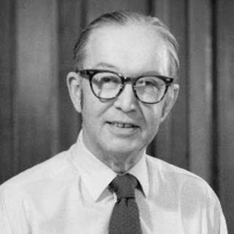
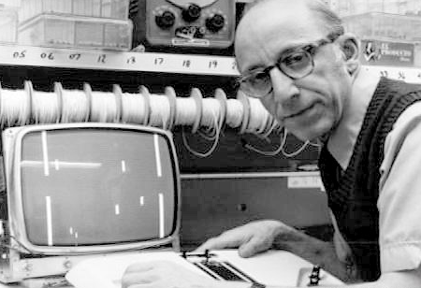
Who invented the first simulation?
The first simulation game may have been created as early as 1947 by Thomas T. Goldsmith Jr. and Estle Ray Mann. This was a straightforward game that simulated a missile being fired at a target.

Slide 4
What are the types of simulations?
Live
Simulation involving real people operating real systems. Involve individuals or groups.
virtual
Simulation involving real people operating simulated systems
constructive
Simulation involving simulated people operating simulated systems

Slide 5
Simulation examples:
Examples:
fire drills
weather forecasting
healthcare to teach skills
CGI graphics in entertainment

Slide 6
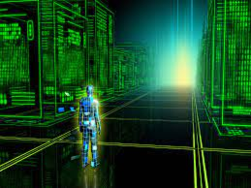
The six Phases of Simulation: 1.Pre-modeling. 2.Model Building. 3.Model Runs. 4.Experimentation. 5.Verification & Validation 6.Final Thoughts

Slide 7
What are the Advantages of a simulation?
Can be safer and cheaper than the real world.
Able to test a product or system works before building it.
Can use it to find unexpected problems.
Can speed things up or slow them down to see changes over long or short periods of time

Slide 8
What are the Disadvantages of a simulation?
Mistakes may be made in the programming or rules of the simulation
The cost of running several different simulations may be high.
Time may be needed to make sense of the results.
People’s reactions to the simulation might not be realistic or reliable.

Slide 9
Resources:
https://www.twi-global.com/technical-knowledge/faqs/faq-what-is-simulation#:~:text=A%20simulation%20is%20a%20model,for%20a%20more%20immersive%20experience.
https://acqnotes.com/acqnote/tasks/simulator-types
https://sps.honeywell.com/us/en/support/blog/automation/four-phases-simulation
https://www.bbc.co.uk/bitesize/guides/zyqfr82/revision/3
https://study.com/academy/lesson/simulations-definition-uses.html#:~:text=Simulations%20are%20used%20in%20multiple,skills%20or%20prepare%20for%20emergencies.
https://nautil.us/can-we-prove-the-world-isnt-a-simulation-238416/

