Slide 1
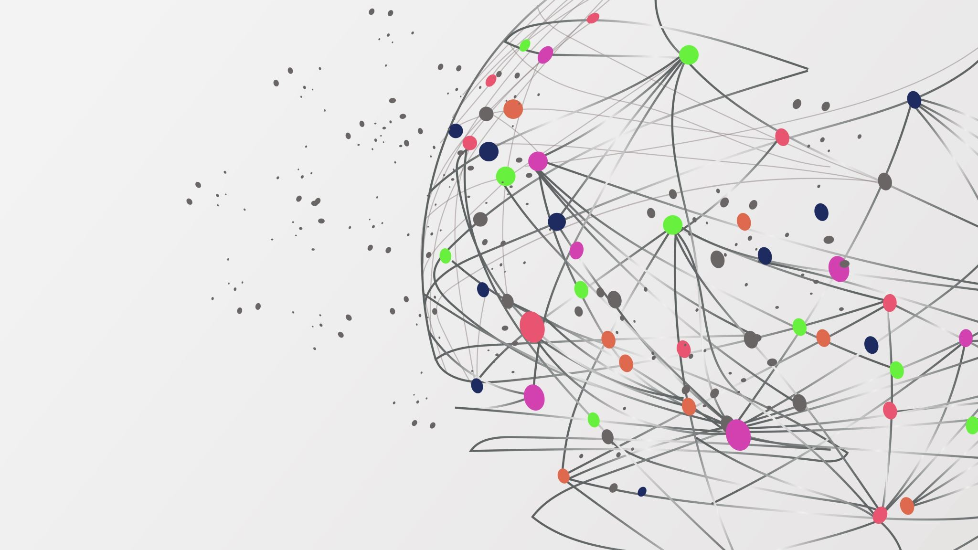
E-Learning
By: Pilar Habash & Sulaf Al-Ayyoub

Slide 2
What is E- Learning ?
E-learning is described as "learning that is enabled electronically“. It is helpful for students to access their learning materials through the internet for improved education, you can receive and share information through E-learning.

Slide 3


How is E- Learning Helpful?
eLearning is a method of sharing knowledge through media such as CDs, web conferencing, and more. It is much more effective faster, and simpler way of communication and receiving knowledge.

Slide 4

Types of E-learning
Social-collaborative e-learning
Gamified e-learning
Micro learning

Slide 5


Social-collaborative e-learning
Social-collaborative e-learning helps students interact with their teacher through google meet or Zoom or through any platforms that encourage people to interact to one another from anywhere.

Slide 6

Gamified e-learning
Gamified e-learning is education through games, it may include leader boards, prizes , and much more. It is a great way to motivate students into learning effectively. Examples are Duolingo and Kahoot.

Slide 7

Micro learning
Micro learning is small parts of information that can be given to people quickly instead of long lessons and classes, but it does not include a lot of details, it can be a video, or a slideshow, and even simulations.

Slide 8
Thank you

