Slide 1
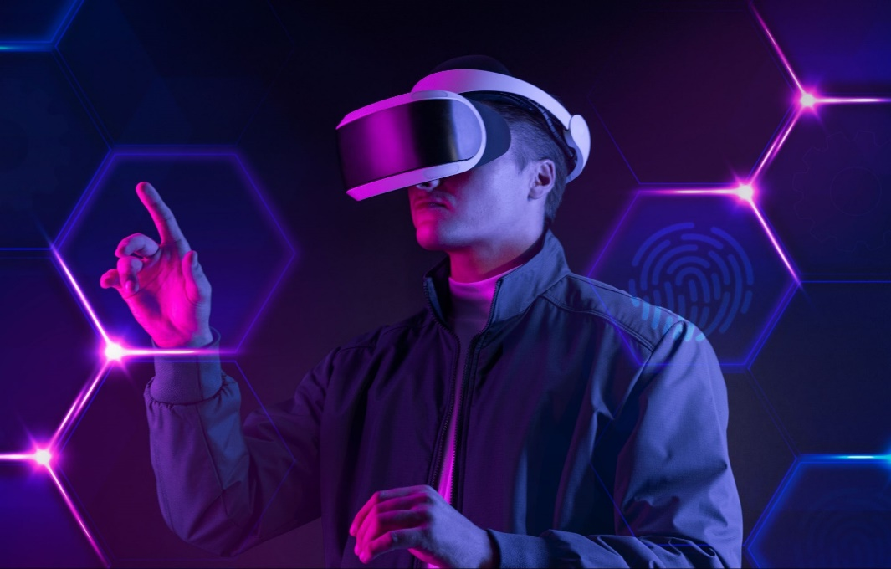
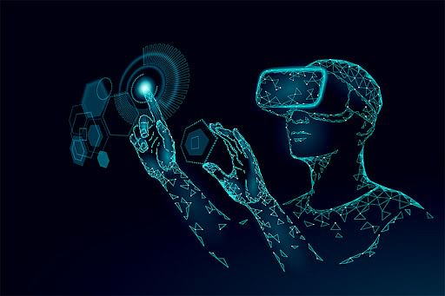
Virtual reality

Slide 2
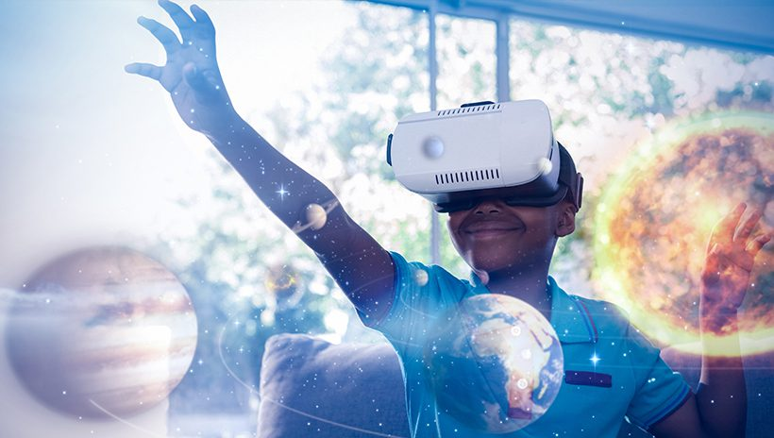
What is virtual reality?
Virtual reality is a simulated experience that employs pose tracking and 3D near-eye displays to give the user an immersive feel of a virtual world. Applications of virtual reality include entertainment, education and business.

Slide 3
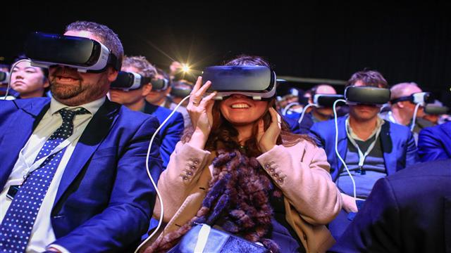
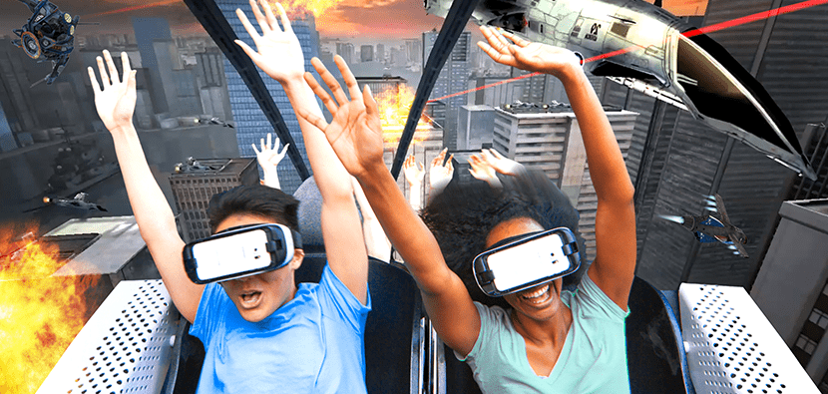
How can vr be used in entertainment?
Applications. Virtual reality is most commonly used in entertainment applications such as video games, 3D cinema, amusement park rides including dark rides and social virtual worlds.

Slide 4
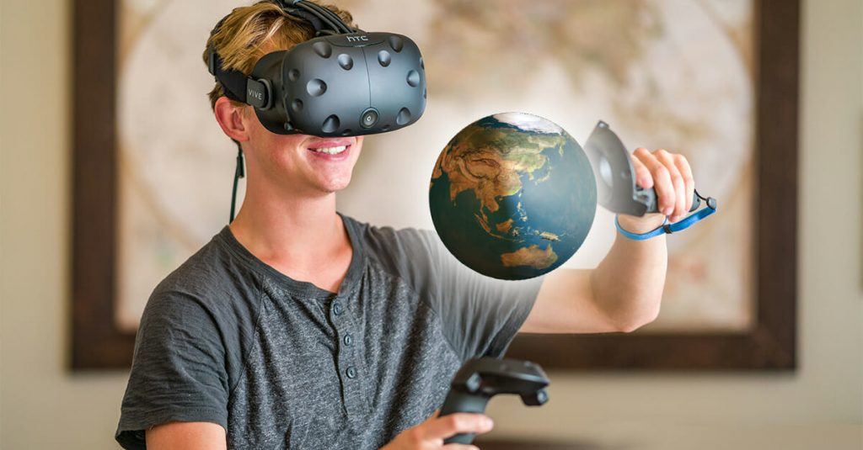
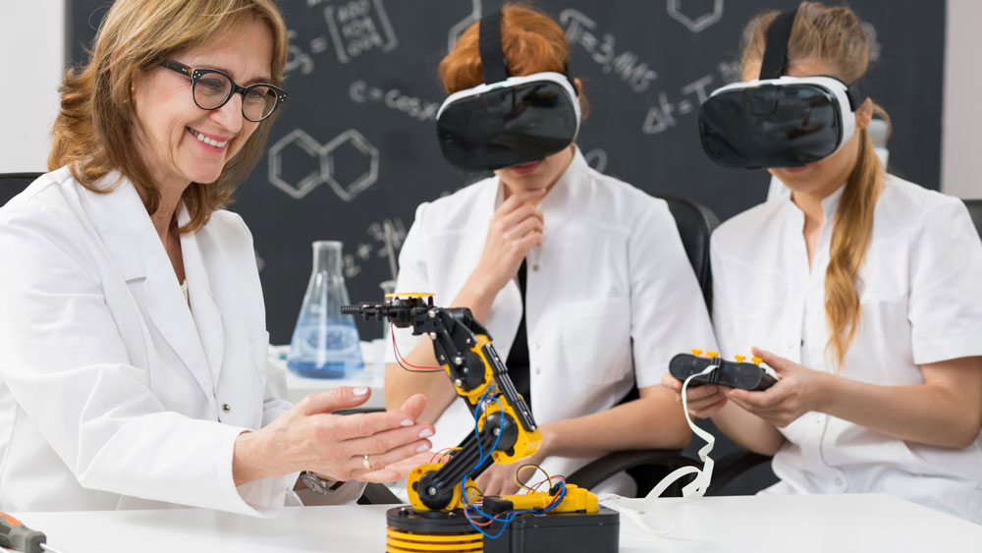
How can vr help in education?
virtual reality helps education by creating immersive lessons that are engaging, memorable and impactful for students. These VR experiences improve learning outcomes and help students build important interpersonal skills such as empathy, collaboration, and social skills needed for the future.
Benefits

Slide 6
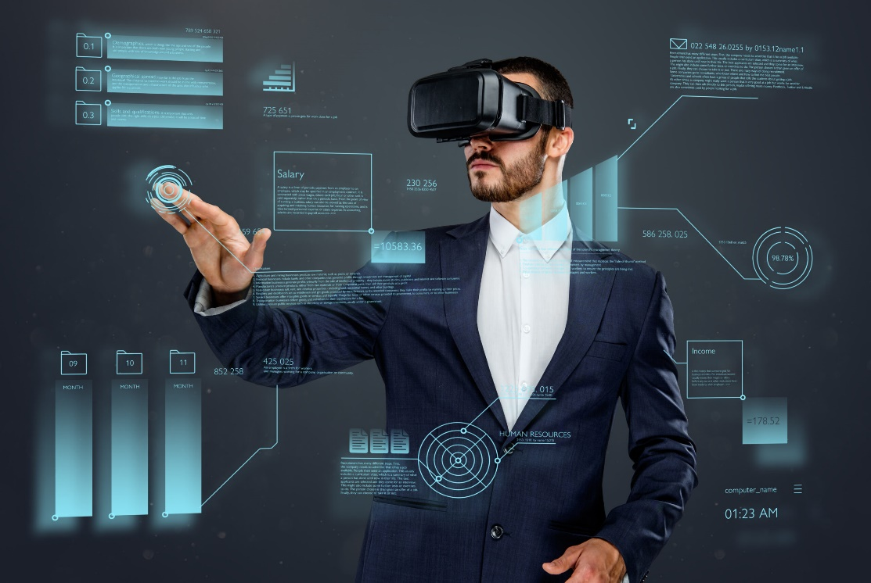
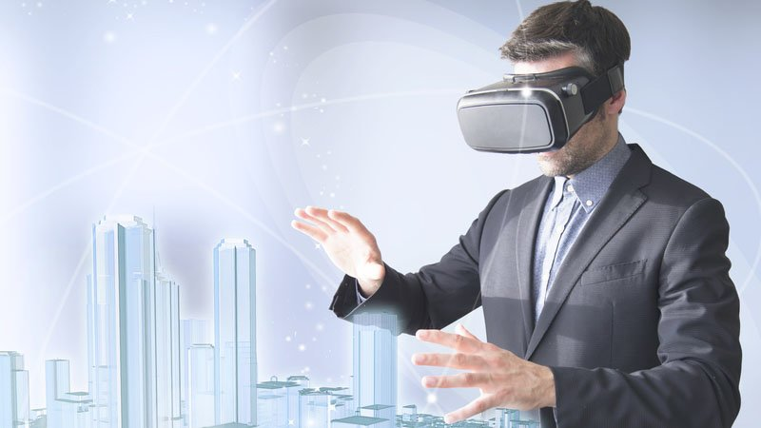
Advantages of virtual reality in business
businesses can create a virtual environment that allows customer service representatives to interact with customers in real-time, regardless of location. This doesn't just reduce costs, but also provides a better customer experience by allowing customers to get the help they need quickly and easily.

Slide 7
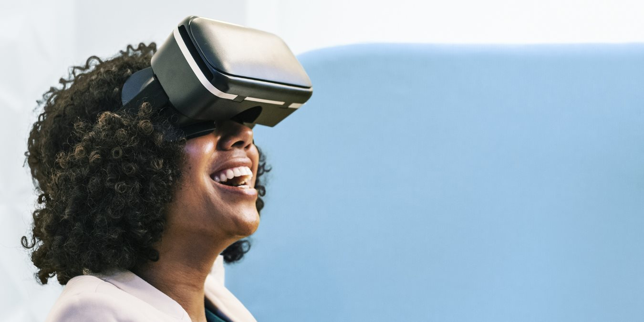
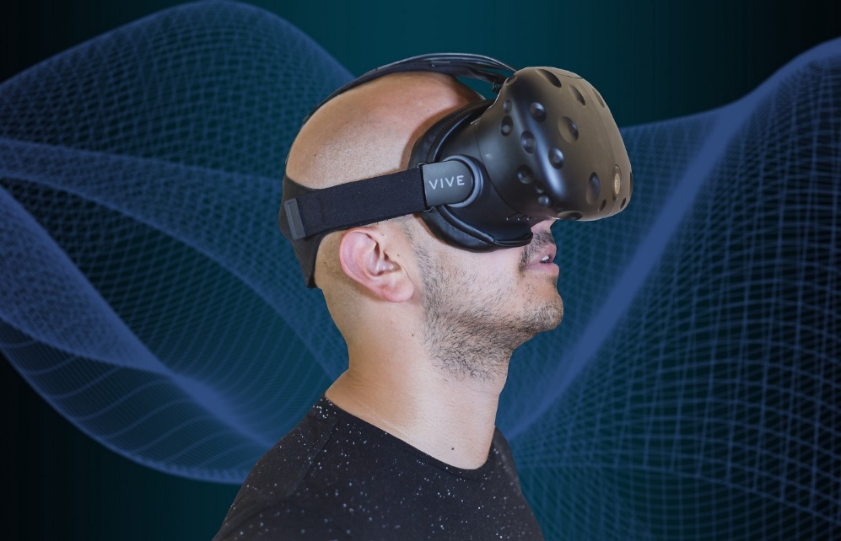
How will VR improve our lives?
The immersive nature of VR provides the flexibility to create various types of environments or experiences. Accordingly, VR can be used to experience situations that are hard to come by in real life, or that can be dangerous to go through in real life.
citation

Slide 8
citation
Wikimedia Foundation. (2023, January 28). Virtual reality. Wikipedia. Retrieved February 3, 2023, from https://en.wikipedia.org/wiki/Virtual_reality
Developer, A. (2022, September 1). Advantages of virtual reality in Education. ClassVR. Retrieved February 3, 2023, from https://www.classvr.com/blog/advantages-of-virtual-reality-in-education/
Gerbus, G. (2023, January 20). Benefits of virtual reality for business. Avatour. Retrieved February 3, 2023, from https://avatour.co/benefits-of-virtual-reality-for-business/
Hamad, A., & Jia, B. (2022, September 8). How virtual reality technology has changed our lives: An overview of the current and potential applications and limitations. International journal of environmental research and public health. Retrieved February 3, 2023, from https://www.ncbi.nlm.nih.gov/pmc/articles/
THE END

