Slide 1
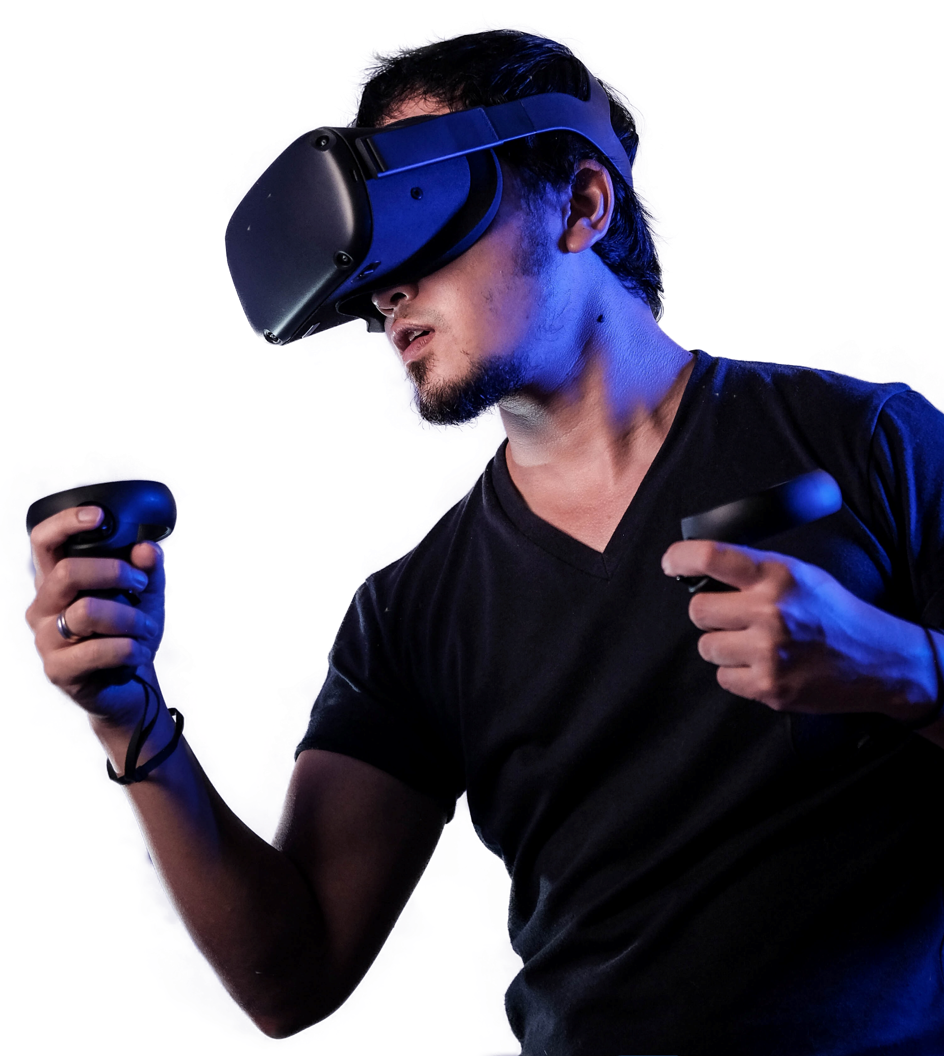
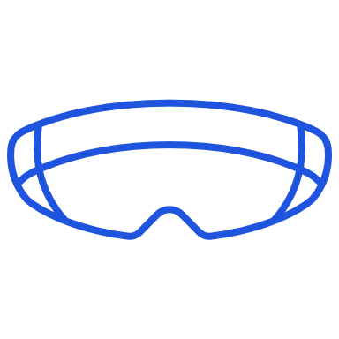
VIRTUAL REALITY
Mariana Haddadin 8D
Press slide show for best experience

Slide 2
Table Of Contents
01
What is Virtual Reality?
02
Types of Virtual Reality
03
Applications of Virtual Reality
04
Advantages and Disadvantages
05
References & Sources

Slide 3
What is VR?
Back
Virtual Reality means feeling the imaginary (Virtual) world, rather than the real one. The imaginary world is a simulation running in a computer. It is the term used for computer generated 3D environments that allow users to interact with alternative realities.

Slide 4
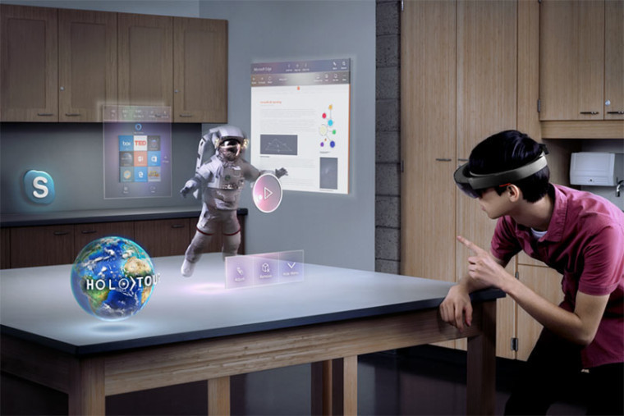
Types of VR
Back
non-immersive
immersive
is the presentation of an artificial environment that replaces users' real-world surroundings convincingly enough that they are able to suspend disbelief and fully engage with the created environment.
provides a computer-generated environment, but allows the user to stay aware of and keep control of their physical environment, has a large display but doesn't surround the user
Window on world
Desktop based Virtual reality, involves displaying a 3D virtual on regular desktop display without the use of specialized movement tracking environment
Non-immersive
immersive
Window on world

Slide 5
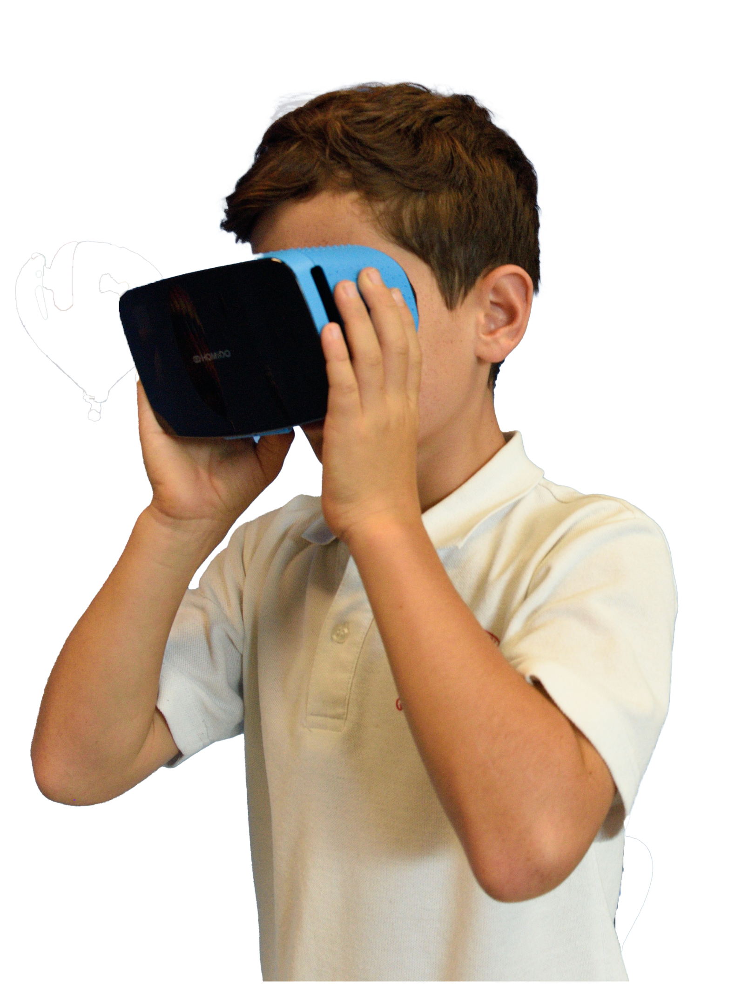
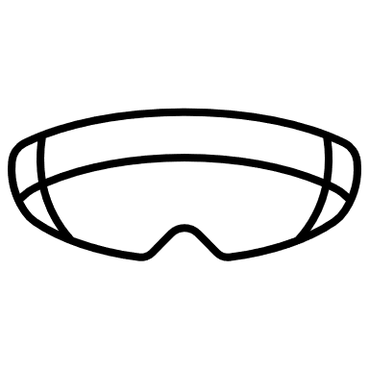
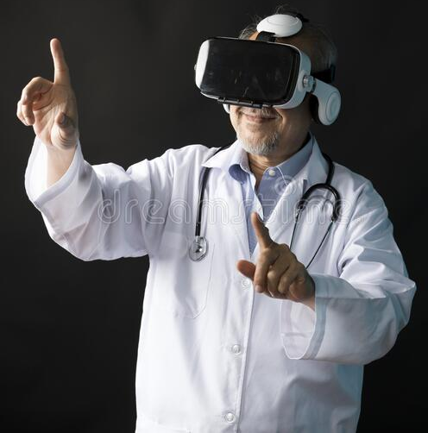
Applications of VR
Back
Military
Health care
Education

Slide 6
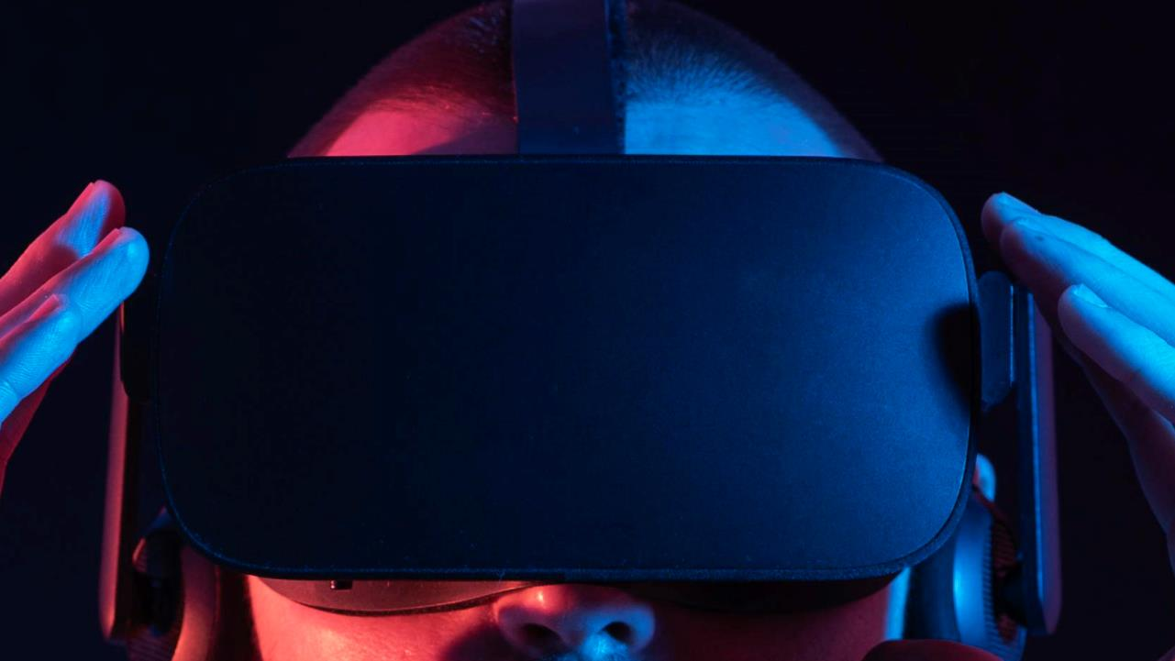
Back
Advantages & Disadvantages
Advantages
Disadvantages
Virtual reality helps in exploring places without actually being there
The education system has been improved
It creates a realistic world
Help in providing training
Lowest risk
Increases interest and engagement toward a subject
Implementation is expensive
Technology is complex
Impact on the real human body
Not engaged in the real world
Psychological damage
Addiction to Virtual Reality

Slide 7
REFERENCES & SOURCES THANK YOU ☺
Back
Aplustopper
Trioblog
RexTheme

