Slide 1
ICT
By Naya Karadsheh

Slide 2
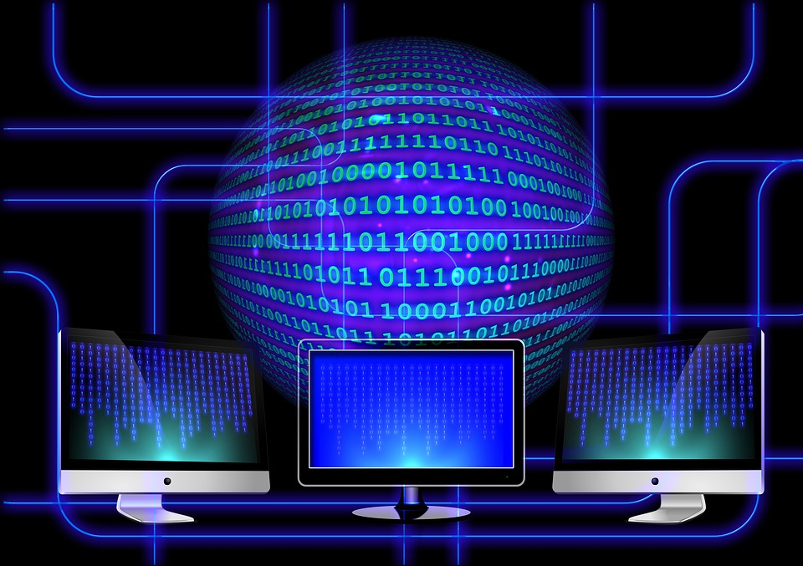
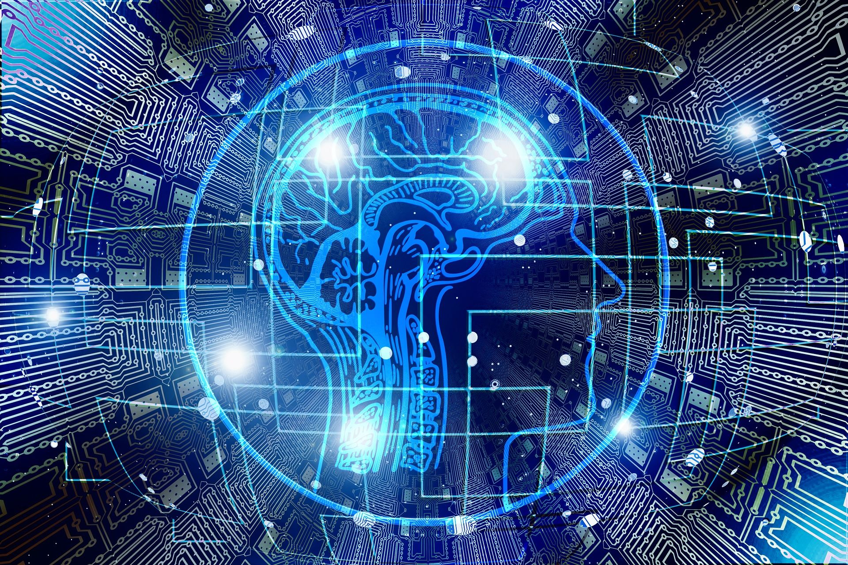
Artificial Intelligence
Artificial Intelligence is the simulation of human processes by machines, especially computer systems. Specific applications of AI include expert systems, natural language processing, speech recognition and machine vision.

Slide 3
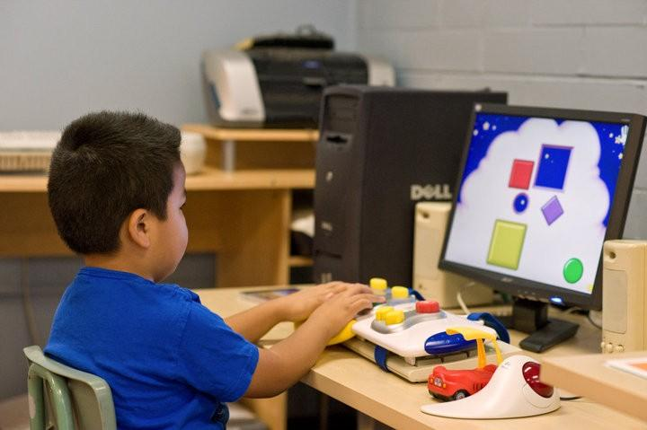
Assistive Technology
Assistive Technology is often used to describe products or systems that support and assist individuals with disabilities, restricted mobility or other impairments to perform functions that might otherwise be difficult or impossible.

Slide 4
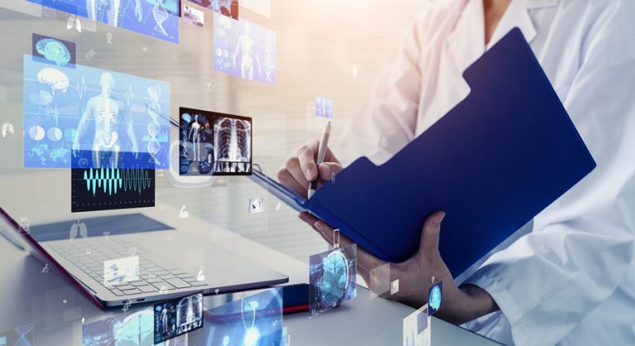
Computer Models
Computer model A program that runs on a computer that creates a model, or simulation, of a real-world feature, phenomenon or event. Computer program A set of instructions that a computer uses to perform some analysis or computation.

Slide 5
E-Learning
E-Learning, or electronic learning, is the delivery of learning and training through digital resources. Although E-Learning is based on formalized learning, it is provided through electronic devices such as computers, tablets, and even cellular phones that are connected to the internet.

Slide 6
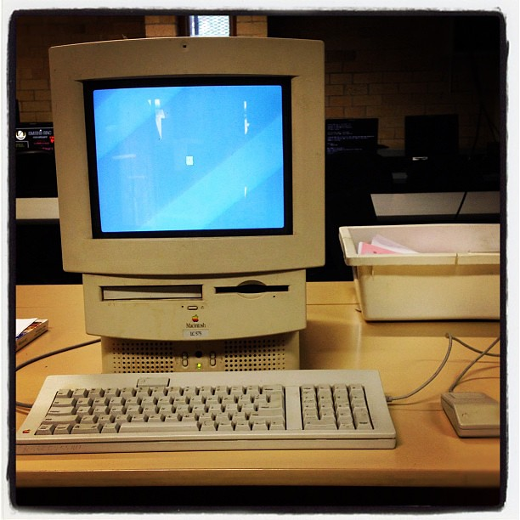
Guidance Computer
The Apollo Guidance Computer is a digital computer whose navigation system was used to guide spacecraft along their prescribed routes during the Apollo missions.
This Photo by Unknown Author is licensed under CC BY

Slide 7
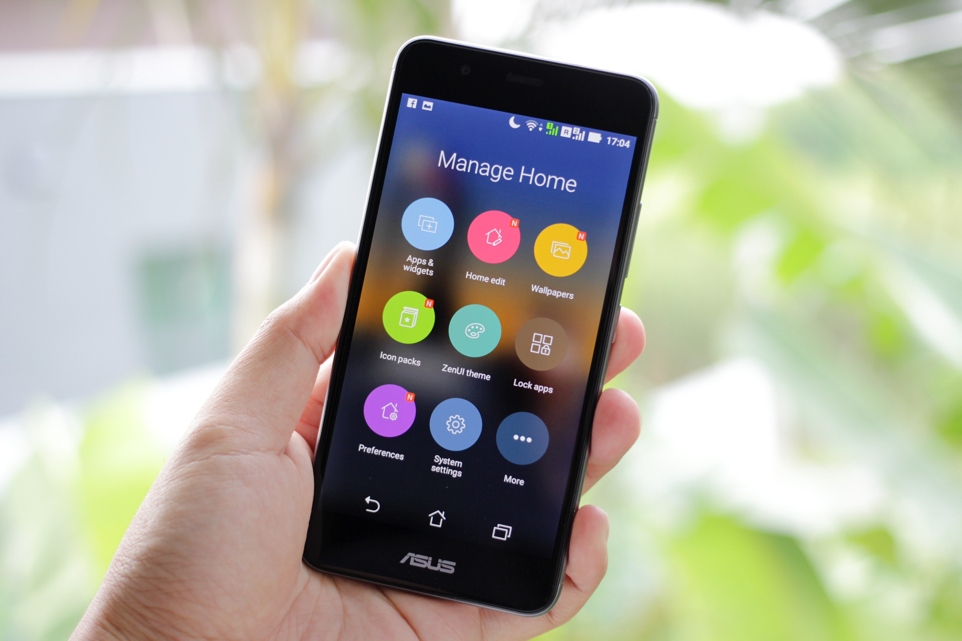
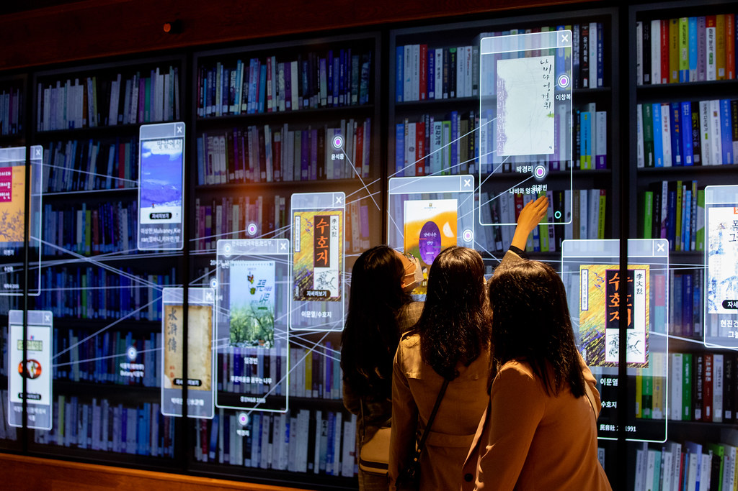
Interactive Video
Interactive Video (also known as “IV”) is a form of digital video that supports user interaction.
Interactive videos provide the viewer the ability to click, on a desktop, or touch on mobile devices within the video for an action to occur.

Slide 8
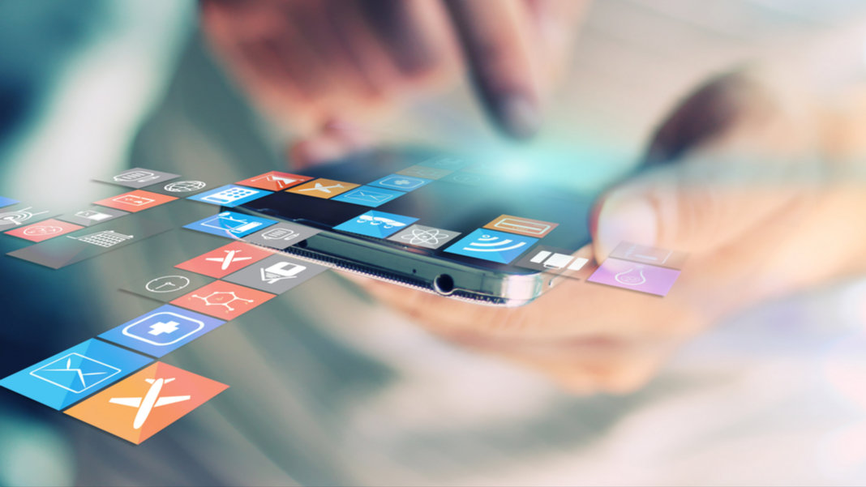
Multimedia
Multimedia is a form of communication that uses a combination of different content forms such as text, audio, images, animations or video into a single interactive presentation.

Slide 9
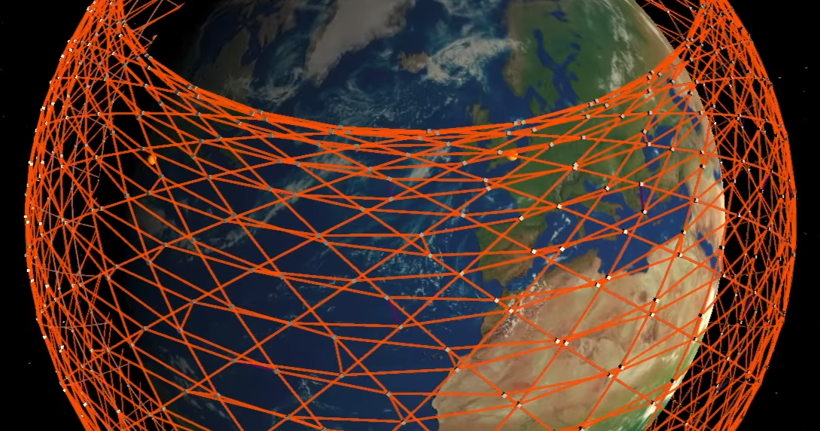
Simulation
A simulation is a model that mimics the operation of an existing or proposed system, providing evidence for a decision-making by being able to test different scenarios or process changes.

Slide 10
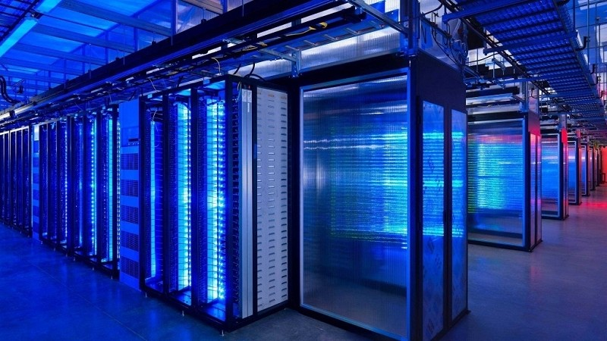
Super-computers
A Super-computer is a computer with a high level of performance as compared to a general-purpose computer. The performance of a supercomputer is commonly measured in floating-point operations per second instead of million instructions per second.

Slide 11
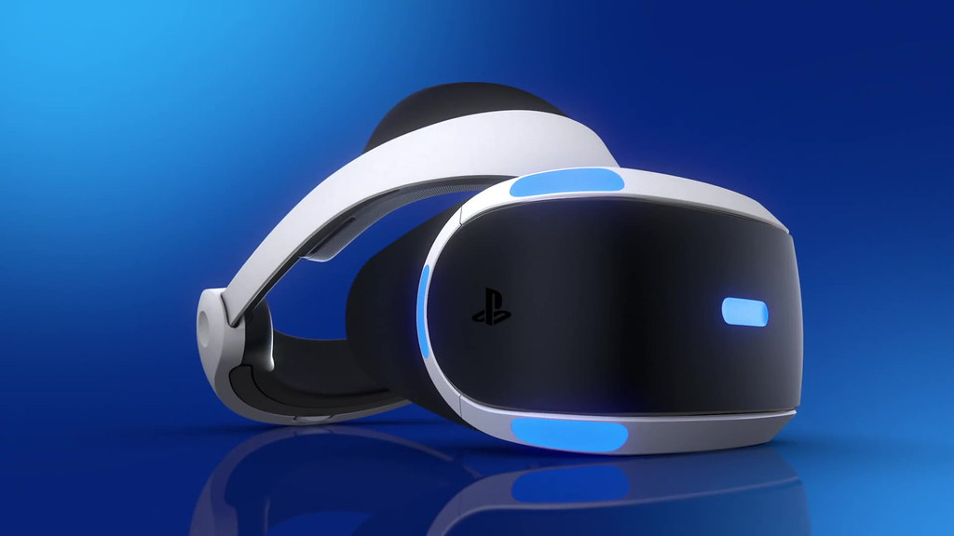
Virtual Reality
Virtual Reality (VR) is a computer-generated environment with scenes and objects that appear to be real, making the user feel they are immersed in their surroundings.

Slide 12
Speech Generator
Speech generating devices allow people who cant use spoken languages to ‘speak’ electronically. Some autistic children have difficulties developing speech and language, which makes communicating their needs and ideas very difficult.

Slide 13
Thank You

