Slide 1
Virtual reality
By: Carla Hijazin

Slide 2
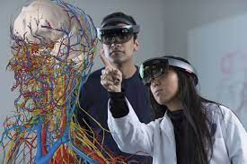
What is virtual reality?
Virtual reality is a simulated 3D environment called virtual reality that allows users to explore and interact with a virtual environment in a fashion that simulates reality as it is experienced by the users' senses.

Slide 3
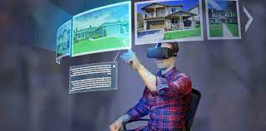
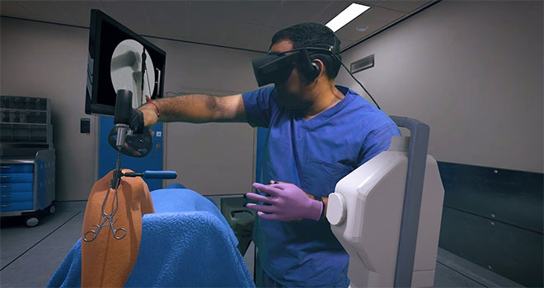
What is virtual reality used for?
Virtual reality has a wide variety of uses besides gaming. Such as:-
Training: people can train for their jobs using a VR headset as a practice tool as if they are working on their jobs in real life.
Travel: this could be used as a hotel simulation for when hotels take you inside their property so you know what to expect as your room and the hotel itself.
Real Estate: developers can move beyond 3D models to simulate life inside their new development.
Healthcare: It would be invaluable in medical school to help students learn how to deal with situations that may arise when they become doctors.
And many more…

Slide 4
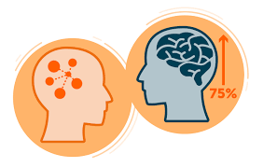
advantages of virtual reality in education
Increases memory power and knowledge retention.
Boosts excitement and engagement in the classroom.
Improves learning outcomes.
Focuses student attention on the lesson.
Opens up new opportunities and create accessibility for every student.
Strengthens the understanding of complex, conceptual subjects.
Builds emotional intelligence, awareness and understanding.
Enhances communication and collaboration skills.

Slide 5
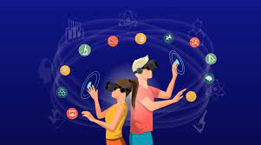
Disadvantages of virtual reality in education
A lack of real communication: The traditional education is based on personal human interaction, meaning that the addition of VR may take that down a notch.
A lack of flexibility: Though VR allows for studying various aspects, it’s not as flexible as it should be, the implementation of more simulations would do the job.
The issue of addiction: Like most technological inventions, VR may contribute to the development of addiction, which heavily inflates the focus ability of a student or worker.

Slide 6
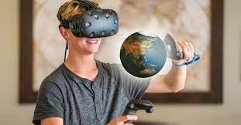
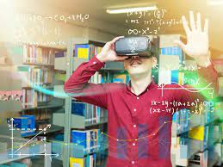
How did virtual reality help?
Virtual reality has helped in many things. Such as the education for people who want to become a doctor or a construction worker who want to know and experience the difficulty of their jobs from all aspects. Moreover, hotel simulations can provide people a clear view of the hotel so they know what to expect. There is a vast selection of advantages to using VR but there is always a dark side to things which in this case is the disadvantages of VR which were stated in previous slides.

Slide 7
sources
https://www.classvr.com/blog/advantages-of-virtual-reality-in-education/#:~:text=So%2C%20in%20summary%20virtual%20reality,skills%20needed%20for%20the%20future.
https://www.marxentlabs.com/what-is-virtual-reality/
https://www.techtarget.com/whatis/definition/virtual-reality#:~:text=Virtual%20reality%20is%20a%20simulated,perceived%20through%20the%20users%27%20senses.
https://edubirdie.com/examples/major-advantages-and-disadvantages-of-using-virtual-reality-in-education/

