Slide 1
Virtual reality(VR)
By: Tania Awwad 8-C

Slide 2
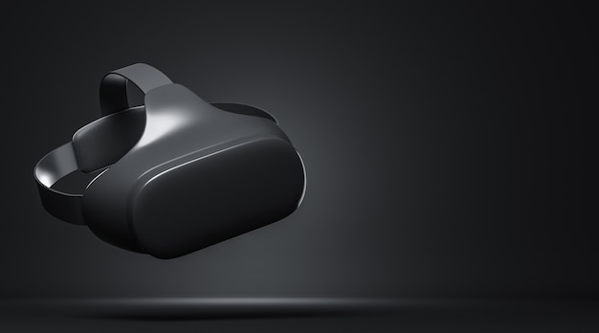
What is virtual reality?
Virtual reality is a computer-generated environment with scenes and objects that appear to be real, making the user feel they are immersed in their surroundings.

Slide 3
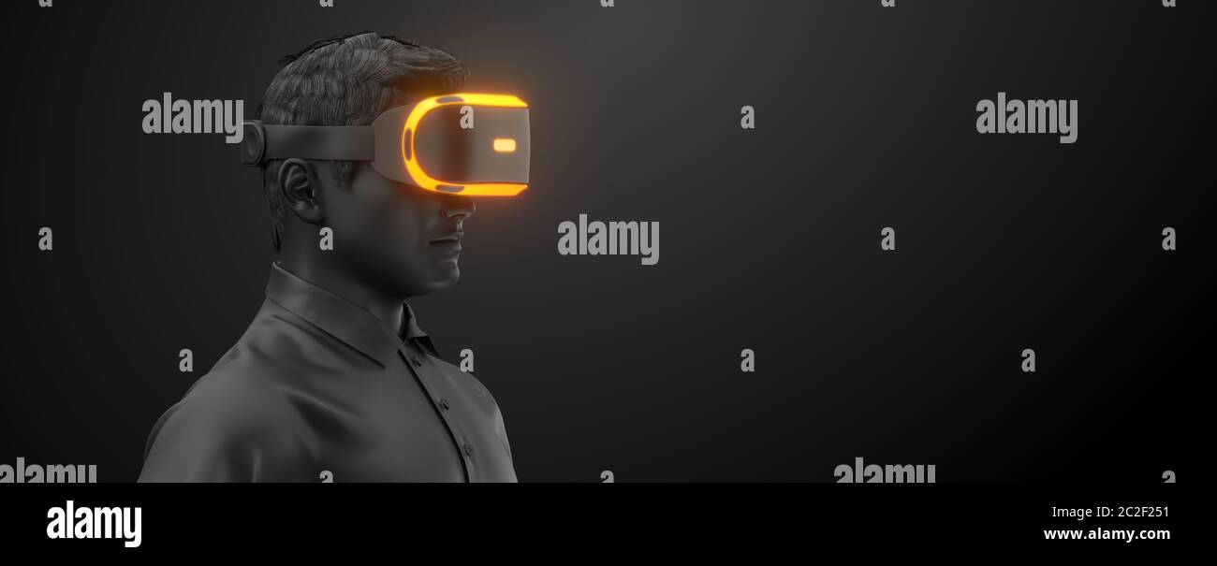
How does VR work?
Virtual reality places a user in a virtual dimension through computer graphics, AI sensors, head, and body trackers. Combining VR hardware and software components creates an immersive experience for the end user.

Slide 4
What are advantages of VR?
Virtual reality has several advantages such as:
Virtual reality helps in exploring places without actually being there.
You can practice doing things without facing the consequences of your mistakes.
Helps with developing education systems.
Increases interest and engagement toward a subject.

Slide 5
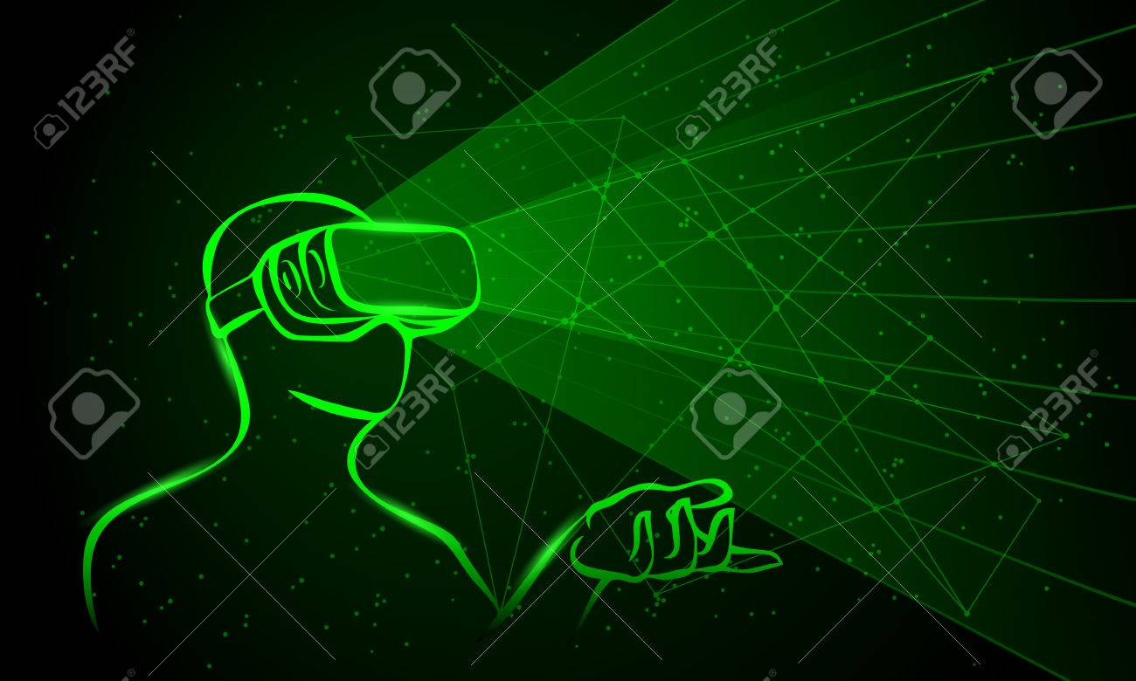
What are disadvantages of VR?
Needed equipment are expensive.
Technology is expensive.
Losing touch with reality.
It may cause poor well being.
Psychological damage.

Slide 6
Resources:
https://www.iberdrola.com/
https://www.aplustopper.com/

