Slide 1
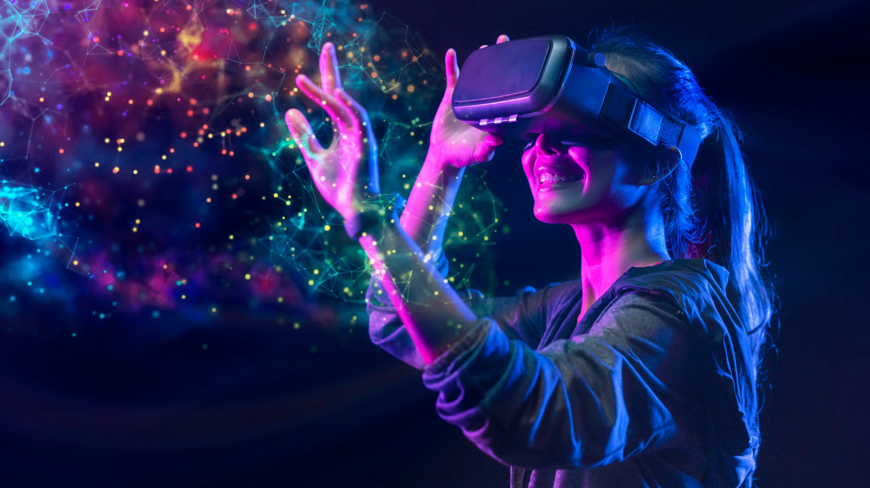
VIRTUAL REALITY
BY : MUNA ISHNANEH
8E

Slide 2
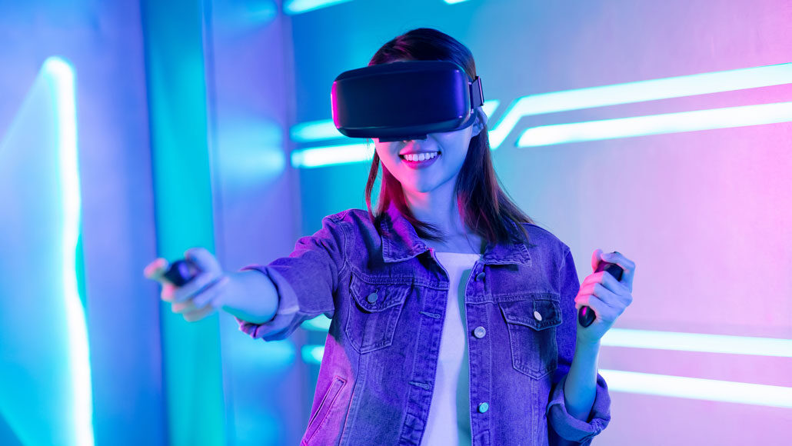
What is virtual reality technology?
Virtual Reality (VR) is a computer-generated environment with scenes and objects that appear to be real, making the user feel they are immersed in their surroundings.

Slide 3
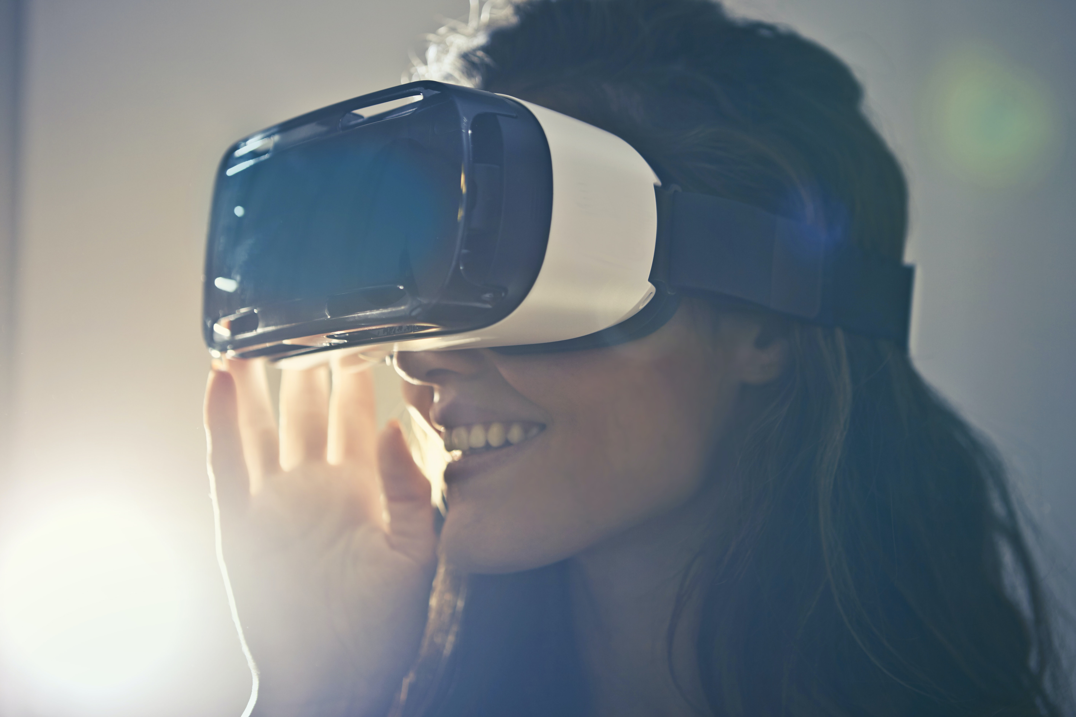
What are the three types of virtual reality?
There are 3 primary categories of virtual reality simulations used today: non-immersive, semi-immersive, and fully-immersive simulations.

Slide 4
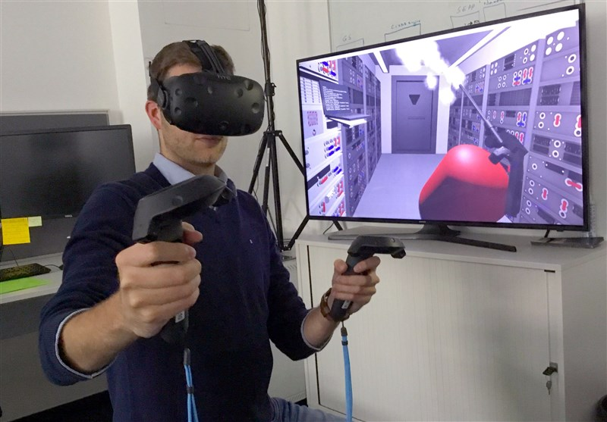
Who created virtual reality?
Ivan Sutherland

Slide 5
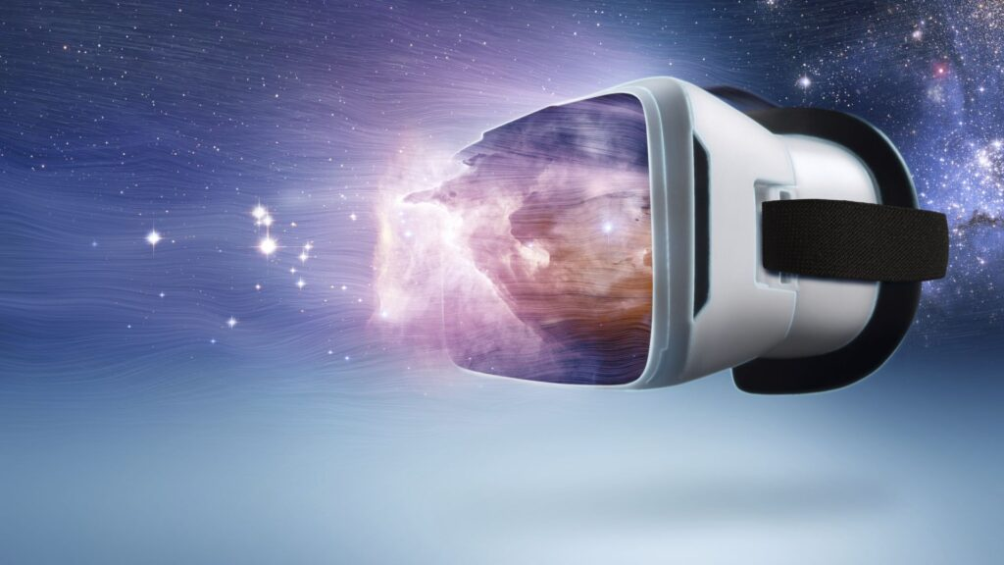
what does virtual reality help with in real life?
VR can also be used as a treatment for mental health issues, with Virtual Reality Exposure Therapy thought to be particularly effective in the treatment of PTSD and anxiety.

Slide 6
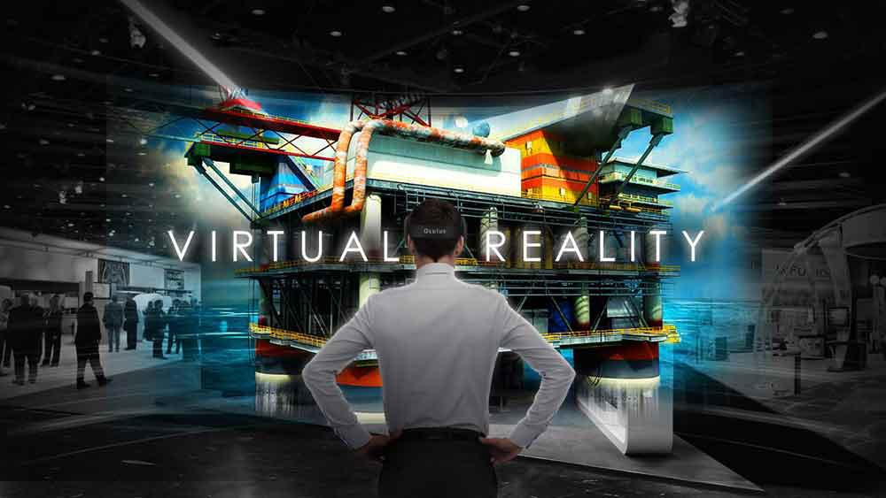
THANK YOU

