Slide 1
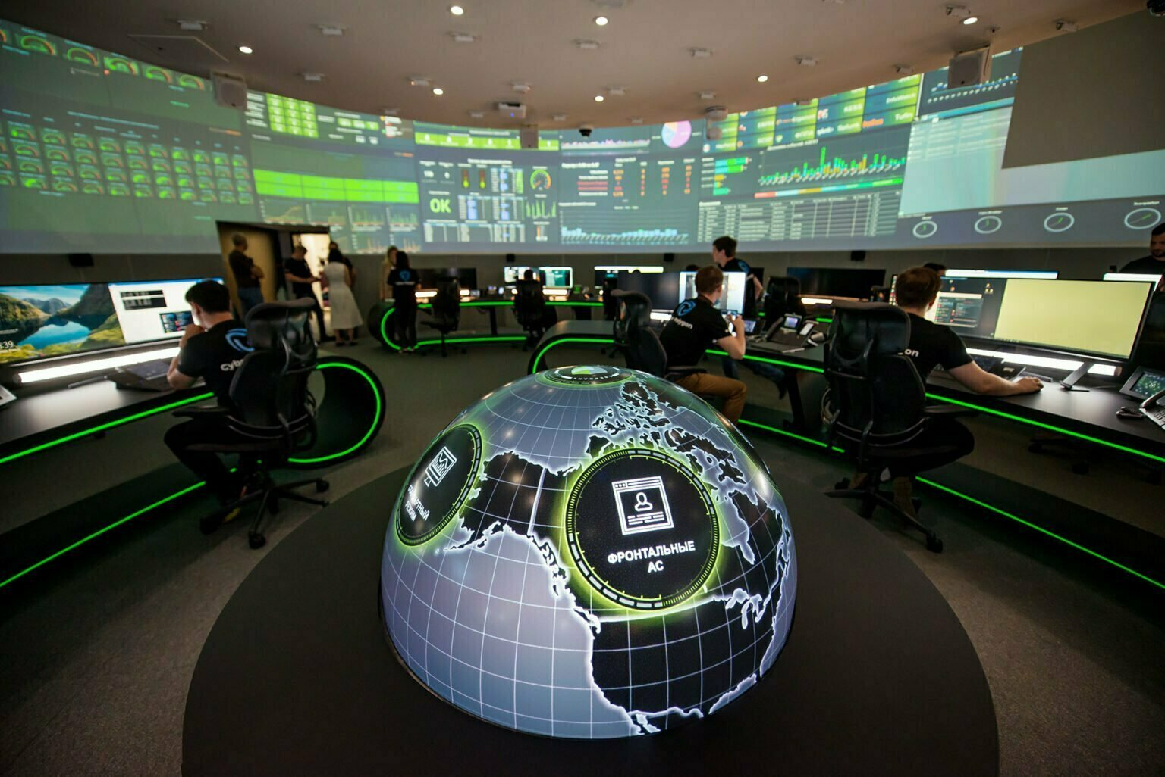
Simulation
Project by: Cynthia Nino

Slide 2
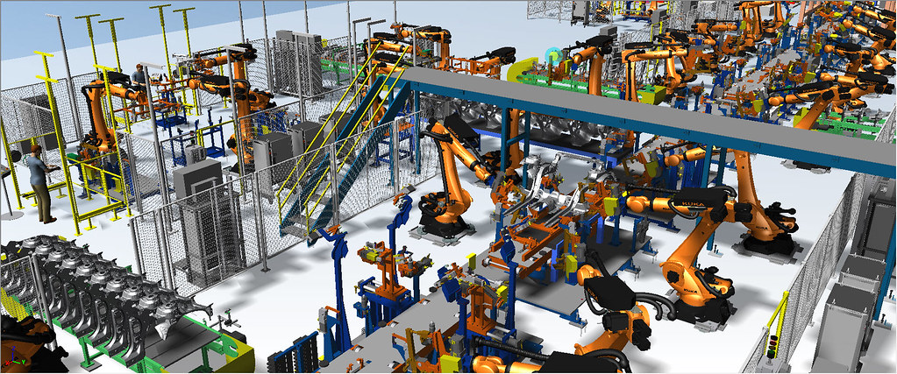
What is a simulation?
A simulation is a model that mimics the operation of an existing or proposed system, providing evidence for decision-making by being able to test different scenarios or process changes.

Slide 3
How can a simulation be used?
Simulations can be used to tune up performance, optimize a process, improve safety, test theories, train staff, and even for entertainment in video games! Scientifically modeling systems allow a user to gain insight into the effects of different conditions and courses of action.
This Photo by Unknown Author is licensed under CC BY

