Slide 1
J.K. ROWLING
By Alexander Zayyat

Slide 2
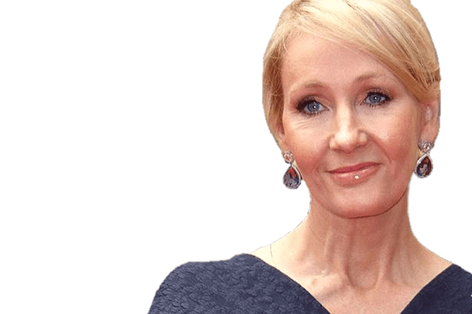
Why I Like J.K. Rowlings Books
J.K. Rowling is one of my favorite authors because she wrote my favorite series of books which is Harry Potter. She has made interesting stories about Harry potter. Such as Harry Potter and The Order of the Phoenix. J.K. Rowling has made what was one of the best top selling novels.

Slide 3
Facts about J.k. Rowling and Harry Potter
Did you know that J.K. Rowling was not just a british author but also a philanthropist. The Dementors in Harry Potter were based of J.k. Rowling having suffered depression after the book was rejected many times. J.K. Rowling was born in Yate, Gloucestshire. J.K. Rowling conceived the idea of Harry Potter series while on a delayed train.
Source: Wikipedia

Slide 4
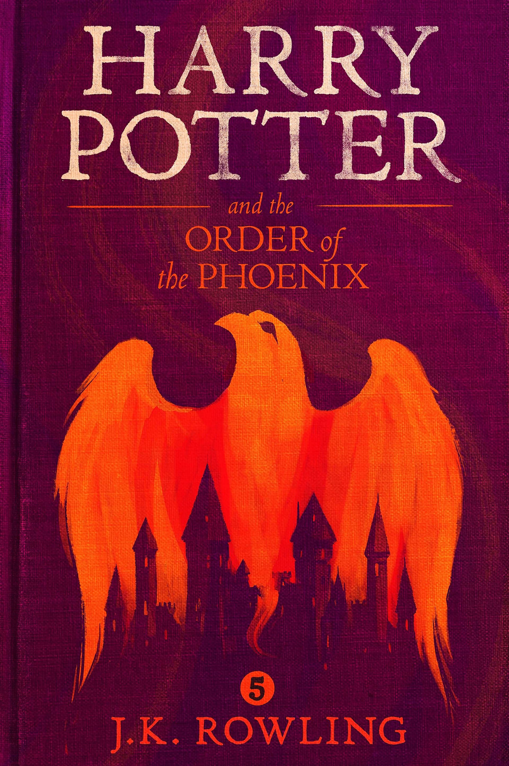
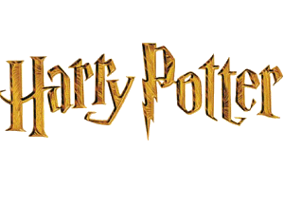
My favorite Harry Potter Book
My personal favorite Harry Potter book is The Order of The Phoenix, because it talks about how Harry Potter and his friends saved the world from impending doom of Lord Voldemort, but at a cost.

Slide 5
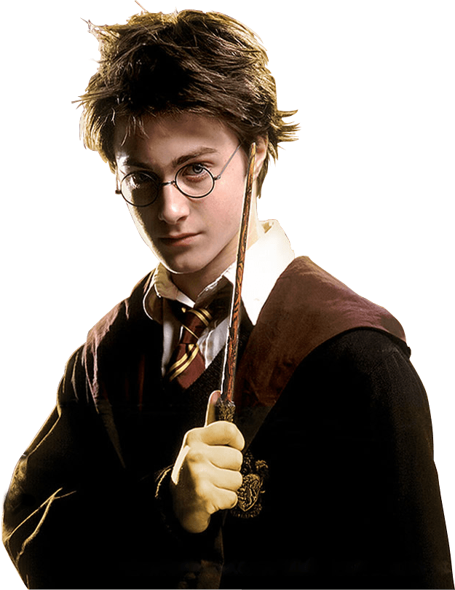
Why I like the book
I like the book because it talks about how Lord Voldemort was reeking havoc around London. Lord Voldemort realizes that Harry can see what he was doing. Eventually Lord Voldemort tricks Harry Potter into a trap killing his godfather and barely saving his friends lives.

