Slide 1
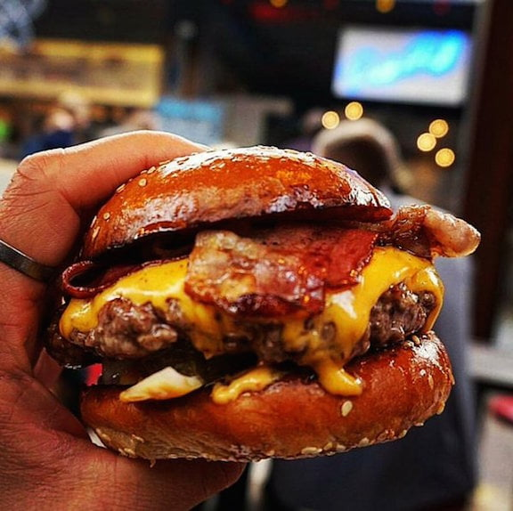
The burgers restaurant menu
Burgers
cheese burger 3.50
BBC burger 3.75
Mexican burger 4.15
Chicken burger 2.99
Healthy burger 3.00
Special burger 2.50
Desserts
Chocolate cake 3.50
Strawberry cake 3.50
Potato
French fries 0.99
Curly potato 1.50
Potato wedges 1.25
Cold Drinks
Coca cola 0.50
Pepsi 0.50
Water 0.25
Orange juice 1.00
Apple juice 1.00

