Slide 1
CASE CLOSED: THE PHANTOM OF BAKER STREET
BY: RAMA HANAQTA
GRADE: 6C

Slide 2
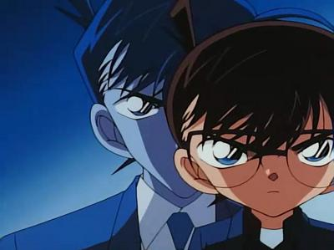
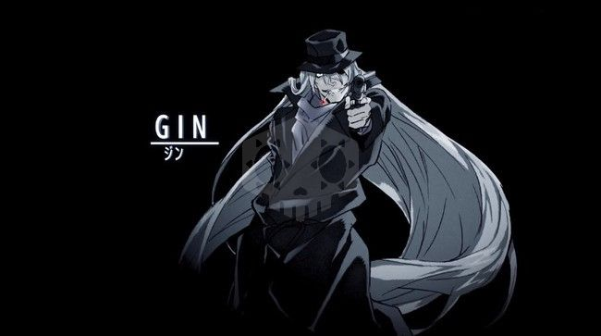
Detective Conan (Shinichi Kudo)
Conan or “Shinichi Kudo” is a high school detective which is the protagonist of the whole case closed series. In each episode he solves a mystery in order to get closer to the Black Organization, which is the reason he got shrunk in size. It all happened when he and his friend Ran Mori went to an amusement park and he witnessed a deal. Unknowingly, a member of the Black Organization slid a pill in his mouth and caused him to pass out. Awoken by the sound of people surrounding him, he found himself smaller in size. In order to keep his identity a secret, so no one that knows him can get harmed, he went by the name “Conan Edogawa”.
Shinichi Kudo.
The boy who got shrunk, and now he is known as Conan Edogawa.
GIN.
The master of the Black Organization, that gave Conan the pill.

Slide 3
CASE CLOSED SERIES
Case closed, also known as detective Conan is one of my favourite series, that is originally a Japanese detective manga and anime series, in addition to movies. Detective Conan is illustrated and written by Gosho Aoyama. It’s made of and concentrates about mystery and thriller. When I watch it I like to participate in finding the evidence that leads to the murderer. It makes me feel that I am part of it as if I am one of the characters. One of the reasons that made me love this series and choose it is that it uses science, math, and different languages, which enhances my knowledge and helps me to solve and find clues in the case. One of the movies that I watched is called The Phantom of Baker Street.

Slide 4
THE PHANTOM OF BAKER STREET
Conan was invited to a party with many other guests. They were there to test a new virtual game system, when a murder mystery occurred. However, the AI goes rogue and takes the children hostage. Now Conan must go into the game system to figure out who the murderer is with the help of the famous book character Sherlock Holmes. The lives of 49 kids testing the game are in his hands.

Slide 5
THANK YOU FOR READING

