Slide 1
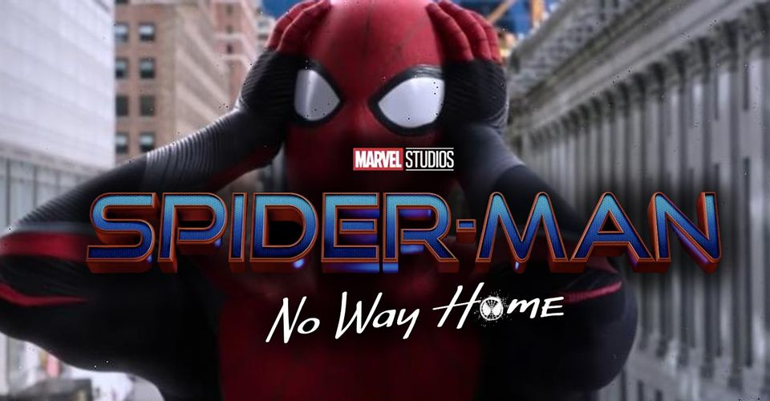
No way home movie
By: Ghina Abu khadra
Grade: 6C

Slide 2
Description
Peter Parker’s secret identity is revealed to the entire world. Desperate for help, Peter turns to Doctor Strange to make the world forget that he is Spider-Man. The spell goes horribly wrong shatters the multiverse, bringing in monstrous villains that cold destroy the world

Slide 3
Why I choose this movie?
I chose this movie because it is good. No Way Home is a phenomenal conclusion to the trilogy and Holland’s best outing as Spidey yet. Starts off fun, safe and familiar and then becomes extremely emotional, satisfying and full of great callbacks.

