Slide 1
Yes Day
Sura 6C

Slide 2
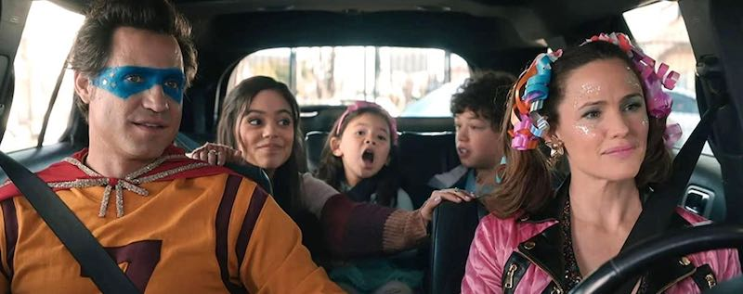
Yes Day
The movie “Yes Day” is a popular movie. It is a movie about two parents that couldn’t get control over their kids, so the parent decided to say yes to everything their kids says in order to teach them a lesson about how much rules are important in our daily lives especially for kids!

Slide 3
Why I Chose “Yes Day”
“Yes Day” is a really nice, funny and family friendly movie. It helps realizing how much u have to appreciate rules and most importantly your parents! There are NO violent scenes or inappropriate scenes, just funny and family friendly ones! I recommend this movie if you want to watch it with family, friends or by yourself, if you are in a bad mood “Yes Day” will help your day and make it 10X better!!!!

Slide 4
Thank you!
Thank you for taking time out of your day and read this! Watch “Yes Day”!!! (see what I did there???)

