Slide 1
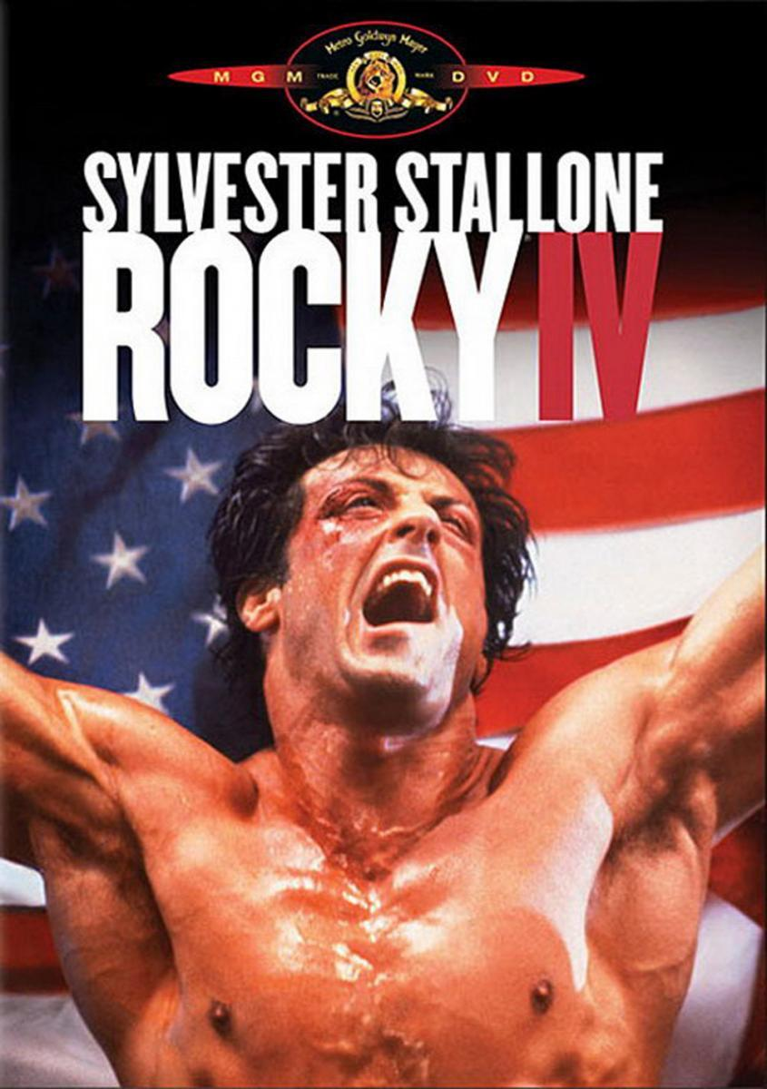
Rocky IV
By Fares Zumut

Slide 2
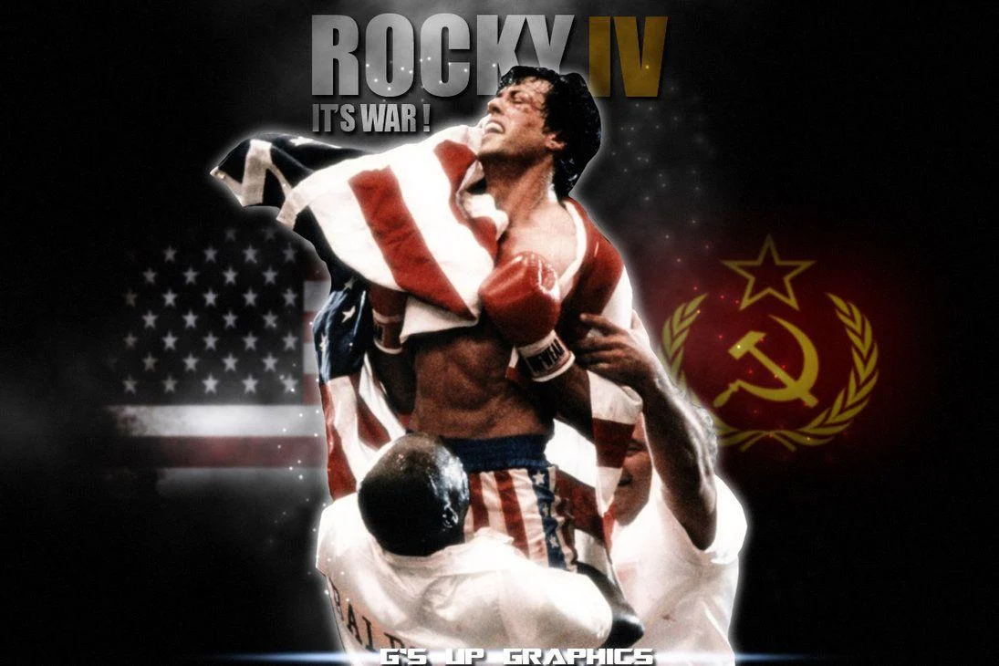
The description
The movie was made in 1985,the time of the cold war between the Soviet Union and the U.S.A.
The story of the movie plays out like this: Rocky Balboa proudly holds the world heavyweight boxing championship, but a new challenger has stepped forward: Drago, a six-foot-four, 261-pound fighter who has the backing of the Soviet Union. Rocky Balboa accompanies his friend Apollo Creed to the ring in a boxing match against a Russian Boxer named Ivan Drago. After a 2-round battle Creed gets a big hit to his face killing him, so Rocky seeks revenge.

Slide 3
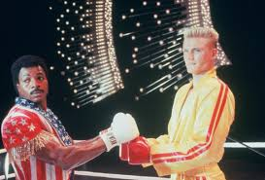
Why I chose it as my favorite
I like action and boxing sport.
I like the way how the actor acts.
I like the suspense it gave me to keep watching.

