Slide 1
The Secret Life Of Pets 2
2019 American computer-animated comedy film

Slide 2
Directed by | Chris Renaud
Written by | Brian Lynch
Produced by | Chris Meledandri Janet Healy

Slide 3
I was watching a film called "The Secret Life Of Pets 2", it's a cartoon, of course It's about the pets that can talk, and the main characters are two brown dogs. These two dogs are Max and Duke, and the owner has just had a son.

Slide 4
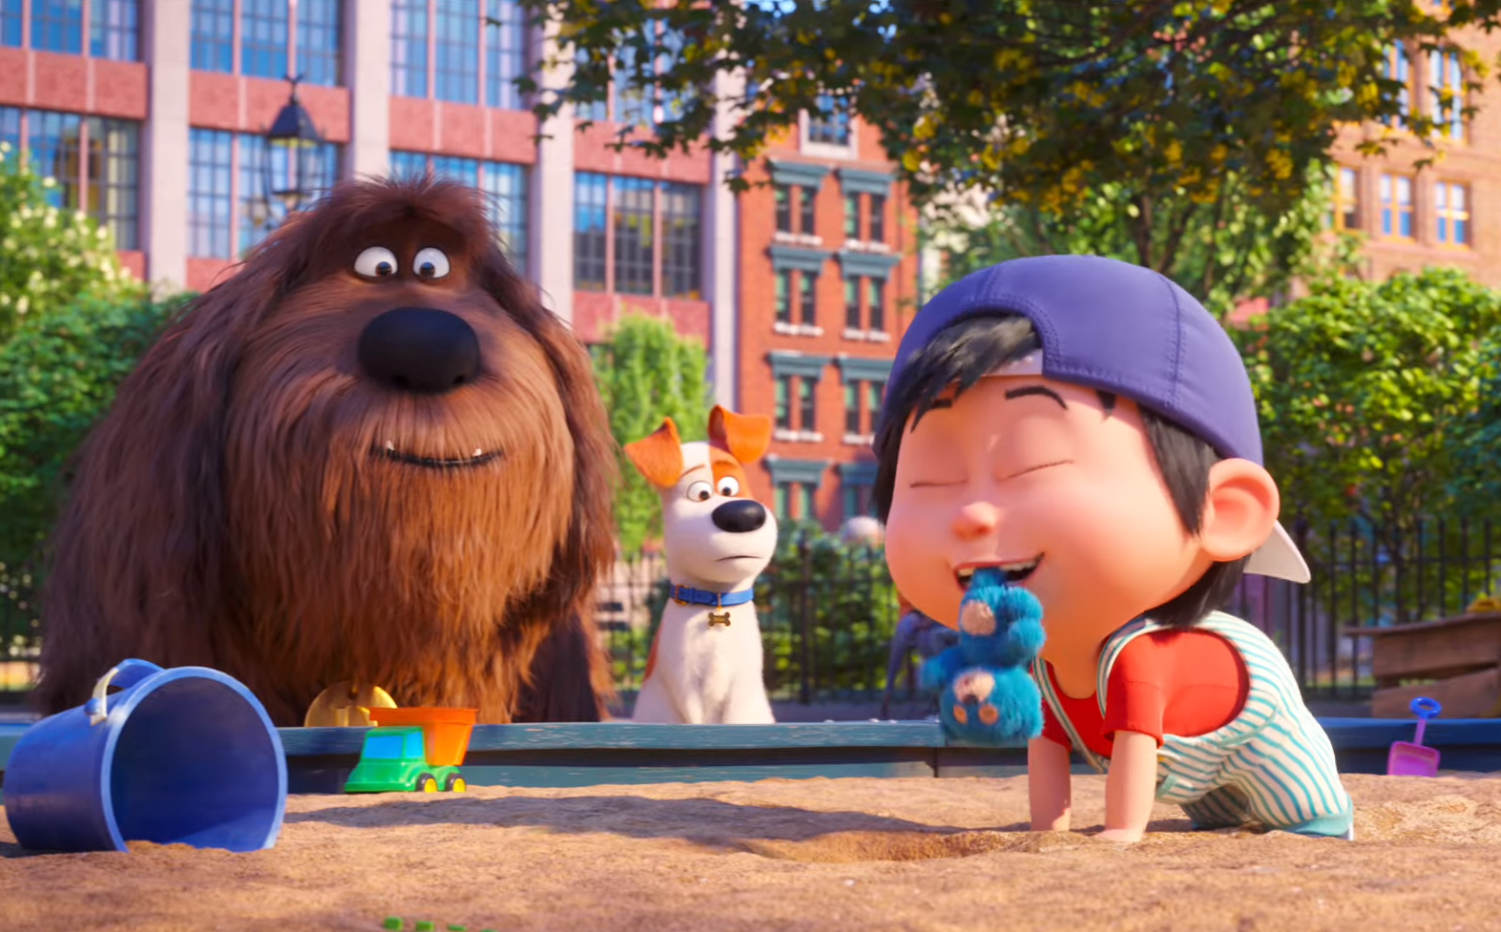
One of 2 dogs-Max, at first he was afraid to live with the children, but the owners son is too cute. And then he realizes he fell in love with him, and the baby needs to go to the kindergarten. Max was very afraid about his safety, because in part 1, he saw the outside world is too dangerous.

Slide 5
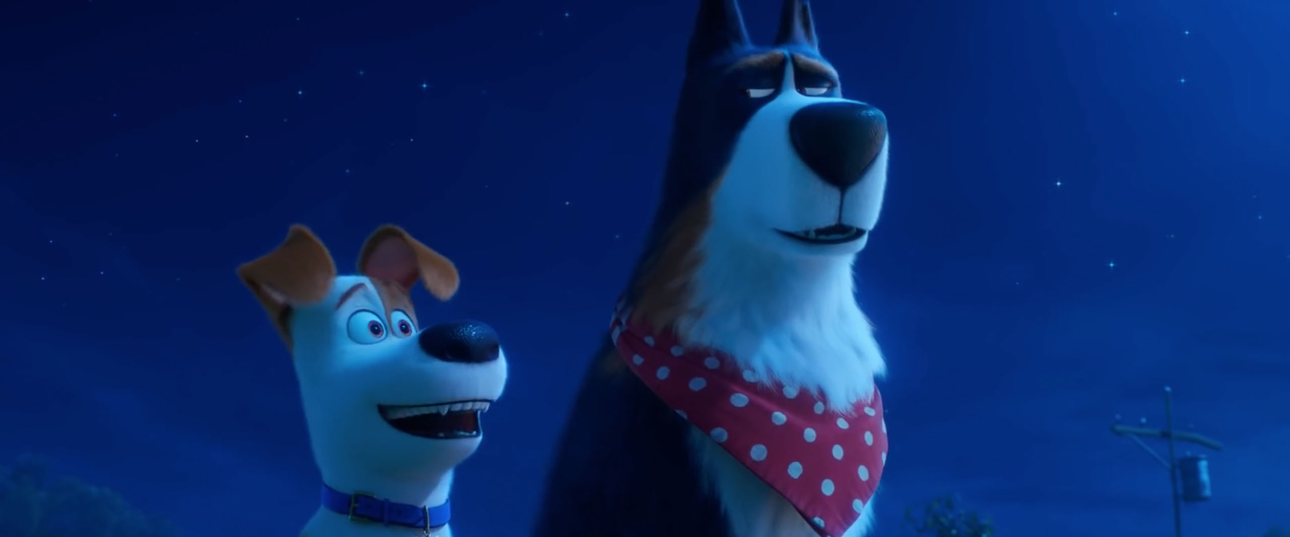
He started to become too outrageous until he met a brave dog. His name is Chicken. Duke told Chicken about the status of Max, so then he started training Max. And in the end, Max let the baby go.

Slide 6
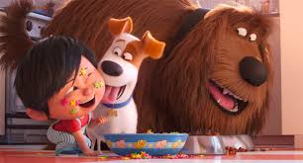
There are many other funny scenes in this film. You guys can watch, too. I recommend watching it.

Slide 7
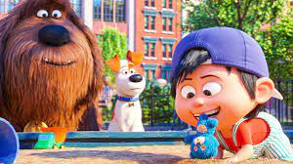
The moral story of The secret life of pets 2 is that it shows that children grow by facing new things and overcoming difficulties.

Slide 8
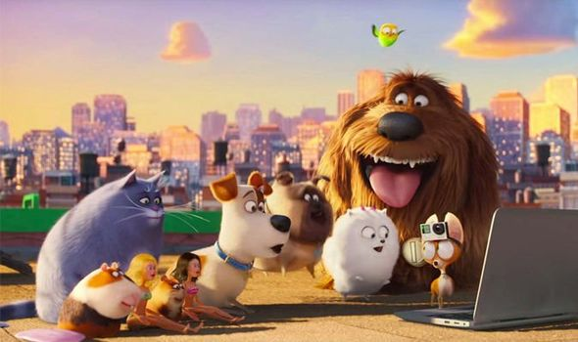
Finally…
The perfect family film, Pets 2 is both heart warming and funny, and ideal for a cosy movie night.
The camaraderie between the animals is adorable, but it has plenty of jokes too to keep both adults and kids entertained.

Slide 9
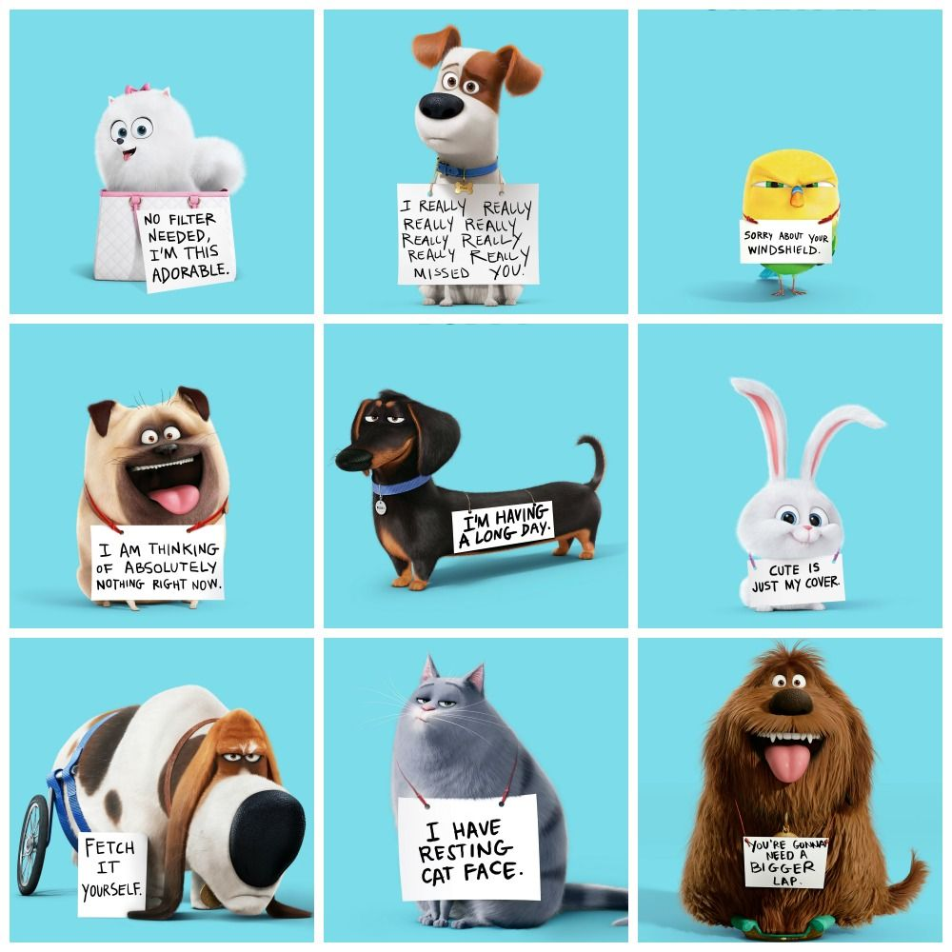
Hope you enjoy what I wrote.
By: Adnan Eliwat.
Grade 6 (c)

