Slide 1
Jungle
By Tia Alayoub, Rita AlHourani, Karmel Abawi and Celine Musleh

Slide 2
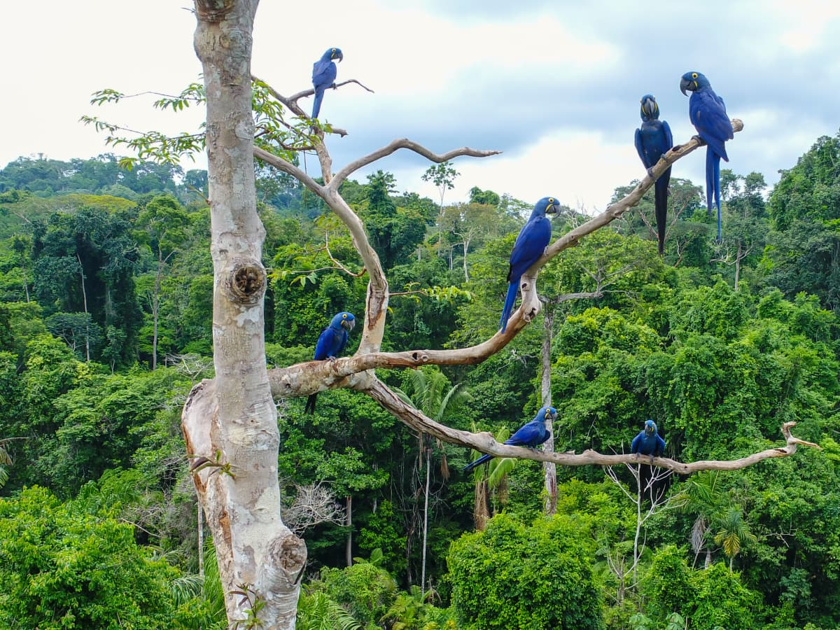
Some of the animals that live in the jungle
Jaguars
Monkey
Sloth
Bears
Cobras
Tigers

Slide 3
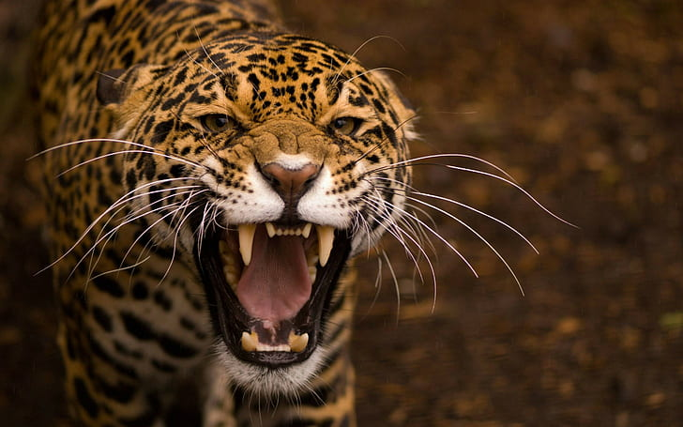
Jaguars
The jaguar is a large cat
Their territory is shrinking.
They've got spotty spots to
camouflage
Jaguars are good/ fast swimmers.
They'll eat almost anything.
With one powerful bite they can kill you

Slide 4
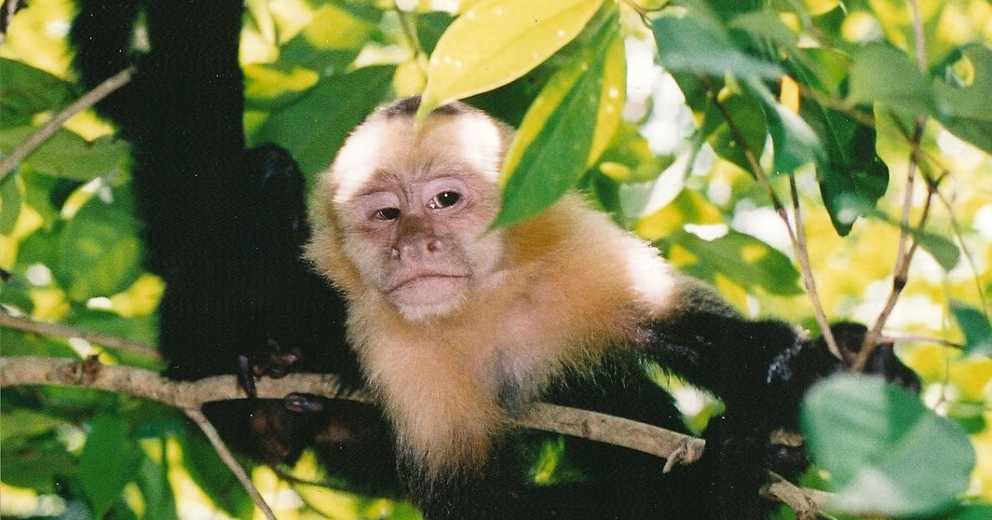
Monkeys
Monkeys strengthen their bond by grooming.
Baby monkeys are adults from 3-4 years.
The largest monkey in the world is a Mandrill.
The pygmy marmosels is the smallest monkey in the world
Spider monkeys are very sociable.
Monkeys live in trees, using their tails they are able to grab and hold onto things, to swing from limb to limb, while some monkeys live on the ground, only going in the trees when needed for food or safety.

Slide 5
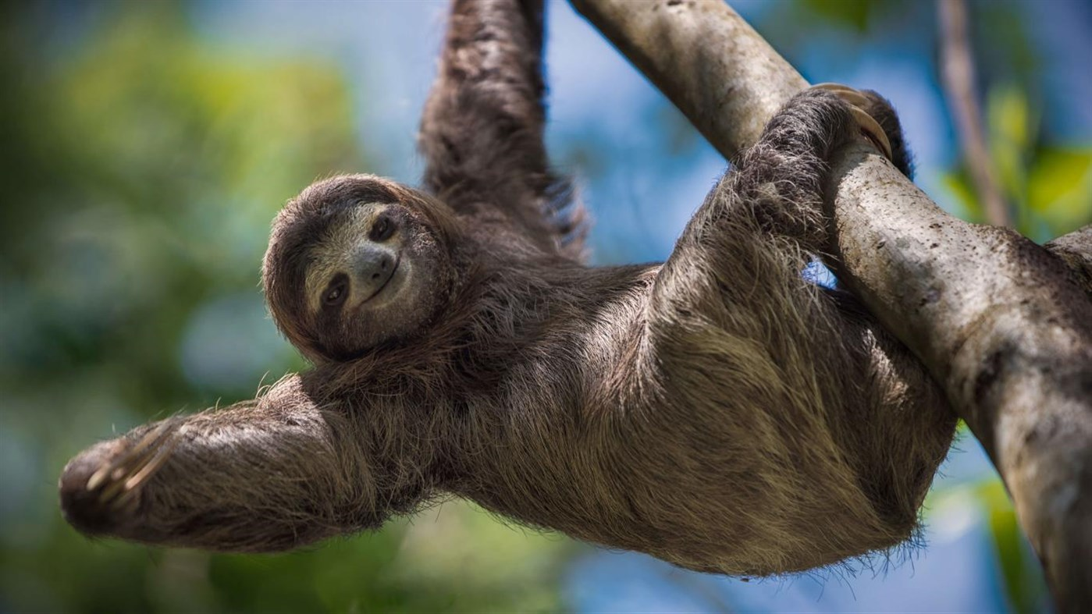
Sloth
Sloths spend almost all their lives hanging on trees
Their slow paced lifestyle helps them survive
sloths spend most of their lives upside down
Their fir is a living breathing microcosm
they are very slow so the predators find them
as an easy prey
Sloths are blind in a bright daylight
Sloths are half deaf
Sloths sleep 18 to 15 hours a day
sloth are constantly smiling because of their facial structure

Slide 6
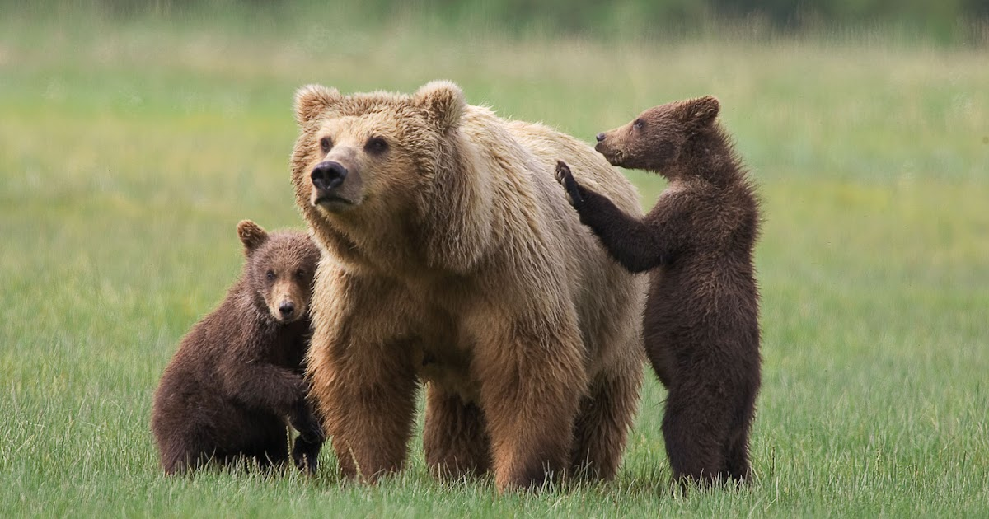
Bears
Black bears are the largest land mammals
Bears are intelligent animals
Bears have great sense of smell sight and hearing
Bears are land animals in North America and
one of the most intelligent land animals
Bears are afraid of loud noises
bears have the same claws as dogs
bears lose heat from their paws
they have four-chambered heart

Slide 7
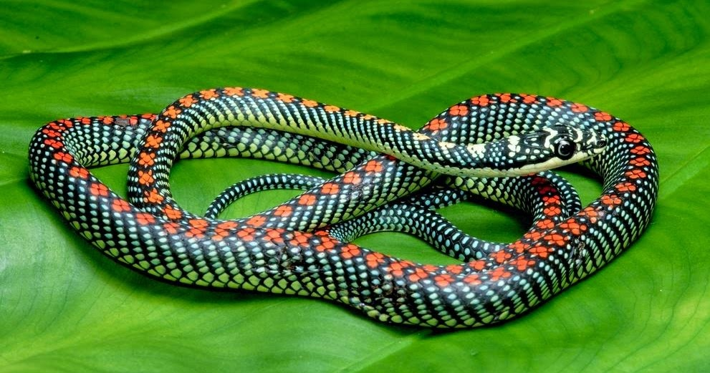
Cobras
Cobras are longest venomous snakes
They can grow up to 18 feet long
One toxic bite is powerful enough to
kill an elephant
They are cannibals
Cobras are scared of mongoose
Cobras are considered the smartest snake
Even baby Cobras can bite
Cobras can swim
Cobras are deaf

Slide 8
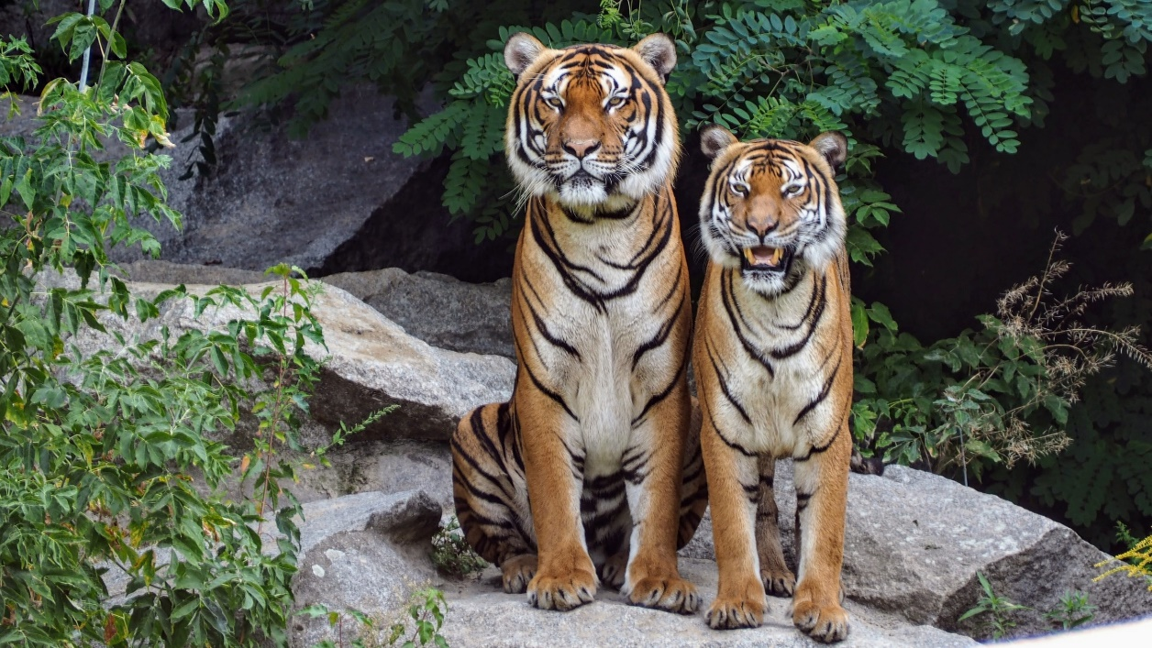
Tigers
Only half of the cubs survive
One punch from a Tiger may kill you.
Tigers live for about 25 years
Tigers love to play in the water
Tiger cubs are born blind
Tigers are the largest cats on earth
They don't roar a lot

Slide 9
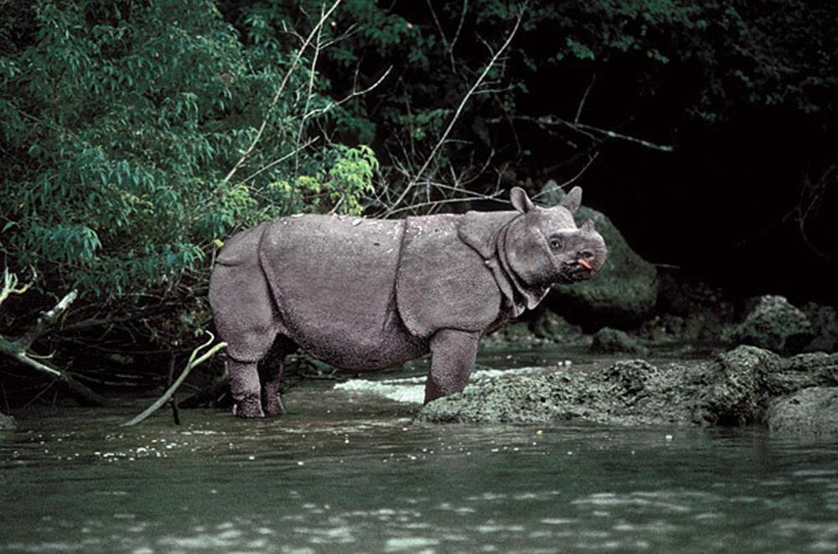
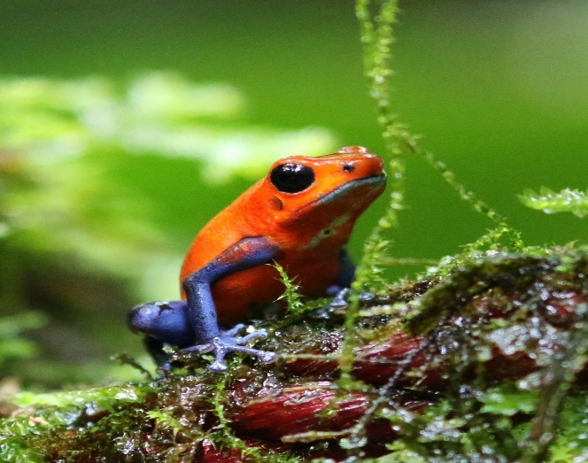
Animals that will be extinct
Javan Rhinos
Poison dart frogs
Turtle

Slide 10
Turtles
Turtles don't have teeth
Sea turtles suffer from poaching and over-exploitation
They eat a lot of food
They can dive down to 960 feet in the ocean
They can hold their breath up to 2 hours
one-million, one-hundred and thirty-three thousand turtles left
In the last 100 years we lost 80% of the turtles on earth

Slide 11
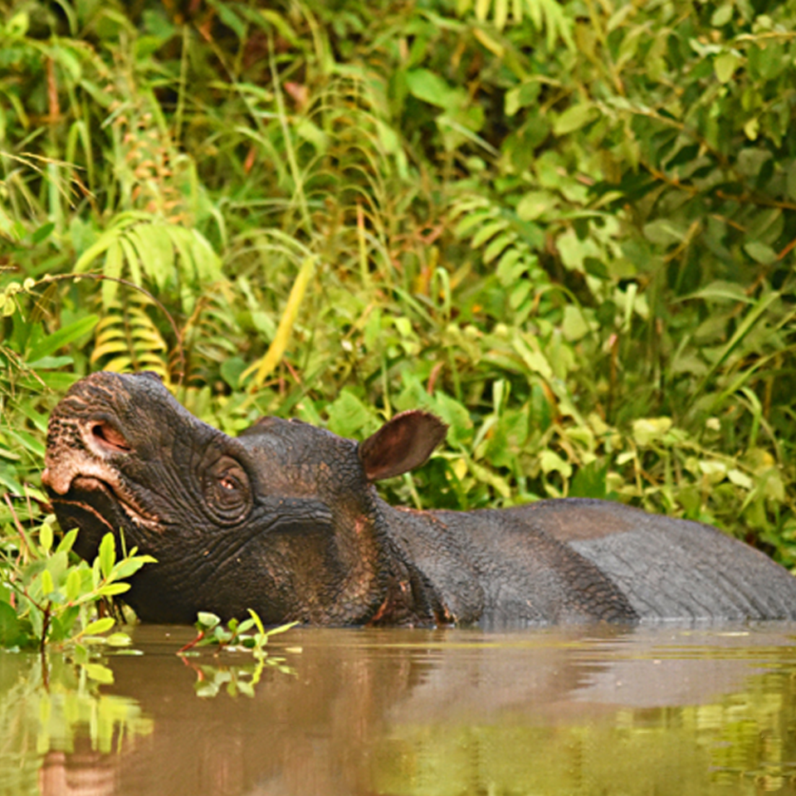
Rhinos
Rhinos will be extinct
due to persistent poaching and
habitat loss over many decades.
They run 30 miles per hour
Their vision is, not good
Rhinos can weight between 900 to 2300
Only 22,137 rhinos in Africa : 15,942 white rhinos and only 6,195 black rhinos

Slide 12
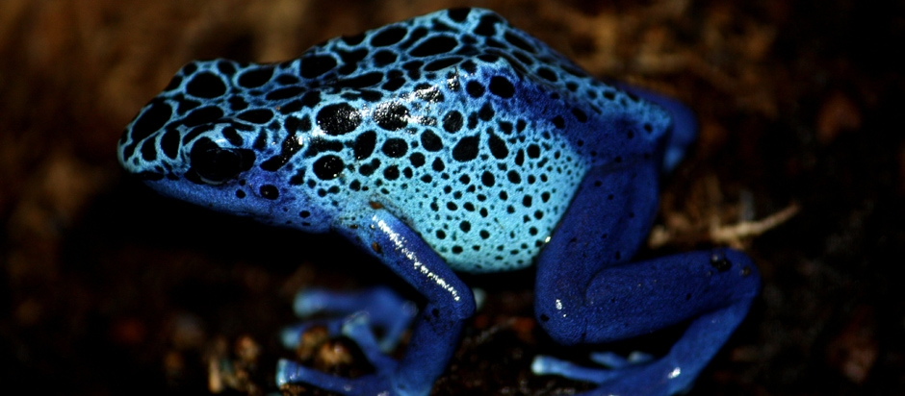
Poison dart frogs
They live 10 to 15 years
Climate change and habitat loss
threaten their survival.
they eat 14 times per hours
If you touch them there could be swelling
nausea and paralysis
They are considered one of the most poisonous species in the world
They can jump 1.5 feet high

Slide 13
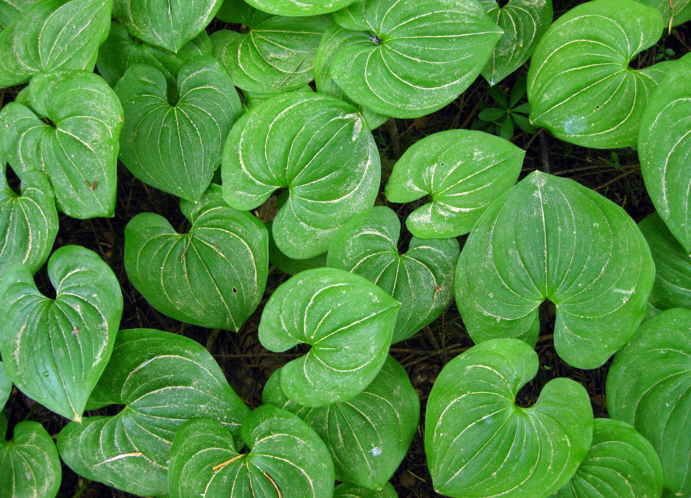
Some Plants that live In the jungle
Passion flower
Bam boo trees
Devils tongue
Orchids

Slide 14
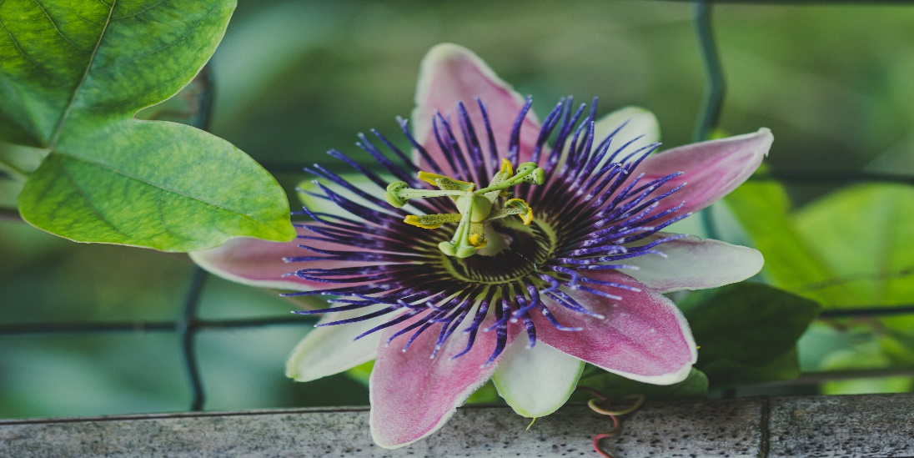
Passion flower
Passion flower helps with sleeping problems and anxiety, as well as for heart rhythm problems and pain, menopausal symptoms, and attention-deficit hyperactivity
It can survive the jungle with its large leaves that blocks the sunlight from reaching the ground, it has a very strong scent which attracts pollinators and camouflage themselves from predators like birds

Slide 15
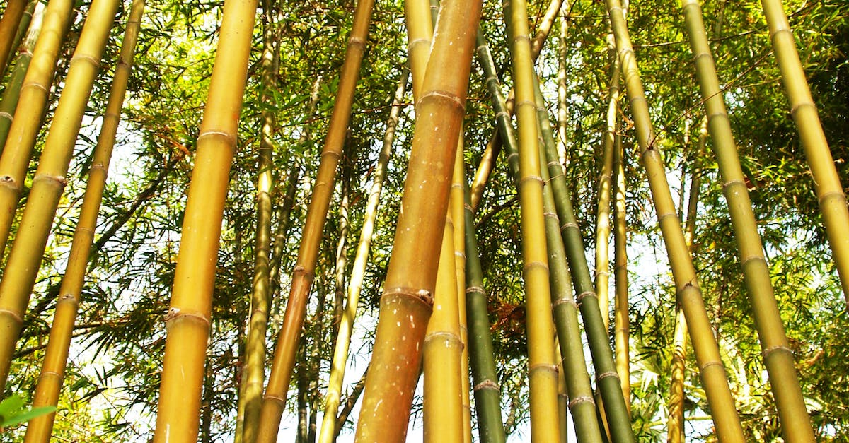
Bam boo trees
Bamboo is used in almost 1500 things such as food, musical instruments, production of paper, pulp, water pipes bicycles and furniture Bamboo
It is the fastest growing land plant in the world bamboo
It is known for the pandas favourite food bamboo can also be used an medicine
It survives the jungle by sucking up water from heavy rains that might cause flooding. It also provides shelter for many animals. A jungle has plenty of water for this plant to grow

Slide 16
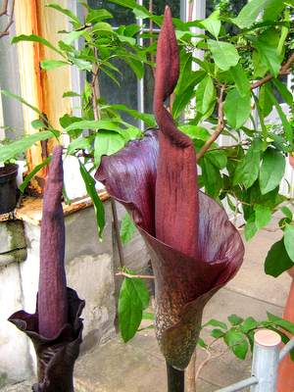
Devil’s tongue
devils tongue is a very large plant that can reach up to 4 feet tall with leaves spreading out of the central stalk Devil’s Tongue has been grown over 2000 years, today it is one of the most important plant in japan It’s sold in blocks like tofu and they put it in soups and stew-like dishes to provide a chewy texture.

Slide 17
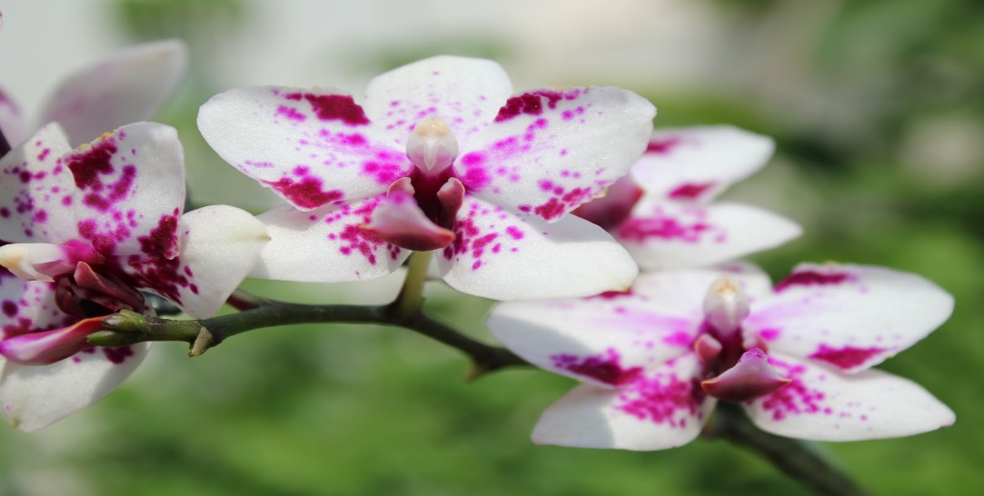
Orchids
Orchids can live up to 100 years the shape size and colour depends on the species Orchids are a great source Of vitamin and anti oxidant
Orchids will replenish and rejuvenate your skin you can use it for treating skin like wrinkles
Orchids absorb a lot of water and use it later on to survive

Slide 18
Thank you

