Slide 1
RED PANDAS
BY: RAMA, ZEINA QUDIES, MIRAL, RAYA
Grade: 6C

Slide 2
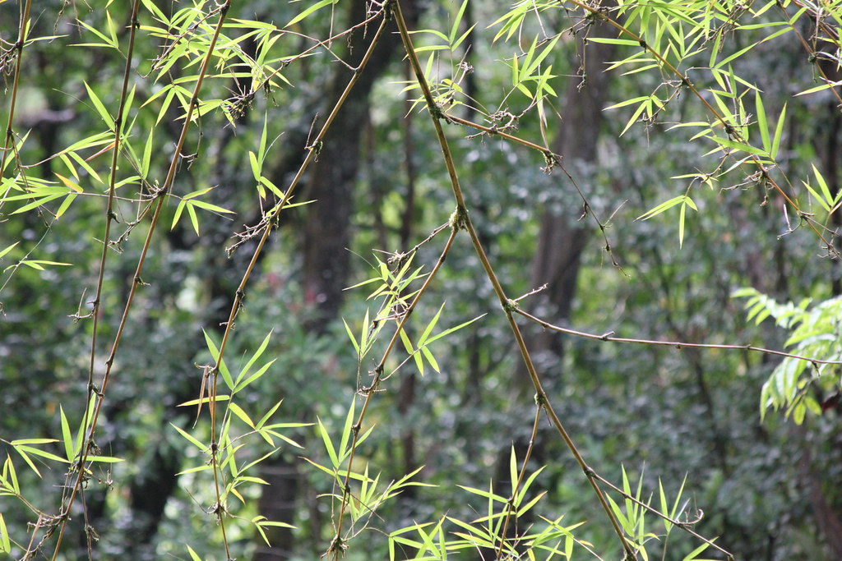
HABITAT
Red panadas live in the Easter Himalayas in places like China, Nepal, and Bhutan. They spend most of their time in trees. Their semipredictable claws help them move easily from branch to branch.
Red pandas rely on their long bushy tails for balance as they cross tree branches. They also wrap it around themselves for warmth. They live alone, but when they travel they travel in groups or families. Red pandas feed on leaves some times on fruit, insects, bird eggs, and small lizards.
Their habitat is endangered because of the loss of nesting trees and bamboo in the Eastern Himalayas. Trees are getting cleared to build houses.

Slide 3
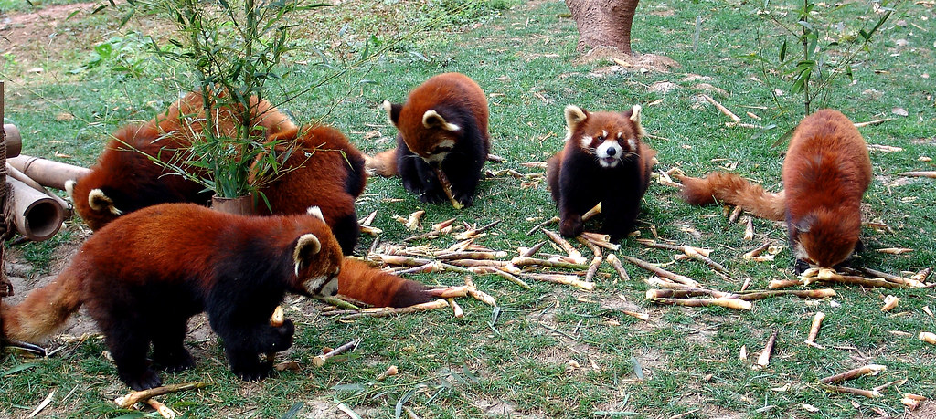
POPULATION
The red pandas population is on a rapid decline!
Red pandas declined by 50% over the past tow decades. This means that half of all the red pandas in the wild have died out in the last 20 years.
It is estimated that there may be less than 7,000 red pandas remaining in the wild today, while the number was around 14,000 red pandas in 2001.

Slide 4
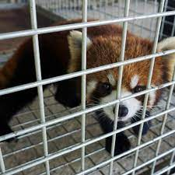
HOW ARE RED PANDAS GETTING ENDANGERD
Red pandas are often killed for their fur to make hates and clothes out of it.
They usually live in China, and because of the growing human population in China, red pandas are being killed to build houses.
Red pandas don’t interact much with people. Even when the red pandas are hand-raised they are known to get aggressive towards their keepers. Also they can deliver powerful bites that are strong enough to harm a humane leg.
Red pandas might be killed when they get caught in trapes that are meant for other animals such as wild pigs and dears.

Slide 5
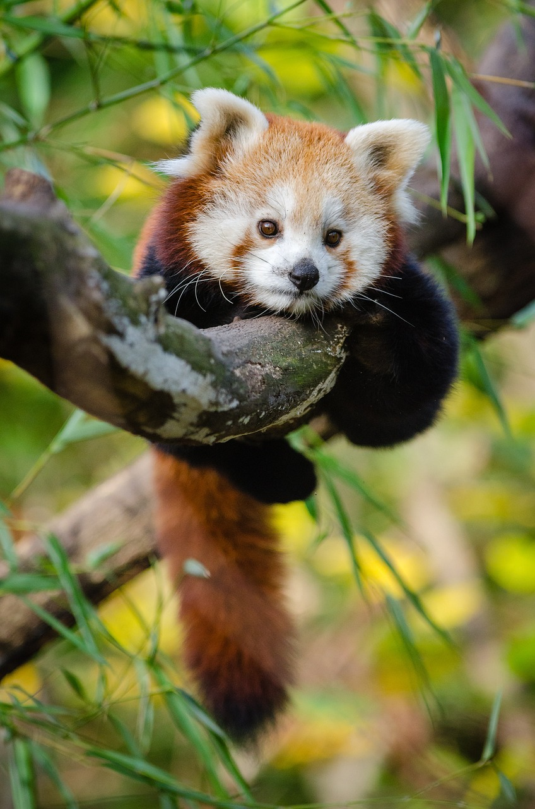
WHAT IS BEING DONE TO SAVE THE RED PANDAS
The red pandas network is a non-profit organization that protects the red pandas and their habitat.
They work with local community groups to establish wildlife corridors, train “forest guardians” to raise awareness about red pandas, and work with villagers to establish protected areas.

