Slide 1

Paddington
Alfaisal Thalji 6e

Slide 2
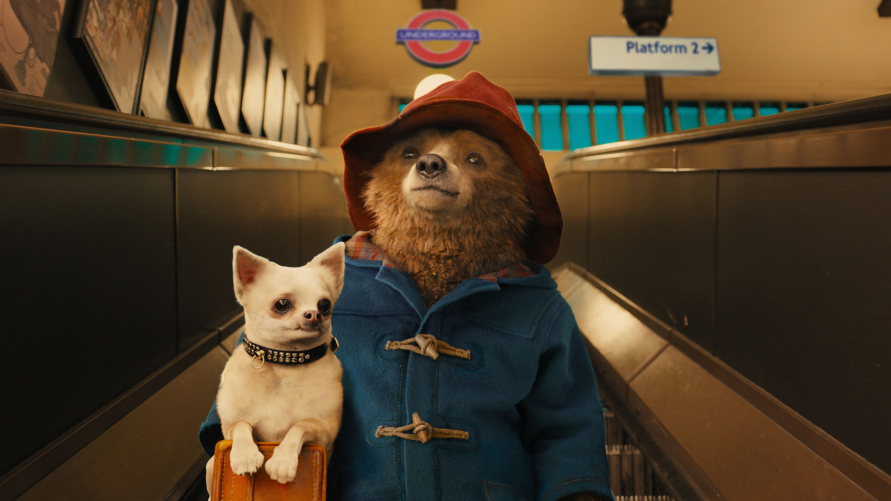
Who is the director of this movie
Director: Paul King
Writers: Paul King/Hamish McColl/Micheal Bond

Slide 3
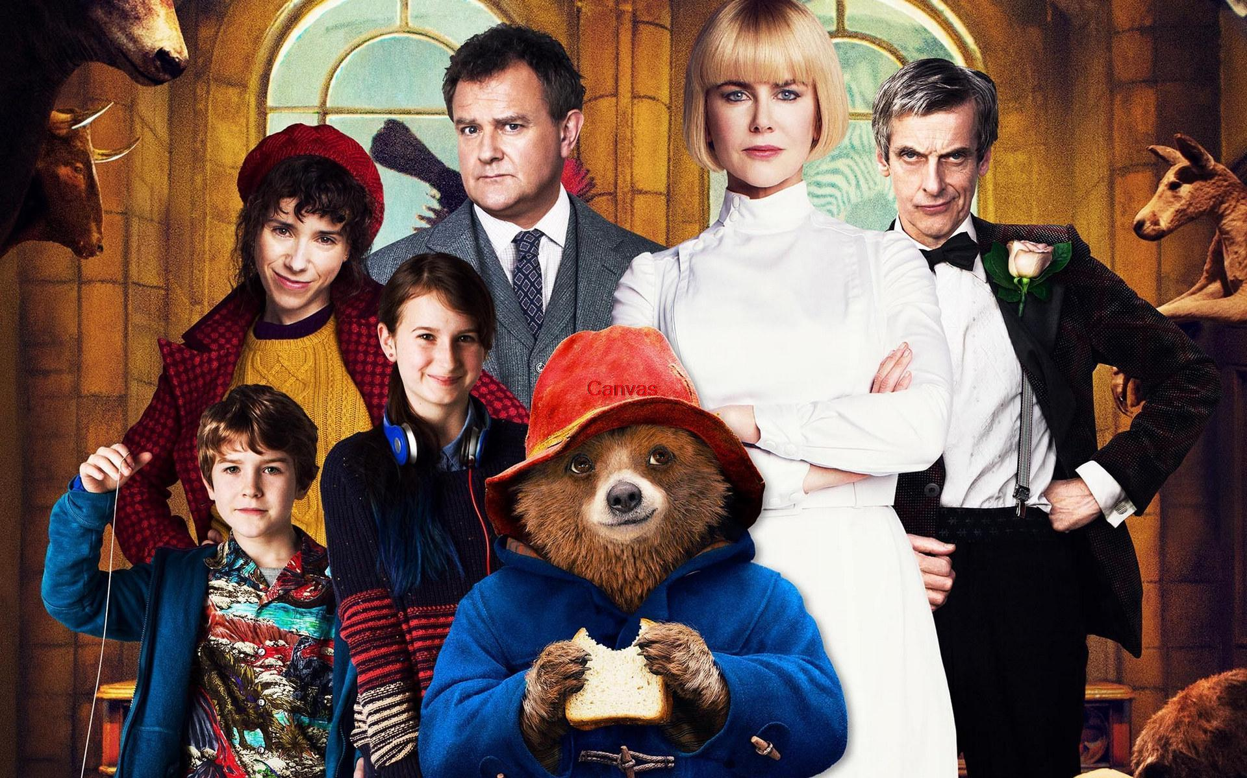
Main characters are
Paddington Bear
Aunt Lucy
Mr. curry
Mrs. Bird
Mr. Gruber
Mrs. Mary Brown
Henry brown
Millicent Clyde

Slide 4
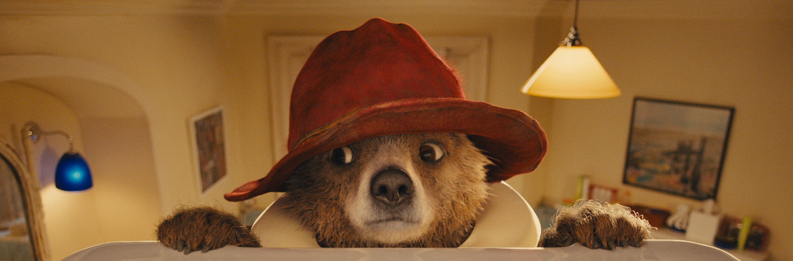
What the movie is about
The movie is about a bear named Paddington that travels to London in search of a home. Finding himself lost and alone at Paddington Station, he meets the kindly Brown family, who offer him a temporary haven. A young Peruvian bear with a passion for all things British travels to London in search of a home.

Slide 5

Fun Facts about Paddington
He loves marmalade.
Why he always wear his Red Hat is because it used to belong to his Uncle Pastuzo, given to him by Montgomery Clyde when he visited Darkest Peru.

Slide 6

Thank you

