Slide 1
Enola Holmes
By:NoorNassar 6D

Slide 2
introduction
Enola Holmes movie talks about a young lord who is called “Enola Holmes”. She had a great relation-ship with her mother “ Eudora Holmes, but at one day her mother disappeared randomly. It is on Enola's mission to go out in the world and find her mother. She had 2 siblings one called Sherlock Holmes and Mycroft Holmes. Eudoria Holmes husband had died and none of her sons wanted to be with her so they left. She was alone with Enola Holmes.

Slide 3
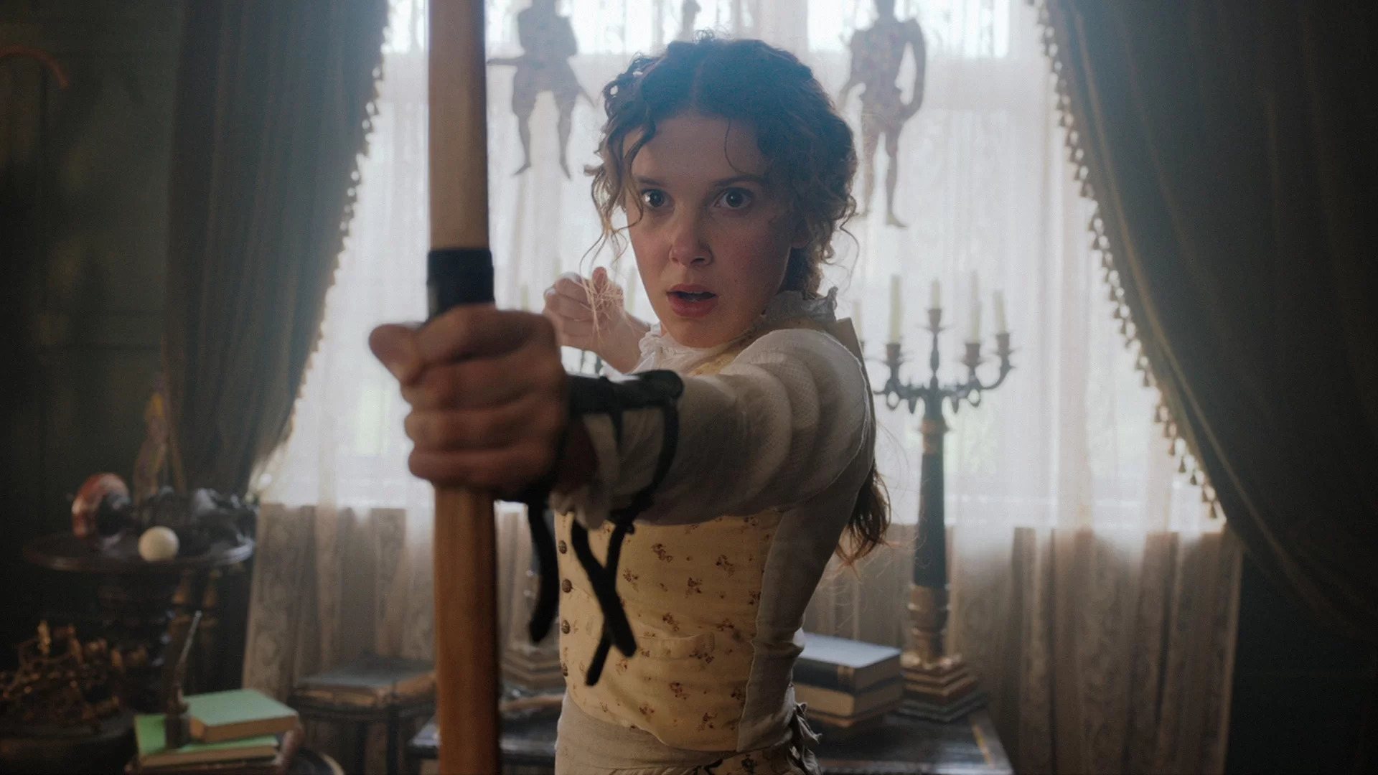
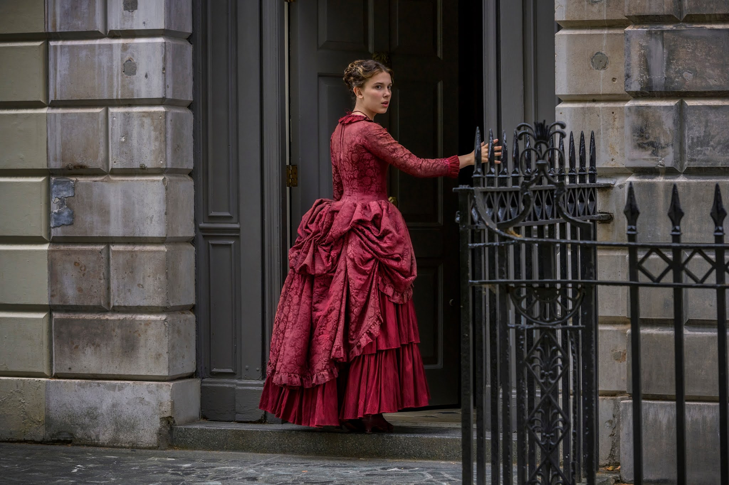
Enola Holmes
Enola Holmes is a young lord who is on her mission to find her mother. You could describe her as: Intelligent, observant and insightful. Her mother has taught her everything from chess to jujitsu and encouraged her to be strong.

Slide 4
Mycroft Holmes
Mycroft Holmes is a consulting detective and the older brother of Enola Holmes and Sherlock holmes In the Novel series Nancy springer and its 2020 film adaptation. He had left his mother all alone .

Slide 5
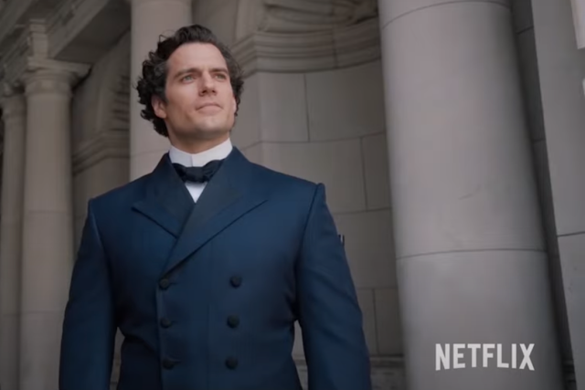
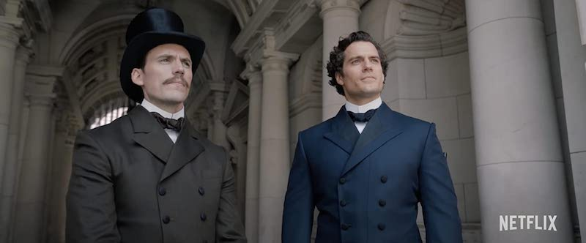
Sherlock holmes
Sherlock Holmes is a fictional of the late 19th nd on the early 20th Century.
Holmes is famous for his prowess at using logic and astute observation to solve cases.

Slide 6
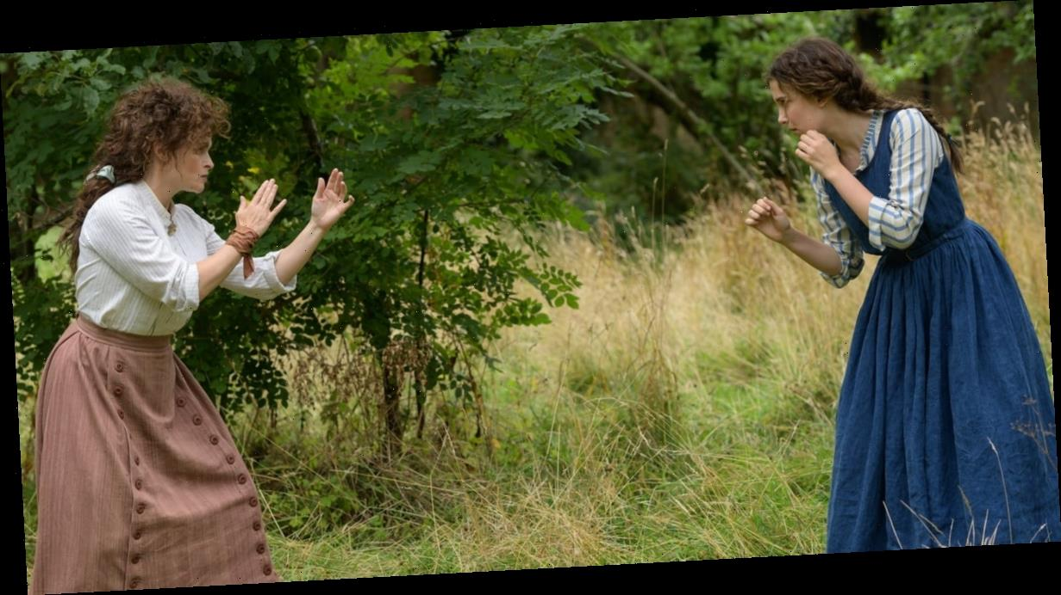
Eudoria HOlmes
Eudoria Holmes is a mother for sherlock holmes,Mycroft Holmes,Enola Holmes.She was left alone with a young child (Enola Holmes) after her husband passed away and sons left home. She devoted the time Until Enola was 16 to equipping her daughter with skills and a liberal education. She is a brave intelligent women. But sadly none of her sons like her except for Enola.
This Photo by Unknown Author is licensed under CC BY-NC-ND

Slide 7
tewksbrey
Tewkesbry is a wealthy, progressive young peer who has recently inheritd his fathers land and tiles, However, he runs away from home, where he meets Enola holmes and soon discovers that he is in great danger from an unknown indivistial.

Slide 8
THANK YOU
By:Noor Nassar

