Slide 1
Coco
Alia Abu Mariam 6e

Slide 2
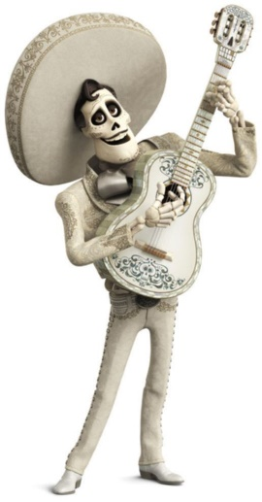
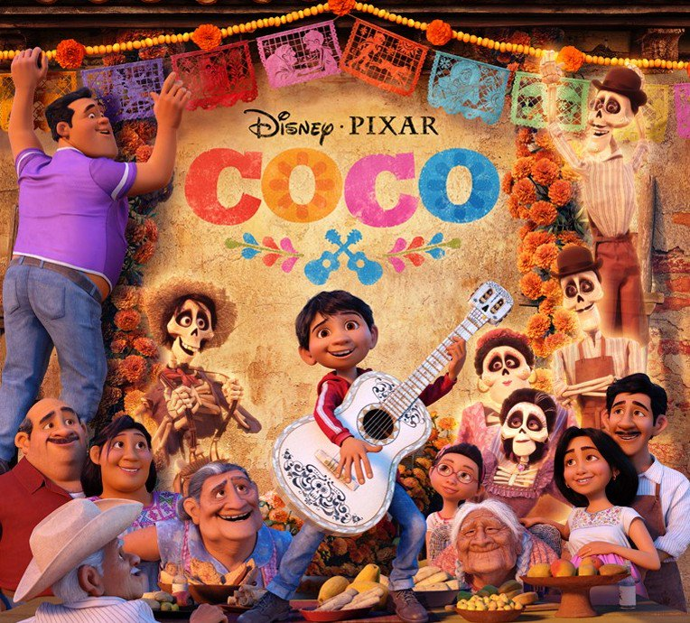
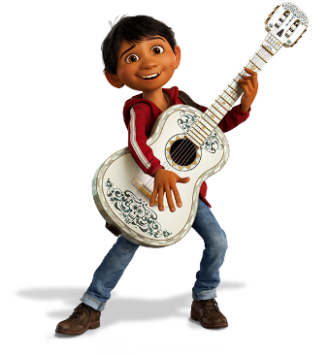
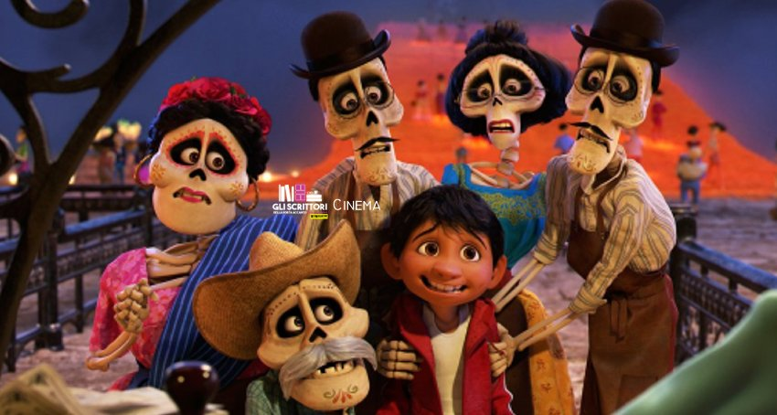
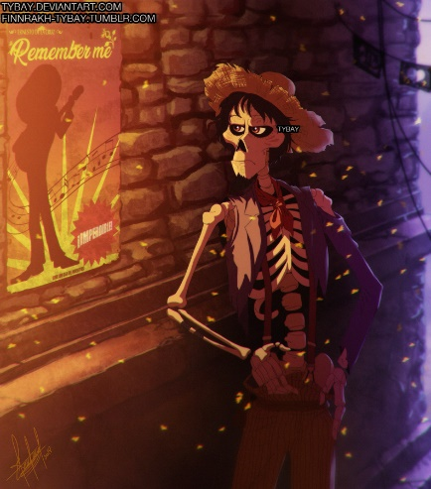
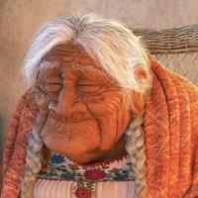
Main characters
Miguel
Ernesto de la cruiz
Coco Rivera
Hector
Elena Rivera
My favorite character in this movie is hector Rivera because he s really kind hearted and he brings a lot of love for his family

Slide 3
About this movie
The movie coco is an animated Pixar movie about a Mexican family that hates and bans music. there is many members in the family but here are the main members grandma Elena/her son Enrique which is Miguel's father/coco etc. There is a kid called Miguel that loves music and tries to play music without getting caught by his family but later on when he was visiting his great grandmother coco he was looking at all his family tree he thought that his great great grandfather was a music artist called Ernesto de la cruiz so he went and confronted to his family about what he found out they thought he was crazy so his grand mother Elena broke his guitar, so he ran away from his family and accidently entered in the land of the dead by touching de la cruizes old guitar. He freaked out and started running, then he ran into his dead family
His family was confused why he was there and after he explained why his great great grandmother was pissed so she gave him a change and wanted him to promise if she gives him the blessing leaf he would never play music ever again but the blessing didn’t work and they wanted to just send him in but he ran away and met this guy named hector which used to play music later on they sang their own song called:”un poco loco” in front of a stage full of people from the dead but hector found out he was missing and so wanted to send him in but Miguel ran and left him to find de la cruiz by himself. Later on he saw him at his concert and preformed a song then fell inside his pool de la cruiz saved him and Miguel told him he was great great grandfather so he kept him to live in his mansion then hector found Miguel inside on de la cruizes mansion and exposed him about poisoning him and stealing all his songs and guitar so hector is Miguel's actual family member de la cruiz took his picture from him so he stays in the land of the dead and never leaves they tried to fight him but they failed so they got thrown out by the guards and got saved by mama emeldas dragon and went and exposed him and tried to take the picture but he threw it out and it got ruined but mama Imelda finally forgave hector after knowing why he left her and they gave him the blessing. He came back and went strait to coco and sang her the song hector used to sing to her she finally remembered her family and his family from the dead came to visit them but no one could see them because they were skeleton ghosts Miguel now has a baby sister and then they all loved music and later on coco entered the land of the dead and the others lives their ordinary lives

Slide 4
Why I like this movie
I like this movie because it teaches me a very important life lesson about family always comes first.
This movie is very fun to watch with family and kit talks about a fun exiting family adventure.

Slide 5
.
Thank you

